Slide 1
Information Technology Report
Dave Pagliai
Manager, IT Support Services

Slide 2
Incident Report Highlights
Service Availability – November/December
Retail Market IT systems met all SLA targets
Incidents & Maintenance – January
01/18/15 – Retail Market planned maintenance outage (Site Failover)
March 2015
03/01/15 – Retail Release
Supplemental AMS Interval Data Report Issue
No impacts to report in January
Long term solution being tested

Slide 3
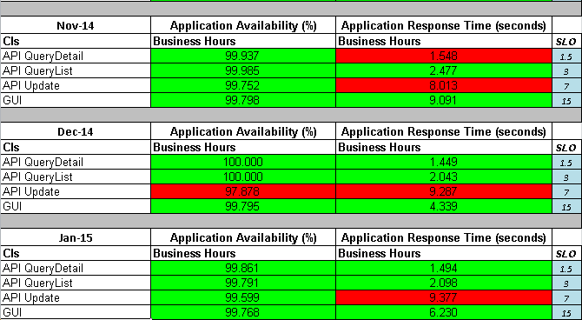
MarkeTrak Performance

Slide 4
Browser Upgrade Project
ERCOT Application Browser Support
ERCOT intends to support IE 8 into 2016. The market will be given adequate time to migrate to a newer browser before ERCOT discontinues IE8 support.
ERCOT is testing IE 9, 10, and 11 in both native and compatibility mode to determine what needs to be fixed in the ERCOT applications. That work will continue through Q1.
The mitigation projects and change requests resulting from the testing will be submitted through the normal ERCOT project process in Q2, to be prioritized and delivered through the normal ERCOT release process. The release schedule for those projects will determine when the applications are fully supported on the newer browsers.
There are no current plans to expand the number of browsers supported by the ERCOT applications beyond IE 9, 10, and 11.

