Slide 1
Project Update and Summary of Project Priority List (PPL) Activity to Date
February 12, 2015

Slide 2
2015 Project Update – Agenda
  Project Portfolio Update p. 3-5
    Recent/Upcoming Project Highlights
    2015 Release Targets
    2015 Project Spending Update
  Appendix
    Project Portfolio Gantt Chart p. 7-14
Location of Project Priority List (PPL): http://www.ercot.com/services/projects/index

Slide 3
Recent / Upcoming Project Highlights
2015 February Release In Flight
  NPRR500 – Posting of Generation that is Off but Available
    Delivered on 2/6
  SCR772 – New Extract for Five Minute Interval Settlement Data
    Delivering on 2/12
2015 April Release In Flight
  SCR778 – Credit Exposure Calculations for NOIE Options Linked to RTM PTP Obligations
  SCR779 – Increase to the CRR Auction Transaction Limit
Note: Projected Go-Live dates are subject to change.
Please watch for market notices as the effective dates approach.

Slide 4
2015 Release Targets – Board-Approved NPRRs / SCRs / xGRRs
February 2/2 – 2/12 | April 3/23 – 3/27 | June 6/13 – 6/28 |  | August 8/10 – 8/14 | Sept. / Oct. Dates TBD | December Dates TBD
NPRR500 SCR772 | NPRR493 NPRR559 NPRR573 NPRR581 NPRR597 NPRR601 SCR771 SCR778 SCR779 | NPRR210 NPRR487 NPRR495 NPRR543 NPRR559 NPRR568 NPRR573 NPRR581 NPRR588 NPRR589(b) | NPRR597 NPRR601 NPRR615 NPRR626 NPRR639 NPRR645 NPRR665 SCR774(b) SCR775 OBD (Shadow Price Caps) | NPRR256 NPRR568 (remaining gray-box) NPRR626 OBD (Shadow Price Caps) NPRR595 SCR771 | NPRR484(2) | NPRR419 NPRR439 NPRR553 NPRR556
2 | 2 | 19 |  | 3 | 1 | 4
Moved to TBD
E
E
I
E
E
E
E
E
P
E
NS
E
I
NS
E
E
NS
NS
P
E
E
I
I
I
NS
NS
NS
NS
NS
2015 TBD Items (and month they became “TBD”)
July 2014 | Aug 2014 | Oct 2014 | Nov 2014 | Dec 2014 | Jan 2015 | Feb 2015
NPRR484(1b) | NOGRR084 | NPRR327 H | NPRR617, NPRR620 | NPRR519, NPRR272, SCR777 H | NPRR210 | NPRR219, NPRR493, SCR783
Go-live dates can differ from Protocol effective dates – Please refer to market notices for more details
Red Text: New additions and target release changes
NPRR484(Ph1b) – Remaining Phase 1 items
NPRR484(Ph2) – S&B portion of NPRR
NPRR589(b) – S&B portion
SCR774(b) – Addition of Comments field
Strike-Through Text: Previous target release changes
Release targets are subject to change
(a), (b), etc. indicates multiple phases
Project Status Codes: NS = Not Started, I = Initiation, P = Planning, E = Execution, H = On Hold

Slide 5
2015 Project Spending Update
2015 project budget is $21.65M
Reason: Minor Capital, Program Control and Common Infrastructure projects were re-allocated to areas who use those funds

Slide 6
Business Integration Update – Appendix
  Appendix
    1/31/2015 Project Gantt
      In-flight items sorted by Project End Date
      “On Hold” projects listed separately
      “Not Started” items sorted by Project Start Date

Slide 7
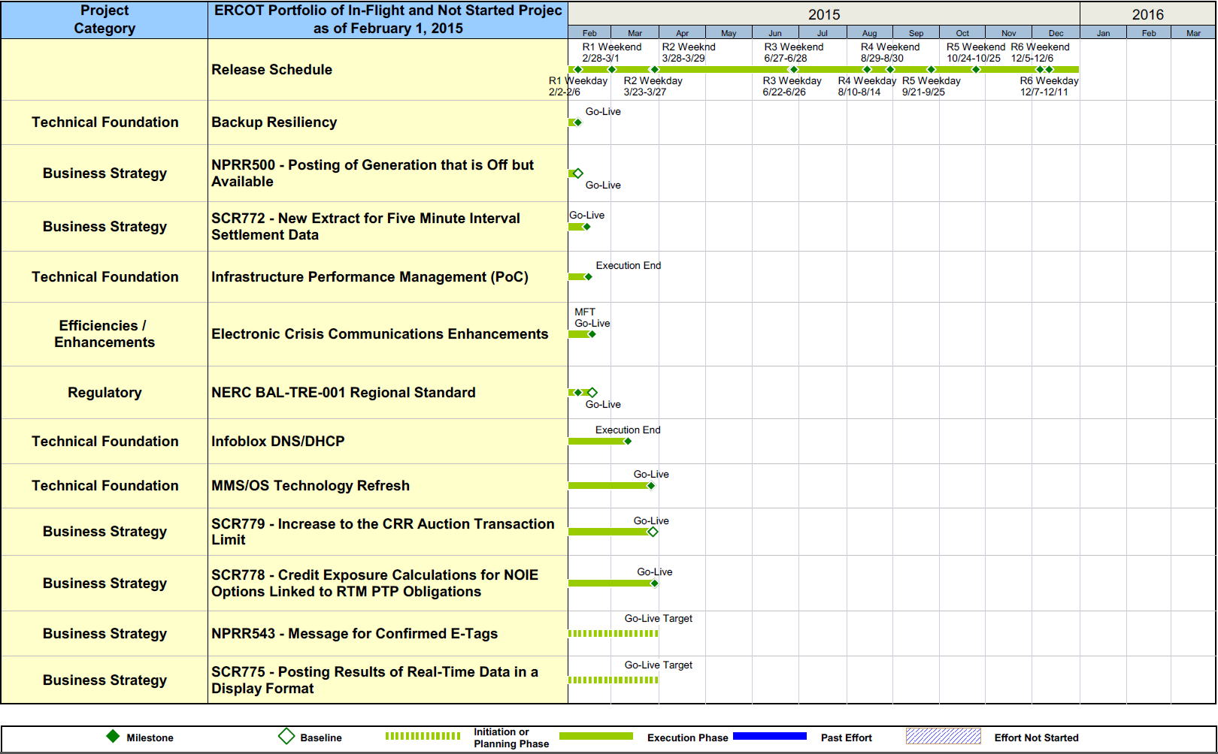
Project Portfolio Status – as of 1/31/2015

Slide 8
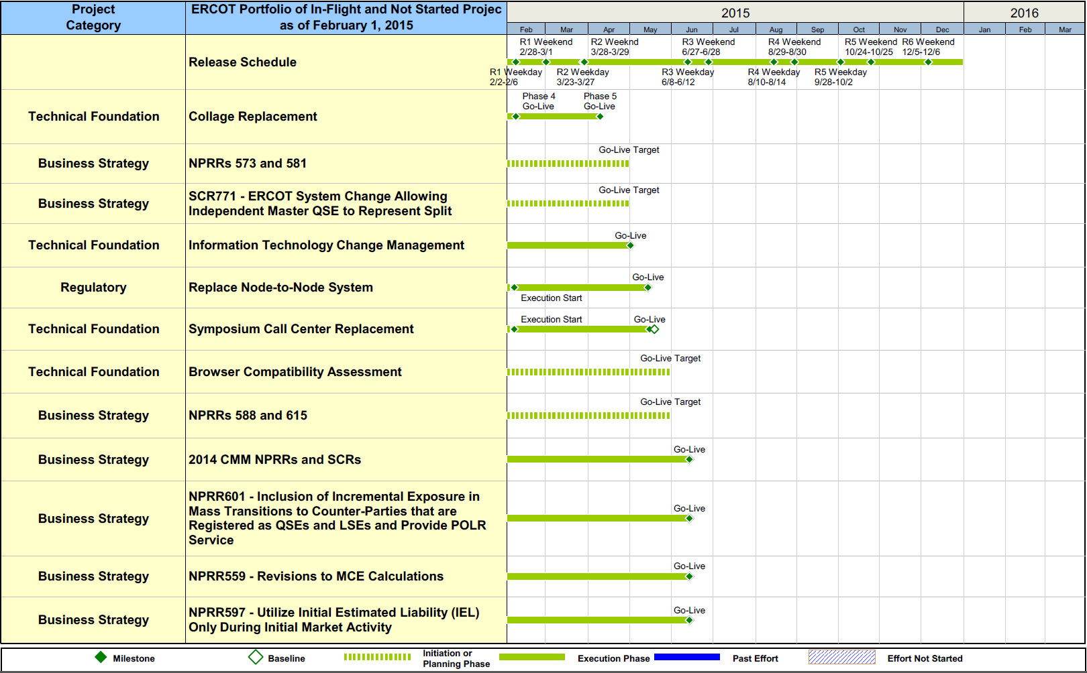
Project Portfolio Status – as of 1/31/2015

Slide 9
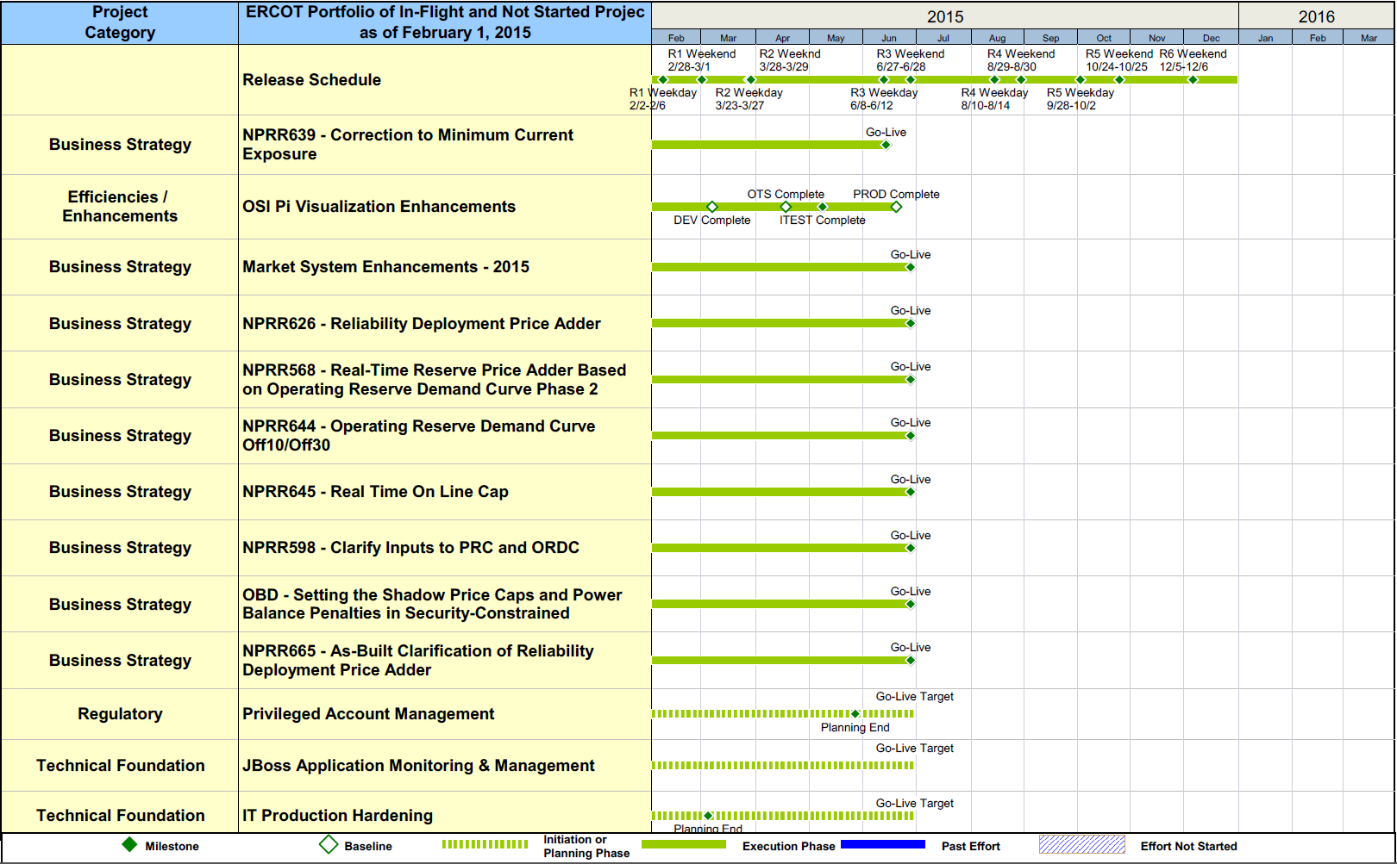
Project Portfolio Status – as of 1/31/2015

Slide 10
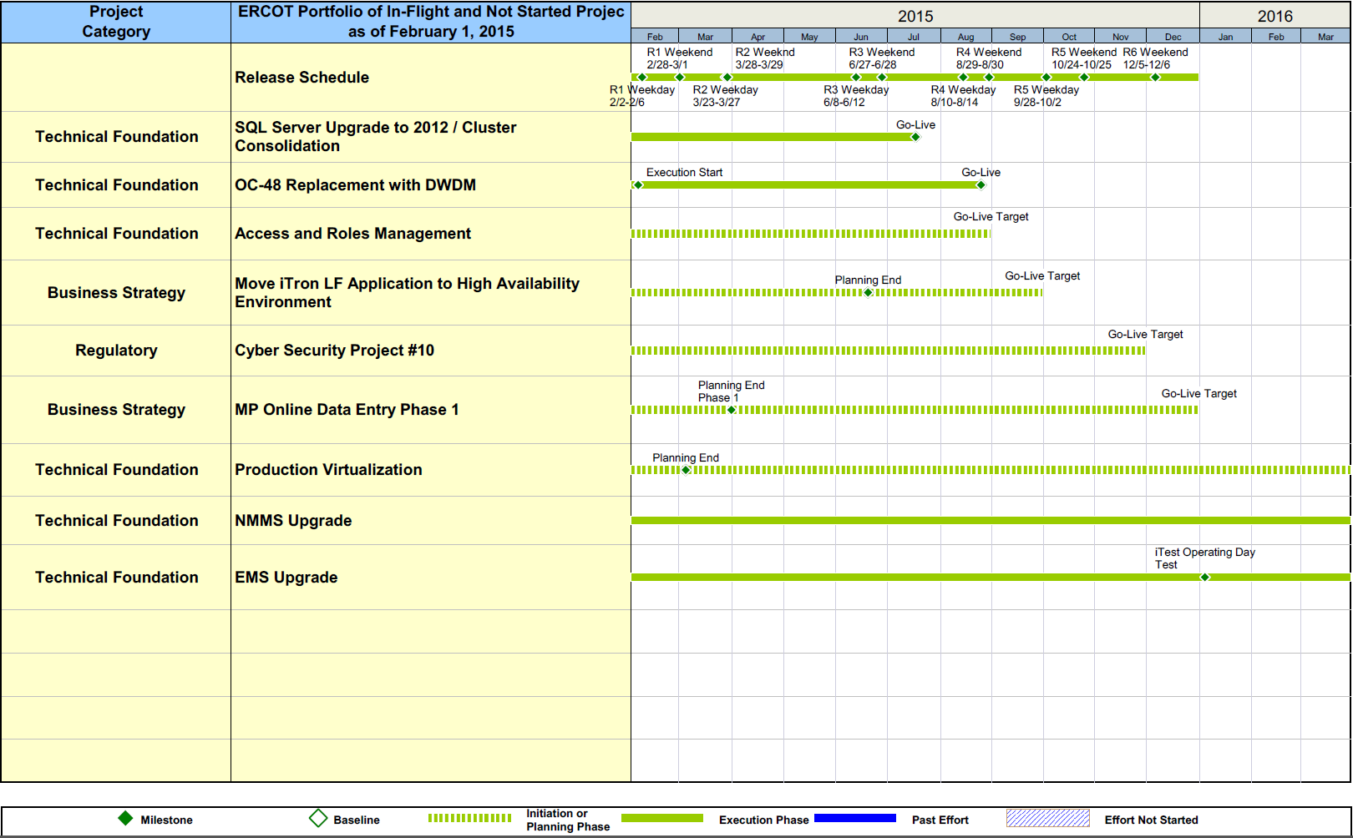
Project Portfolio Status – as of 1/31/2015

Slide 11
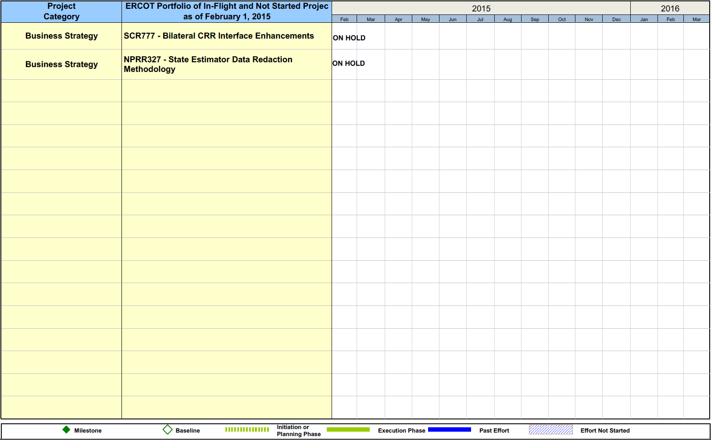
Project Portfolio Status – as of 1/31/2015

Slide 12
Project Portfolio Status – as of 1/31/2015

Slide 13
Project Portfolio Status – as of 1/31/2015

Slide 14
Project Portfolio Status – as of 1/31/2015

