Slide 1

Day to Day (D2D) Issue Subtypes- Inadvertent Workflows

Slide 2
Day to Day (D2D) Issues – Inadvertent Gain
  An inadvertent issue begins upon the discovery of an Inadvertent Gain or Move-In transaction submission. Upon identification of an Inadvertent Gain or Move-in, the CR will check the transaction status via the ERCOT MIS.
    If transaction Status is pending, and the Inadvertent CR is the submitting CR, then the CR will cancel their submitting transaction either by submitting an EDI cancel transaction or by submitting a Cancel with Approval MarkeTrak issue.
    For other Status types or if the CR was not the submitter of the transaction, the CR will log a MarkeTrak Inadvertent issue.
    CR’s will work together in a manner outlined in Section 7.2 of the Retail Market Guide (RMG) to determine appropriate resolution.
    If the CR/TDSP resolution requires a backdated move-in being generated by the Original CR, then the date should be at least the Gaining CR start date plus 1 day to avoid creating transaction business process exceptions at ERCOT and the TDSP.
    The submitter should include any details, (ex. Customer name), which may expedite resolution of the issue.

Slide 3
Day to Day (D2D) Issues – Inadvertent Gain
  ERCOT’s Receipt of Inadvertent Gain Issue
    Confirm the pending or actual change of CR relationship.
    Assign CR2 and the TDSP to the MarkeTrak issue.
    ERCOT will transition the MarkeTrak issue to the parties involved with CR2 as the Responsible MP.
    CR2 is responsible for selecting Begin Working to transition the item into a State of In Progress.
    The Original CR must wait for the TDSP to select Ready to Receive prior to sending the EDI to regain the account.
  Examples of Invalid Inadvertent Gain Issues where ERCOT will select Invalid IAG and populate the Invalid IAG Reason field with the reason the issue could not be worked:
    Invalid ESI ID
    Wrong or Invalid Tran ID
    Invalid Order Type (order something other than MVI or Switch)
    Submitter selected Gaining and is not the Gaining CR
    Submitter selected Losing and is not the Losing CR
    ESI ID was De-Energized prior to completion of MVI
    The Losing and Gaining CR are the same
    Losing CR has left the Market
    Gaining CR has left the Market
    Order was Cancelled – No IAG
    Other

Slide 4
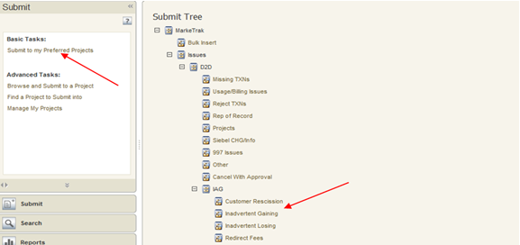
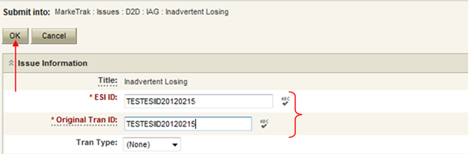
Day to Day (D2D) Issues – Inadvertent Gain
  Submitting an Inadvertent Gain – CR Submits as the Gaining CR
    From the Submit Tree, select IAG – Inadvertent Gaining
    CR1 (Gaining/Original CR) will enter all required information.
      ESIID
      Original Tran ID – The original tran id of the other CR’s enrollment. (BGN06 of the 814_06).

Slide 5
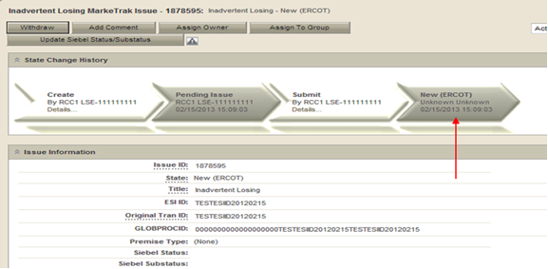
Day to Day (D2D) Issues – Inadvertent Gain
  CRITICAL: The Comments field is technically optional; however, not providing the required information referenced in RMG Section 7.3.2(1) could result in a delay of issue resolution. Please include any additional information in this box.
    Select OK to create the IAG – Inadvertent Gaining MarkeTrak Issue. The issue enters the state of New (ERCOT) and is visible only by the Submitting CR and ERCOT.
    The Submitting CR has the option to Withdraw the issue at this point
    ERCOT will select Begin Working to provide the Gaining CR Start Date, if the Gaining CR is still the rep of record (Gaining CR ROR), assign CR2 (Gaining CR) and TDSP. ERCOT will then select “OK” to move the issue to CR2 (Gaining CR).

Slide 6
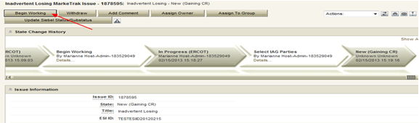

Day to Day (D2D) Issues – Inadvertent Gain
    CR2 (Losing CR) will select Begin Working and Issue details and Investigate Market Conditions to determine the appropriate regain date.
    If CR2 (Losing/Original CR) determines that an Inadvertent Gain has NOT taken place, they have the option to select “Unexecutable” to stop the Inadvertent Gain process. Invalid IAG Reason is required, enter one of the following:
      3rd party CR involved
      Authorized Enrollment Confirmed
      Duplicate Issue
      Other (should require comments)

Slide 7
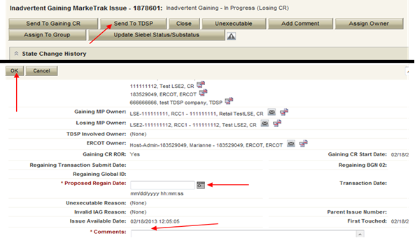
Day to Day (D2D) Issues – Inadvertent Gain
    If CR2 (Losing/Original CR) determines they will need more information from CR2 (Gaining CR), then they will need to select Send to Gaining CR. This transition allows both CR’s to talk back and forth while transitioning the issue back and forth before a resolution is made.
    If CR2 (Losing/Original CR) determines that an Inadvertent Gain has taken place, they will select Send to TDSP, enter the proposed regain date, add comments and select “OK” to move the issue to the TDSP. A validation will occur on the Proposed Regain Date: Validate that the date is less than “Submit Date” + 15 days. If not the following error message will be displayed “Proposed Regain Date is greater than 15 Calendar days from the submittal of MarkeTrak Issue, please update with valid Proposed Regain date.”

Slide 8
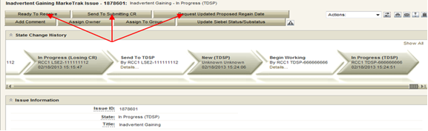
Day to Day (D2D) Issues – Inadvertent Gain
    The TDSP will select Begin Working, investigate the issue details, then select one of the following:
      Ready to Receive – The TDSP would select this transition to send the issue back to CR1 (Losing/Original CR). It is extremely important that CR1 (Losing/Original CR) wait for the TDSP to select Ready to Receive indicating TDSP’s systems have been prepared to receive the Original MP’s transaction before the EDI is actually sent. If not, the EDI will be rejected at the TDSP.
      Send To Submitting CR – The TDSP would select this transition if they needed further information from CR1 (Losing/Original CR).
      Request Updated Proposed Regain Date – The TDSP would select this transition if they do not agree with the proposed regain date that was provided. They would suggest a new date and send the issue back to CR1 (Losing/Original CR).

Slide 9
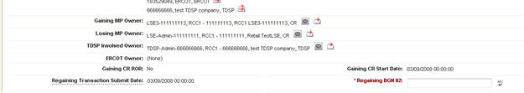
Day to Day (D2D) Issues – Inadvertent Gain
    CR2 (Losing/Original CR) will select Begin Working then select Provide Regaining BGN 02. CR2 (Losing/Original CR) will provide the Regaining BGN02 and then select “OK”. When the regaining transactions process into ERCOT’s registration system, the Regaining Transaction Submit Date, Regaining BGN Requested Date and Regaining BGN Priority Code will be auto-populated on the MarkeTrak issue.
    All parties should continue to monitor MIS and internal systems for the successful delivery and completion of the EDI transaction being sent by CR1 (Losing/Original CR) to the Market to regain a premise and resolve the associated Inadvertent Gain MarkeTrak issue.
    Once the regaining transaction has been successfully sent to the Market by CR2 (Losing/Original CR), Siebel will automatically:
      Check Regaining Transaction Siebel Status every 30 minutes using the BGN 02 from the new initiating transaction
      Update the issue with the current Regaining Transaction Siebel Status
      Assign the state of Complete with the Submitting MP as the Responsible Party once the Regaining Transaction Siebel Status is Complete.
      Issues remaining in a state of ‘Regaining Transaction Submitted (PC)’ for 14 calendar days will be transitioned by MarkeTrak to a state of ‘New (Losing CR Re-Submit)’ with the following comment: “Regaining Transaction has been idle for too long. Please review and re-submit transaction.”

Slide 10
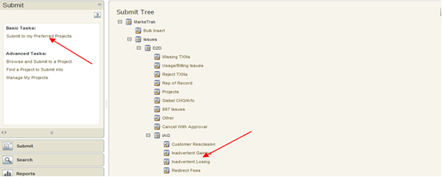
Day to Day (D2D) Issues – Inadvertent Losing
  Submitting an Inadvertent Gain – CR Submits as the Losing CR
    From the Submit Tree, select IAG – Inadvertent Losing
    CR1 (Losing/Original CR) will enter all required information.
      ESIID
      Original Tran ID – The original tran id of the other CR’s enrollment. (BGN06 of the 814_06).

Slide 11
Day to Day (D2D) Issues – Inadvertent Losing
  CRITICAL: The Comments field is technically optional; however, not providing the required information referenced in RMG Section 7.3.2(1) could result in a delay of issue resolution. Please include any additional information in this box.
    Select OK to create the IAG – Inadvertent Losing MarkeTrak Issue. The issue enters the state of New (ERCOT) and is visible only by the Submitting CR and ERCOT.
    The Submitting CR has the option to Withdraw the issue at this point
    ERCOT will select Begin Working to provide the Gaining CR Start Date, if the Gaining CR is still the rep of record (Gaining CR ROR), assign CR2 (Gaining CR) and TDSP. ERCOT will then select “OK” to move the issue to CR2 (Gaining CR).

Slide 12
Day to Day (D2D) Issues – Inadvertent Losing
    CR2 (Gaining CR) will select Begin Working and investigate the Inadvertent Gain issue details to determine if CR1 (Losing/Original CR) should regain ESI ID as of their date of loss.
    If CR2 (Gaining CR) determines that an Inadvertent Gain has NOT taken place, they have the option to select “Unexecutable” to stop the Inadvertent Gain process. Invalid IAG Reason is required, enter one of the following:
      3rd party CR involved
      Authorized Enrollment Confirmed
      Duplicate Issue
      Other (should require comments)

Slide 13
Day to Day (D2D) Issues – Inadvertent Losing
    If CR2 (Gaining CR) determines that an Inadvertent Gain has taken place, they will select Agree, enter comments and select “OK” to move issue to CR1 (Losing/Original CR). Selecting Agree indicates the Gaining CR is agreeing to all fees associated with transitioning the premise back to the Losing CR.
    CR1 (Losing/Original CR) will select Begin Working and Investigate Market Conditions to determine the appropriate regain date. The regain date shall be a day beyond the date of loss or any subsequent date chosen by the Losing/Original CR but no greater than 10 days past the date the MarkeTrak issue was logged.
    CR1 (Losing/Original CR) will select Send to TDSP, enter the proposed regain date, add comments and select “OK” to move the issue to the TDSP. A validation will occur on the Proposed Regain Date: Validate that the date is less than “Submit Date” + 15 days. If not the following error message will be displayed “Proposed Regain Date is greater than 15 Calendar days from the submittal of MarkeTrak Issue, please update with valid Proposed Regain date.”
    If CR1 (Losing/Original CR) determines that an Inadvertent Gain has NOT taken place, they have the option to select Unexecutable.

Slide 14
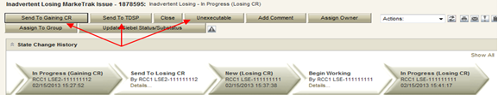

Day to Day (D2D) Issues – Inadvertent Losing
    If CR1 (Losing/Original CR) determines they will need more information from CR2 (Gaining CR), then they will need to select Send to Gaining CR. This transition allows both CRs to talk back and forth while transitioning the issue back and forth before a resolution is made.
    The TDSP will select Begin Working, investigate the issue details, then select one of the following:
      Ready to Receive – The TDSP would select this transition to send the issue back to CR1 (Losing/Original CR). It is extremely important that CR1 (Losing/Original CR) wait for the TDSP to select Ready to Receive indicating TDSP’s systems have been prepared to receive the Original MP’s transaction before the EDI is actually sent. If not, the EDI will be rejected at the TDSP.
      Send To Submitting CR – The TDSP would select this transition if they needed further information from CR1 (Losing/Original CR).
      Request Updated Proposed Regain Date – The TDSP would select this transition if they do not agree with the proposed regain date that was provided. They would suggest a new date and send the issue back to CR1 (Losing/Original CR).

Slide 15
Day to Day (D2D) Issues – Inadvertent Losing
    CR1 (Losing/Original CR) will select Begin Working then select Provide Regaining BGN 02. CR1 (Losing/Original CR) will provide the Regaining BGN02 and then select “OK”. When the regaining transactions process into ERCOT’s registration system, the Regaining Transaction Submit Date, Regaining BGN Requested Date and Regaining BGN Priority Code will be auto-populated on the MarkeTrak issue.
    All parties should continue to monitor MIS and internal systems for the successful delivery and completion of the EDI transaction being sent by CR1 (Losing/Original CR) to the Market to regain a premise and resolve the associated Inadvertent Gain MarkeTrak issue.
    Once the regaining transaction has been successfully sent to the Market by CR1 (Losing/Original CR), Siebel will automatically:
      Check Regaining Transaction Siebel Status every 30 minutes using the BGN 02 from the new initiating transaction
      Update the issue with the current Regaining Transaction Siebel Status
      Assign the state of Complete with the Submitting MP as the Responsible Party once the Regaining Transaction Siebel Status is Complete.
      Issues remaining in a state of ‘Regaining Transaction Submitted (PC)’ for 14 calendar days will be transitioned by MarkeTrak to a state of ‘New (Losing CR Re-Submit)’ with the following comment: “Regaining Transaction has been idle for too long. Please review and re-submit transaction.”

Slide 16
Customer Rescission
Due to changes made to PUCT rule 25.474 Selection of Retail Electric Provider, an expedited timeline for the processing of an 814_01 switch transaction may result in an overlap of the period for customer rescission.
Only the gaining CR in a rescission scenario may utilize the rescission-based MarkeTrak process to initiate reinstatement of a customer to its original CR.
In order for an issue to be submitted through this subtype, it must be submitted on or before the twenty-fifth (25th) calendar day following ERCOT’s established First Available Switch Date (FASD).
Should a matter of rescission need to be resolved, but a Customer Rescission issue has not been submitted for this purpose within the specified timeframe the two CRs should work to resolve this issue through the Inadvertent Gaining subtype.

Slide 17
Customer Rescission
The submitter should include any details (ex. customer name) in the comments section which may expedite resolution of the issue.
The Gaining CR selects the Submit tab.
From the Submit Tree, select Customer Rescission.

Slide 18
Customer Rescission
The following fields must be populated for successful submission of Customer Rescission issue:
  ESIID
  Original Tran ID
  Comment( Optional)
Select ‘Ok’ to create the issue.

Slide 19
Customer Rescission

Slide 20
Customer Rescission
ERCOT validates ESIID, submission timeframe and valid originating transaction.
Once validation is complete, MarkeTrak issue is created and ERCOT updates the issue with the following information:
      Losing CR Name and Duns
      TDSP Name and Duns
      Gaining CR ROR = Y or N
      Gaining CR Start Date
      Regain Date – auto populated by ERCOT. Calculation is Gaining CR Start Date plus 1 calendar day.
MarkeTrak issue is assigned to the state of ‘New (Losing CR)’ with the Losing CR as the Responsible Party.
Losing CR user selects ‘Begin Working’.

Slide 21
Customer Rescission
MarkeTrak issue is assigned to the state of ‘In Progress (Losing CR)’ with the Losing CR as the Responsible Party.
Losing CR selects ‘Send to TDSP’.

Slide 22
Customer Rescission

Slide 23
Customer Rescission
Issue is in a state of ‘New (TDSP)’ with TDSP as Responsible MP.
TDSP selects ‘Begin Working’.
Issue is in a state of ‘In Progress (TDSP)’ with TDSP as Responsible MP.
TDSP selects ‘Ready to Receive’.

Slide 24
Customer Rescission

Slide 25
Customer Rescission
Issue is in a state of ‘New (Losing CR Submit)’ with the Losing CR as Responsible MP.
Losing CR selects ‘Begin Working’.
Issue is in a state of ‘In Progress (Submit Regaining)’ with the Losing CR as Responsible MP.
Losing CR selects ‘Provide Regaining BGN02’.

Slide 26
Customer Rescission

Slide 27
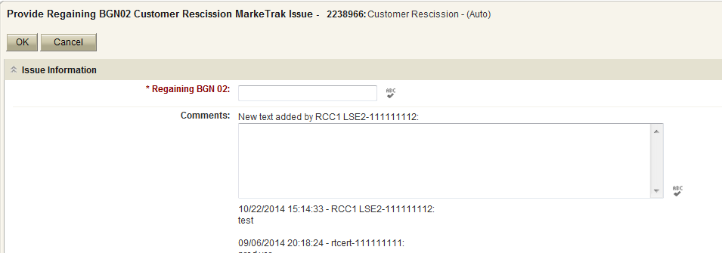
Customer Rescission
Losing CR populates all required information:
      Regaining BGN 02

Slide 28
Customer Rescission
Issue is in a state of ‘Regaining Transaction Submitted (PC)’ with the Gaining (Submitting CR) as Responsible MP.
Once the regaining transaction has been successfully sent by (Losing/Original CR), Siebel will automatically:
      Check Regaining Transaction Siebel Status every 30 minutes using the BGN 02 from the new initiating transaction.
      Update the issue with the current Regaining Transaction Siebel Status.
The issue will move to a state of ‘Complete’ with the Submitting MP as the Responsible Party once the Regaining Transaction Siebel Status is Complete.

Slide 29
Customer Rescission
If the regaining transaction remains in a Siebel status other than Complete in the ERCOT Registration System for greater than five calendar days, the issue will automatically transition back to the Losing CR, and an email generated to notify the Losing CR of the transition.
If the regaining Siebel status is still Scheduled status, the Losing CR should repopulate the regaining BGN field with the same information.
If the Siebel status is blank within the MarkeTrak issue, the Losing CR should verify the status of the regaining transaction and submit/repopulate a new transaction if necessary.
This functionality is to ensure the issue is not closed before the premise has been regained, due to the time restriction on submission of new issues within this subtype.

Slide 30
Customer Rescission

Slide 31
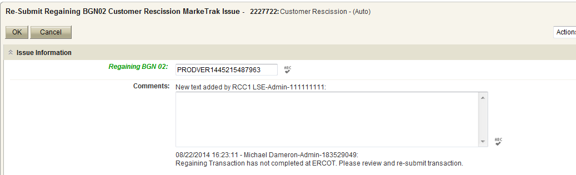
Customer Rescission

