Slide 1
Siemens PTI GIC Data File Contents
Presented to PGDTF
February 11, 2015

Slide 2
GIC Data File Contents
Required Data
Geographic location of substations (longitude and latitude)
Grounding resistance data for substations
DC resistance of transformer windings
Identification of GIC blocking device in the grounding connection
Transformer vector group
Optional Data for Transformers
Number of cores
K Factor
Source: Siemens PTI 2012

Slide 3
GIC Data File Contents
Three group records, with each group containing a particular type of data
Substation Data
Bus Substation Data
Transformer Data
Source: Siemens PTI 2012

Slide 4
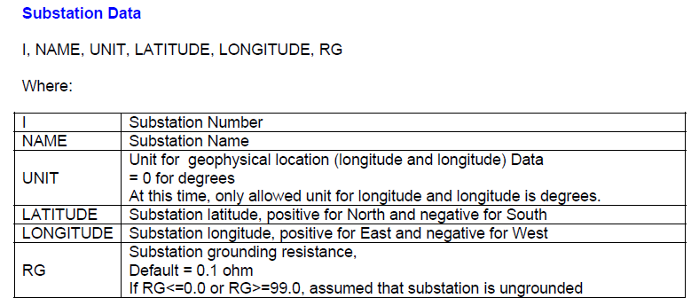
Substation Data
Source: Siemens PTI 2012

Slide 5
Substation Data Example
Source: Siemens PTI 2012

Slide 6
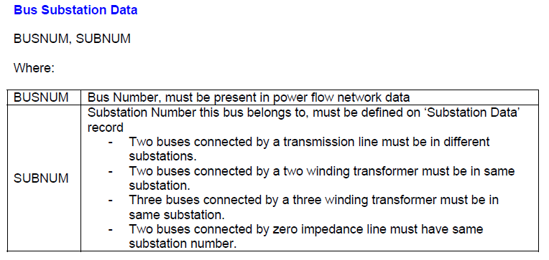
Bus Substation Data
Source: Siemens PTI 2012

Slide 7
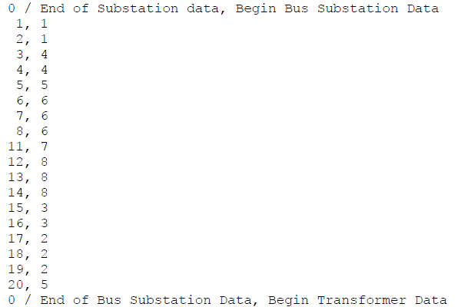
Bus Substation Data Example
Source: Siemens PTI 2012

Slide 8
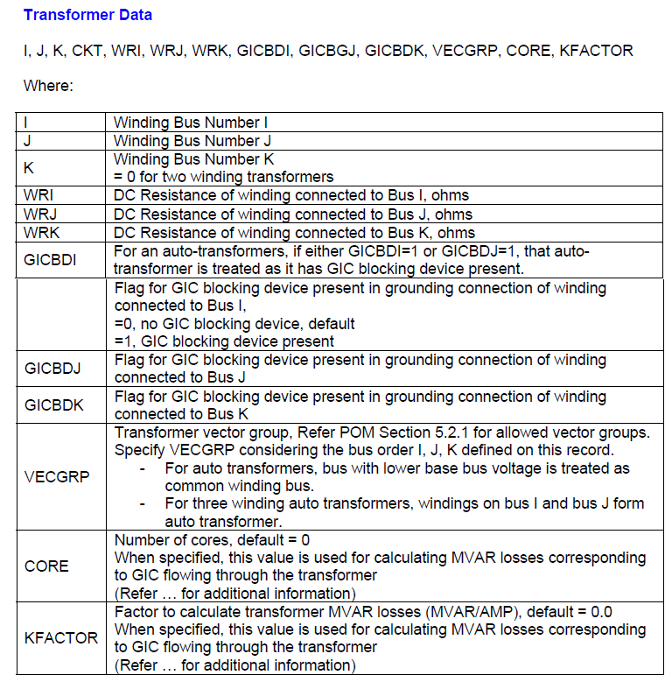
Transformer Data
Source: Siemens PTI 2012
Notes:
DC resistances, if left blank, will be calculated based on power flow data
User can choose to enter, CORE, KFACTOR, or enter “0” for both and k-factor will be determined based on base kV of transformer windings (as shown on next slide)

Slide 9
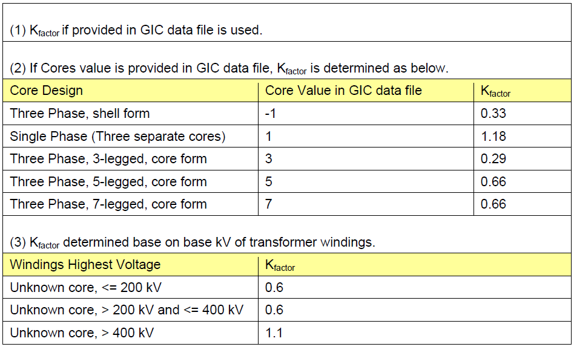
Transformer MVAR Scaling Factors
Source: Siemens PTI 2012

Slide 10
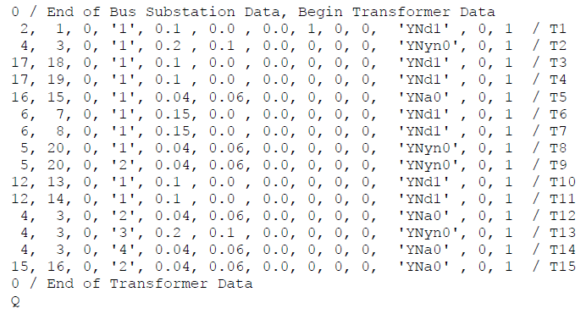
Transformer Data Example
Source: Siemens PTI 2012

