Slide 1
Information Technology Report
Dave Pagliai
Manager, IT Support Services

Slide 2
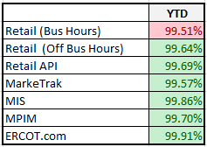
Incident Report Highlights
Service Availability – Year End 2014
Service Availability – January
Market Data Transparency IT systems met all SLA targets
Incidents & Maintenance – January
01/18/15 – Planned maintenance outage (Site Failover)
01/28/15 – Missed intervals for five reports due to a database issue
March 2015
03/01/15 – R2 Retail Release
03/23–03/27 – R2 Release

Slide 3
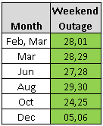
2015 Market Data Transparency Service Level Agreement (SLA)
Proposed Changes for 2015 Review
Section 2.2 Service Characteristics
ERCOT’s six 2015 release windows begin at 7:00 PM on Saturday, instead of 5:00 PM, to allow for the processing of AMS transactions per new tariff language. (Retail Market request)
Updated weekend release schedule (7:00pm Saturday - 12:00am Monday)

Slide 4
Browser Upgrade Project
ERCOT Application Browser Support
ERCOT intends to support IE 8 into 2016. The market will be given adequate time to migrate to a newer browser before ERCOT discontinues IE8 support.
ERCOT is testing IE 9, 10, and 11 in both native and compatibility mode to determine what needs to be fixed in the ERCOT applications. That work will continue through Q1.
The mitigation projects and change requests resulting from the testing will be submitted through the normal ERCOT project process in Q2, to be prioritized and delivered through the normal ERCOT release process. The release schedule for those projects will determine when the applications are fully supported on the newer browsers.
There are no current plans to expand the number of browsers supported by the ERCOT applications beyond IE 9, 10, and 11.

