Slide 1

Loads in SCED v2 Subgroup
The LMP-G Journey

Slide 2
TAC Endorsement of LMP-G
TAC voted to endorse “LMP-G” rather than “Full LMP” as the mechanism to enable direct participation in the real-time market by DR QSEs (i.e. CSPs).
As presented to TAC, LMP-G establishes the principle that a customer should not get the benefit of the curtailment twice -- i.e., LMP plus avoided cost of energy.
TAC endorsed ‘volumetric’ LMP-VG, which requires assignment of the estimated curtailment back to the specific customer.
Through significant discussion and presentations from stakeholders, LRISv2 Subgroup has determined that customer-specific curtailment cannot be estimated for many customers, including all residential, with a level of accuracy necessary for implementation.

Slide 3
LMP-G: What we’ve learned
Residential customers must be aggregated to allow for accurate baseline estimation of curtailment quantity.
  Minimum size of aggregation can be defined.
Many (but not all) larger customers can have site-level curtailment quantity estimated with sufficient accuracy.
  Mid-to-large commercial/industrial.
Residential customers (>50% of ERCOT peak) represent high potential for price responsive load.
  Depending on control systems, residential aggregations may be well-suited for SCED base point instructions.
LRISv2 Subgroup believes LMP-Proxy $G can be utilized for customers on fixed price rates (including most of the residential market).

Slide 4
LMP-G Road Map
Loads in SCED Resource/ALR Request
Represented by LSE/REP or DR QSE?
LSE/ REP
Settled as LRISv1
Bid to buy in SCED
DR QSE
Settled as LMP-$G
Offer to sell in SCED
Can we accurately estimate discreet customer-level curtailment?
Yes
Offer to sell in SCED
No
Settled as LMP-VG
Yes
Does the Resource/ALR contain customers with fixed price rates that are compatible with LMP-$G?
Does aggregation meet minimum customer count for baseline accuracy?
Yes
No
No
ALR fails qualification (Bilateral only through REP/LSE)

Slide 5
The DR potential of residential customers
  2013 Price Responsive Load Study
DR Type | Residential Participants* | Barriers
Retail Real-time Pricing | 164¹ | REP billing system upgrades
Retail “Other Load Control” | 10,071¹ | Cost of DR infrastructure
Retail Peak Rebate | 1,652¹ | Accuracy of individual customer baselines; REP billing system upgrades
Retail TOU | 117,623¹ | REP billing system upgrades
Weather-Sensitive ERS | 60,098² | Cost of DR/QSE infrastructure
Ancillary Services | 0² | Cost of DR/QSE infrastructure including telemetry
Loads in SCED | 0² | Cost of DR/QSE infrastructure including telemetry; 5-minute incremental DR in both directions not suitable for blocky loads; limited to LSE QSEs
  ~5.9 million competitive residential customers remain untapped

Slide 6
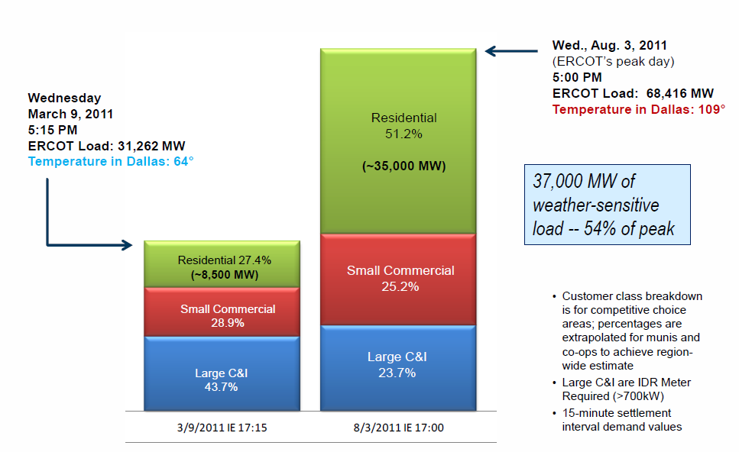
The DR potential of residential customers

Slide 7
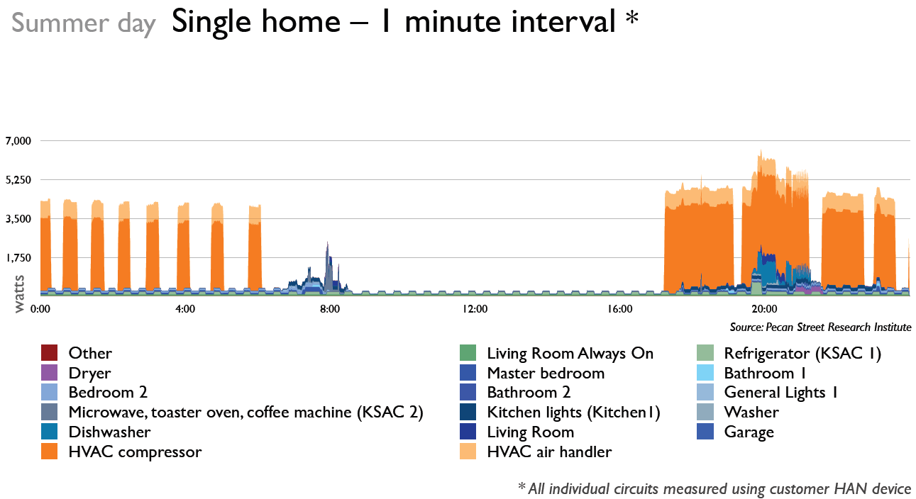
Pecan Street Research
In a studied sample of 40 homes in Austin, Texas for the period June 1 – August 31, 2013, these measurements were observed:
Electricity used for HVAC accounted, on average, for 66 percent of the entire home’s daily electricity use.
During peak demand hours (3-7 pm), the portion of electricity used for HVAC averaged 73 percent.
The portion of discretionary home electricity used for HVAC averaged 81 percent.
During peak demand hours, the portion of discretionary home electricity use for HVAC averaged 82 percent.
http://www.pecanstreet.org/2014/05/ac-accounts-for-23-of-home-summer-electric-use-over-80-of-discretionary-electric-use-in-texas-research-trial/

Slide 8
LRISv2 Subgroup Direction
Significant concerns remain with implementation of LMP-VG that are mostly resolved with LMP-Proxy $G.
  LMP-VG could enable LSEs to bill customers for consumption that didn’t occur. PUCT action likely required.
  LMP-VG presumably targets larger Loads which may be interested in other ERCOT programs (i.e. ERS, RRS).
  It isn’t clear that there is enough of a market need to spend time on this path.
Fixed price customers (including most of residential market), and their HVAC load, represent the most potential for price responsive load capability.
Therefore, LRISv2 Subgroup has discussed focusing the second phase of Loads in SCED on fixed price customers (most residential) and implementation of LMP-Proxy $G.
  We’ll have our hands full with this direction (see next slide).

Slide 9
LMP- Proxy $G Policy and Design Decisions
Methodology to determine Proxy $G
  What is Proxy $G? Next slide.
  How to determine Proxy $G? POLR rates.
Process to qualify LRISv2 ALRs.
  What retail rates are compatible with LMP-$G objective?
  How to identify the rates and the corresponding ESIIDs?
  Define customer rate composition to qualify for LRISv2 as an ALR.
  Define minimum customer aggregation to qualify for LRISv2 as an ALR.
Process to manage and maintain LRISv2 ALRs.
  How to manage changing compositions of ALR customer rates and LMP-$G eligibility?
  How to manage changing ALR customer counts and LMP-$G eligibility?
  Define rules regarding ALR->LSE allocation
    Customer deployment limitations
Notification to LSE/REP
“Offer to sell” details
DR “bounce-back” management
Everything else we haven’t thought of yet
We are here

Slide 10
What is Proxy $G?
“Retail customers that reduce their consumption should not be paid as if they generated the electricity they merely declined to buy. Instead, retail customers should be compensated as if they had entered into a long-term contract to purchase electricity at their retail rate but instead, during a peak demand period, resold the electricity to others at the market rate (LMP).”¹
“In other words, they should be paid “LMP-minus-G,” where G is the rate at which the retail customer would have purchased the electricity. Simply put, the customer must be treated as if it had first purchased the power it wishes to resell to the market.”¹
Proxy $G = A proxy for the “purchase price” or “contract price” that is generally representative of what retail customers paid for their energy adjusted for risk.
¹http://www.hks.harvard.edu/fs/whogan/Economists%20amicus%20brief_061312.pdf

Slide 11
How to determine Proxy $G?
LRISv2 Subgroup evaluated multiple approaches to determine Proxy $G:
  PUCT retail electric service rate reports
  POLR rates
  Power to Choose
The three approaches all yielded similar results
  $96/MWh to $132/MWh
LRISv2 Subgroup supports using POLR rates as the mechanism to calculate Proxy $G. Why?
  POLR rates are formulaic and well established in PUCT rule
  Static and stable mechanism
  Sufficient premium incorporated to account for gas price fluctuations and hedge value
  Easy to strip out wires charges and ERCOT fees

Slide 12
Using POLR rate as Proxy $G?
LRISv2 Subgroup agreed that:
  POLR rate should be used to calculate a market wide Proxy $G
  Weighting factors can be calculated and applied to Load Zone RTSPPs
  One Proxy $G will be applied to residential and small non-residential (one $G for all ALRs that qualify for $G treatment)
  ERCOT fees and AS charges will not be included in Proxy $G and therefore estimated curtailment will not be added to LSE load for these assessments
  NPRR language will refer to PUCT POLR rules and not replicate them

Slide 13
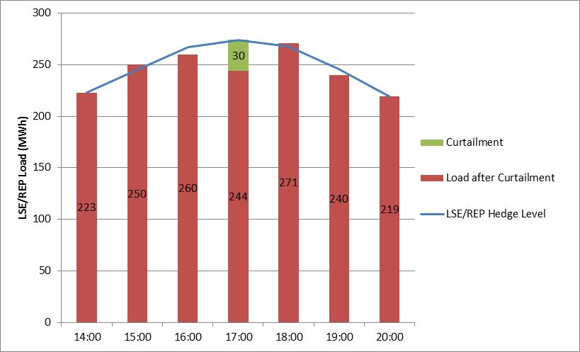
How would LMP-Proxy $G work?
HEDGED
ERCOT Settlement for HE17
ERCOT charges LSE/REP RTEIAMT based on 274MWh
  RTEIAMT settlement is $0 due to hedges
ERCOT credits LSE/REP 30MWh x Proxy $G
ERCOT credits CSP 30MWh x $920 (RTSPP – Proxy $G)
Proxy $G = $105/MWh
(POLR)
RTSPP = $1,025/MWh
CSP is settled for the curtailment quantity at LMP-Proxy $G
LSE/REP is settled like they served the load at the POLR rate

Slide 14
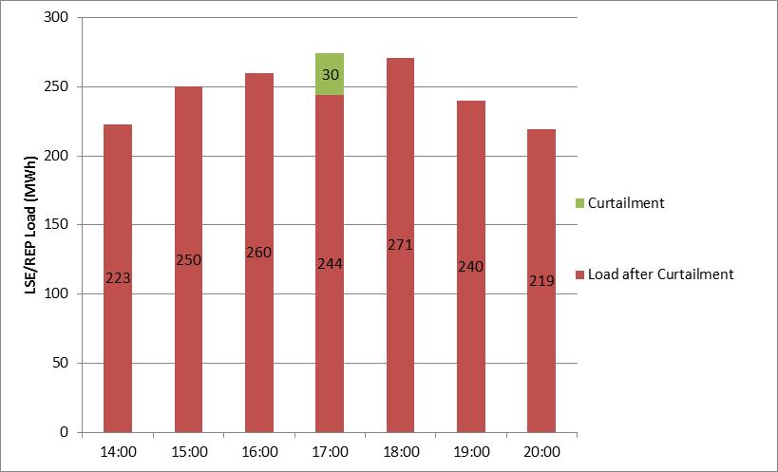
How would LMP-Proxy $G work?
UNHEDGED
ERCOT Settlement for HE17
ERCOT charges LSE/REP RTEIAMT based on 274MWh
  RTEIAMT settlement charge is 274MWh x $1,025/MWh
ERCOT credits LSE/REP 30MWh x Proxy $G
ERCOT credits CSP 30MWh x $920 (RTSPP – Proxy $G)
Proxy $G = $105/MWh
(POLR)
RTSPP = $1,025/MWh
CSP is settled for the curtailment quantity at LMP-Proxy $G
LSE/REP is settled like they served the load at the POLR rate

Slide 15
How to qualify LMP-$G eligible ALRs?
Evaluate the population of customers to determine if they are fully hedged (i.e. on LMP-$G compatible “fixed price” retail rates)
If a customer is on a “DR retail rate” from their REP, they are already getting compensated for their DR capability
Options to perform this evaluation:
  Examine the rate of each customer in the ALR and determine if it is a pre-defined “DR retail rate” (i.e. RTP)
  Assume residential customers are mostly hedged and accept inaccuracies for ones that aren’t
  DR Provider of Record

Slide 16
How to qualify LMP-$G eligible ALRs?
  Option 1) Examine the rate of each customer in the ALR and determine if it is a pre-defined “DR retail rate” (i.e. RTP)
  How would it work?
    DR QSE submits ALR for qualification
    REPs identify unhedged customers in their portfolios and submit ESI ID lists to ERCOT: unhedged fails litmus test
      Submission process TBD; could be similar to the Retail DR data collection project
    ERCOT communicates disqualified ESI IDs back to the DR QSE

Slide 17
How to qualify LMP-$G eligible ALRs?
  Option 1) Examine the rate of each customer in the ALR and determine if it is a pre-defined “DR retail rate” (i.e. RTP)
  Pros
    Identifies and disqualifies customers that would receive DR double payment
    Somewhat accurate settlement for REP
    Low barrier to entry for DR QSE
  Cons
    If not refreshed frequently, the ESIID-to-rate type relationship will become stale through customer switching
    Complex implementation (more frequent or formal Retail DR data collection)
    Potential for ‘DR blocking’ and gaming by REPs
    DR QSE wears risk of unknown ALR composition and “ALR creep” as customers switch to DR rates
    Does not accommodate evolving rate structures of the retail market

Slide 18
How to qualify LMP-$G eligible ALRs?
Option 2) Assume residential customers are mostly hedged and accept inaccuracies for ones that aren’t
  How would it work?
    DR QSE submits ALR for qualification
    ERCOT qualifies or disqualifies the ALR based on whether the ESIIDs are on a residential profile

Slide 19
How to qualify LMP-$G eligible ALRs?
Option 2) Assume residential customers are mostly hedged and accept inaccuracies for ones that aren’t
  Pros
    Simplest implementation
    Low barrier to entry for DR QSE
    Low risk for DR QSE
    Level of inaccuracy (double-payment risk) possibly insignificant
  Cons
    Inaccurate settlement for REPs
    Double payment risk
    Hedging risk for REPs

Slide 20
How to qualify LMP-$G eligible ALRs?
Option 3) DR Provider of Record
  How would it work?
    DR QSE submits enrollment request for ALR using TXSET or similar formalized electronic transaction
    ERCOT maintains a DR Provider of Record for every ESIID
    Customer’s REP could also be his DRPOR
    Transactions update with REP switches, movement to a DR rate, or enrollment with different DRPOR
      Customer rates would become part of switch transactions to determine if ESIID is LMP-$G eligible
      Initial customer rate population required
    ERCOT disqualifies ALR sites if the ESIIDs are not affiliated with the submitting DRPOR

Slide 21
How to qualify LMP-$G eligible ALRs?
  Option 3) DR Provider of Record
  Pros
    Precisely identifies customers that would receive DR double payment
    Most accurate settlement for REP
  Cons
    Highly complex implementation (TXSET or similar)
      If TX SET, system expands to include new type of Market Participant
    PUCT rules required
    Potential to block customers from retail switching to certain rates and inhibits REP product innovation
    DR QSE wears risk of unknown ALR composition
    Does not accommodate evolving rate structures of the retail market

