Slide 1
Summary of Astrapé Reserve Margin Impact Analysis for the PUCT
Pete Warnken
WMS
February 4, 2015

Slide 2
Purpose of the Study
As requested by the Commission, this analysis indicates what Planning Reserve Margins correspond to specific alternative Reliability Standards being reviewed in PUCT docket 42302
Loss of Load Hours for the following durations: 2.4, 4, 6, 12, 15 hours/year
Normalized Expected Unserved Energy, EUE MWh/Total Demand MWh: 0.001% and 0.002%
0.1 Loss of Load Expectation in events per year (current Standard)
Not intended to study cost and other system characteristics associated with the Reliability Standards

Slide 3
Study Approach and Key Assumptions
Study performed by Astrapé Consulting using SERVM software
Methodology and assumptions consistent with EORM study modeling framework conducted with Brattle
2016 simulation year
Resource and load forecasts based on May 2014 CDR
5,500 Monte Carlo simulation runs using 11 historical weather years
2011 weather year given 1% probability of occurrence; other years given equal probabilities
Load is shed to maintain 500 MW of regulation and 600 MW of spinning reserves
Used new wind peak capacity contribution values to compute reserve margins

Slide 4
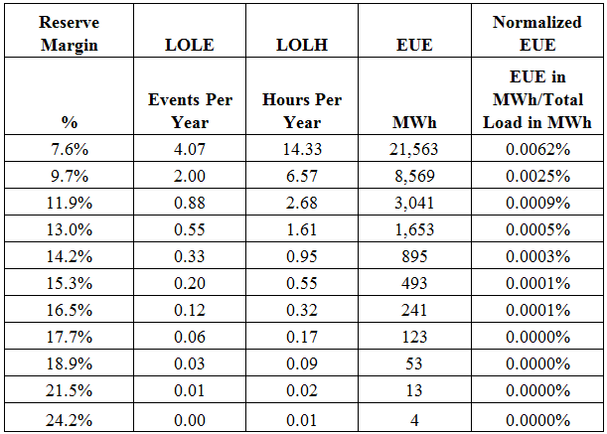
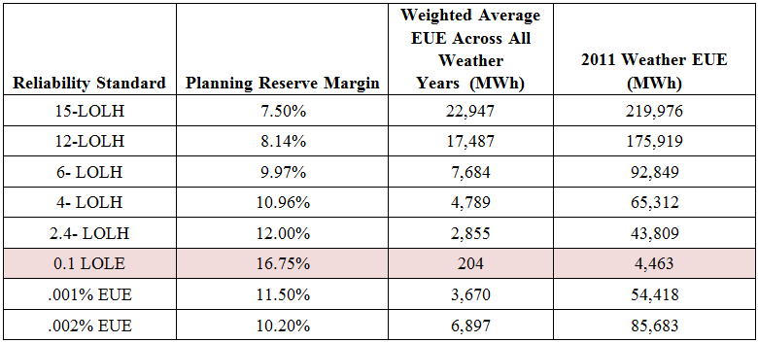
Study Results
Planning Reserve Margins corresponding to various levels of LOLE, LOLH and EUE
Planning Reserve Margins Corresponding to Standards Reviewed by Astrapé

