Slide 1
Market Notices CSWG Meeting January 23, 2015
Ted Hailu
Director, Client Services

Slide 2
2013 Survey Results – Market Notices
2013 Client Services Survey
Content
Timing and clarification of required responses need improvement
Some notices had incorrect information
Small errors such as effective dates make notices difficult to rely on
Separate informational notices from those that require a response
Timeliness
I sometime receive market notices after the fact
Provide more updates / status
Distribution / Audience
ERCOT not always consistent on distribution lists used for notices
I receive notices that don't pertain to my business.
Hard to know which lists to be on to get certain notices
I get many notices multiple times

Slide 3
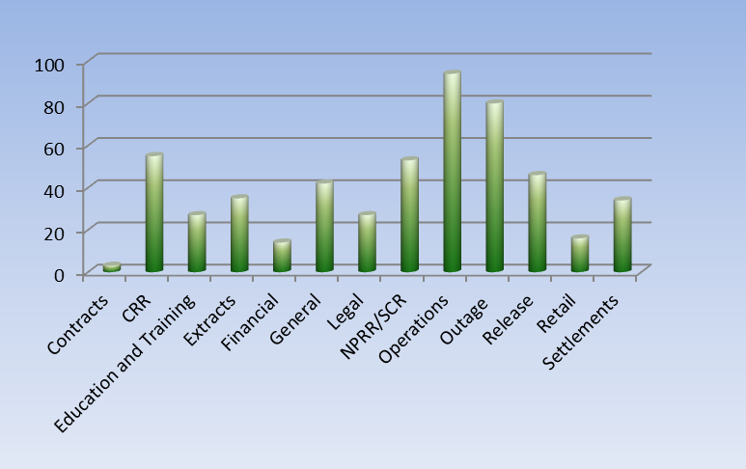
2014 Market Notices – Volume by type
Total number of market notices in 2014 = 526

Slide 4
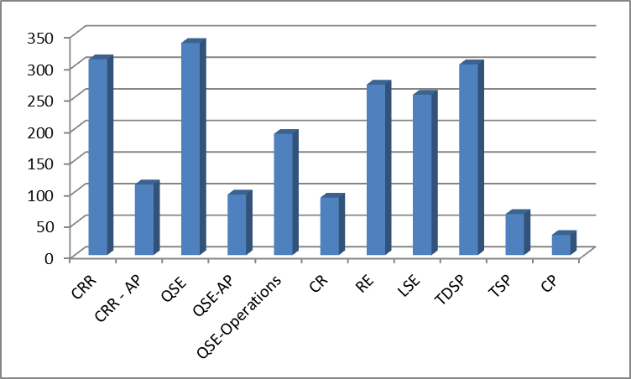
2014 Market Notices – Audience – Market Participants

Slide 5
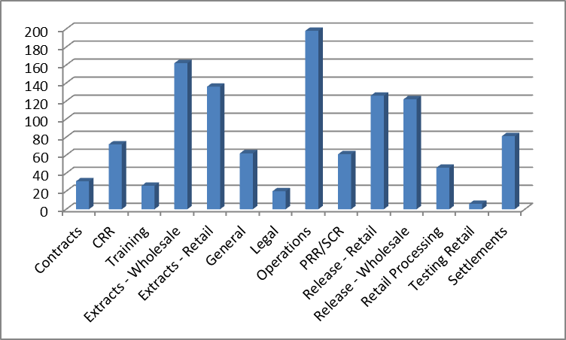
2014 Market Notices – Audience – Public mailing lists

Slide 6
2015 Action Items
Remaining Action Items
Audience
Public
Review public e-mail distribution lists
Example – Credit related notices
Market Participants
Options for notices to Authorized Representatives
Create more granular lists
Communication on use of public lists
Market Notices Survey
Was planned for Q1 2015 / Proposed delay
Work with CSWG on review on COPMG – Appendix A
Complete known action items first

Slide 7
2015 Survey

