Slide 1
Technology Solutions for Wind Integration in ERCOT CCET Smart Grid Demonstration Project: Discovery Across Texas Solar Community Grid Dynamics Milton Holloway, Ph.D. CCET President & COO ERCOT ETWG Meeting Austin, Texas January 22, 2015

Slide 2
Discovery Across Texas: Technology Solutions for Wind Integration in ERCOT
This material is based upon work supported by the Department of Energy under Award Number DE-OE0000194."
Disclaimer: "This report was prepared as an account of work sponsored by an agency of the United States Government. Neither the United States Government nor any agency thereof, nor any of their employees, makes any warranty, express or implied, or assumes any legal liability or responsibility for the accuracy, completeness, or usefulness of any information, apparatus, product, or process disclosed, or represents that its use would not infringe privately owned rights. Reference herein to any specific commercial product, process, or service by trade name, trademark, manufacturer, or otherwise does not necessarily constitute or imply its endorsement, recommendation, or favoring by the United States Government or any agency thereof. The views and opinions of authors expressed herein do not necessarily state or reflect those of the United States Government or any agency thereof.

Slide 3
CCET Membership (early 2014)
Governing Participants:
Affiliated Participants:
Advisor Directors:
University Collaborators:
Notes:
And our newest Affiliated Participants for 2013 - Intel/McAfee

Slide 4
Discovery Across Texas: Technology Solutions for Wind Integration in ERCOT ($27M Project) 2010-2014
Project Participants:
P³E
DOE administers the ARRA funded projects and helps guide the cooperative agreement

Slide 5
CCET Demonstration Project: Discovery Across Texas
CCET defined a demonstration project to help address the challenges of wind integration into the ERCOT grid with 18 GW of wind resources.
Key technology deployments to leverage:
A starter synchrophasor network
Expected AMS rollout of 6.5 million units
A smart grid future community with residential solar, smart appliances, home energy monitoring, and electric vehicles
Smart Meter Texas Portal (SMT)
Wind Farm at Reese Technology Center
Technology Solutions for Wind Integration in ERCOT
Award Number: DE-OE-0000194
Value: $27 million total; $13.5 million DOE
Original Award Date: 4 January 2010
Term: Five-years

Slide 6
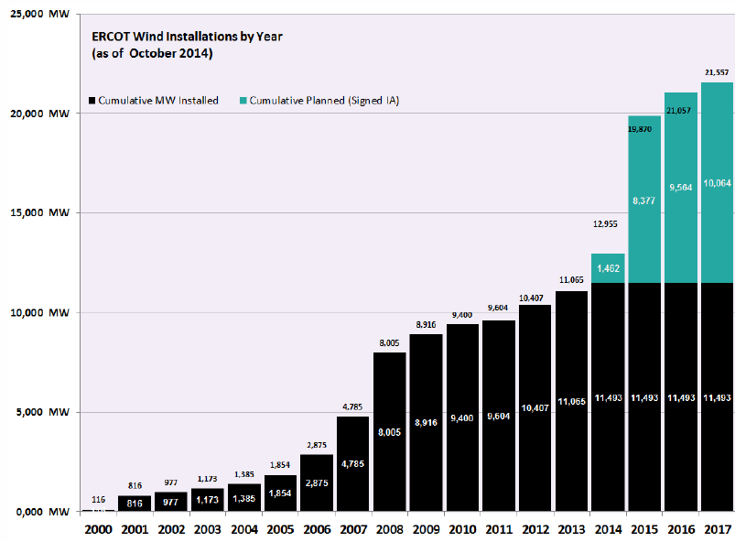
Context: Continuing Investment in Wind Generation
ERCOT Wind Capacity

Slide 7
Context: Continuing Investment in Wind Capacity
Completed ERCOT CREZ Build-Out

Slide 8
Discovery Across Texas Project: ERCOT & Part of SPP

Slide 9
CCET Demonstration Project: Discovery Across Texas
Seven Project Components:
Synchrophasor system with applications (ERCOT wide)
Security fabric demonstration for synchrophasor systems (demonstrated at Lubbock/TTU/RTC)
Utility-scale battery with wind farm (Lubbock/TTU/RTC)
Pricing trials at Pecan Street (Austin)
DLC demonstration with dual communication paths (Dallas and Houston)
Solar community monitoring (Houston & Austin)
PEV fleet Fast Response Regulation Service demonstration (Fort Worth)

Slide 10
VI. Solar community monitoring (Houston & Austin)

Slide 11
VI. Solar community monitoring (Houston & Austin)
Power Quality Impacts from Solar PV on 35 kV URD Circuits
CenterPoint monitored three 35 kV URD circuits in each of two neighborhoods north of Houston
Power Factor (PF)
Frequency
Voltage
Current
THDv
THDi
Real Power
Reactive Power
Apparent Power

Slide 12
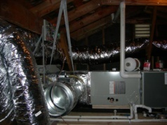
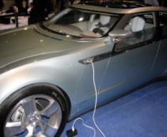
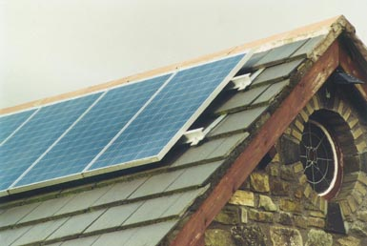
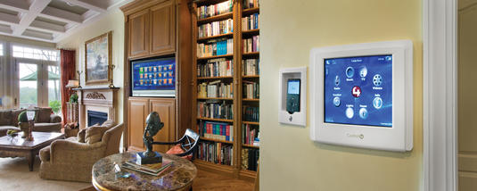
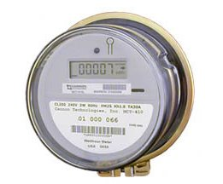
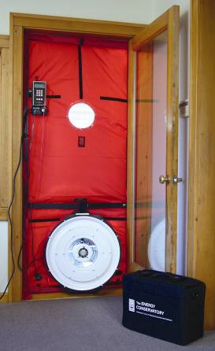
VI. Solar community monitoring (Houston & Austin)
Pricing trials and Solar Dynamics Monitoring at Pecan Street
2-way metering capabilities to support DG and new-generation demand response programs
Electronic Vehicle (EV) charging
Rooftop solar for serving as Distributed Generation (DG) for each home
Home energy management services including an in-home display & software applications to help homeowners manage their electricity more efficiently
High efficiency HVAC systems
Wind Power Purchases Available from AE
Extraordinary high building envelope efficiencies

Slide 13
VI. Solar community monitoring (Houston & Austin)
Power Quality Impacts from Solar PV at the Residential Service Point of Connection
Seven homes were selected for monitoring in Austin. These homes were served by two different transformers, and one of the transformer clusters had high solar PV penetration. One home in the Houston Harmony neighborhood was also monitored to explore similarities and differences between the 35 kV URD circuit data and the customer service line data and to examine whether the solar inverter was contributing to high THDi.
connected a Power Standards Lab PQube power quality and energy monitor/analyzer at the meter and installed E-Gauge sub-meter data collectors at the main power panel to collect and calculate:
PQube at Customer meter:
Volts (leg-neutral, 12-cycle average)
Volts (leg-leg, 12-cycle average)
Amps (12-cycle average)
Ambient Temperature and Relative Humidity (%)
Frequency
Harmonic voltage distortion (% THD_{v})
Harmonic current distortion (% THD_{i})
Flicker
kW
kVA
kVA reactive (kVAR)
Total power factor (PF)

Slide 14
VI. Solar community monitoring (Houston & Austin)
Power Quality Impacts from Solar PV at the Residential Service Point of Connection
Seven homes were selected for monitoring in Austin. These homes were served by two different transformers, and one of the transformer clusters had high solar PV penetration. One home in the Houston Harmony neighborhood was also monitored to explore similarities and differences between the 35 kV URD circuit data and the customer service line data and to examine whether the solar inverter was contributing to high THDi.
connected a Power Standards Lab PQube power quality and energy monitor/analyzer at the meter and installed E-Gauge sub-meter data collectors at the main power panel to collect and calculate:
E-Gauge sub-metering:
Net usage
Actual usage
PV generation
Heating, ventilation, and air conditioning (HVAC) condensing unit
HVAC air handler
Electric vehicle charging
Clothes washer and dryer
Dishwasher
Disposal
Kitchen appliances 1
Kitchen appliances 2
Oven 1
Oven 2
Refrigerator 1
Refrigerator 2
Microwave
Lights 1
Lights 2
Sub-panel

Slide 15
VI. Solar community monitoring (Houston & Austin)

Slide 16
VI. Solar community monitoring (Houston & Austin)

Slide 17
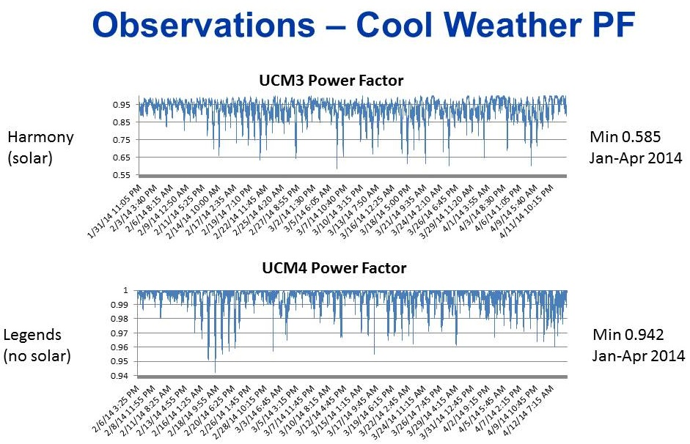
VI. Solar community monitoring (Houston & Austin)
Cool Weather PF Observations

Slide 18
VI. Solar community monitoring (Houston & Austin)
Hot Weather PF Observations

Slide 19
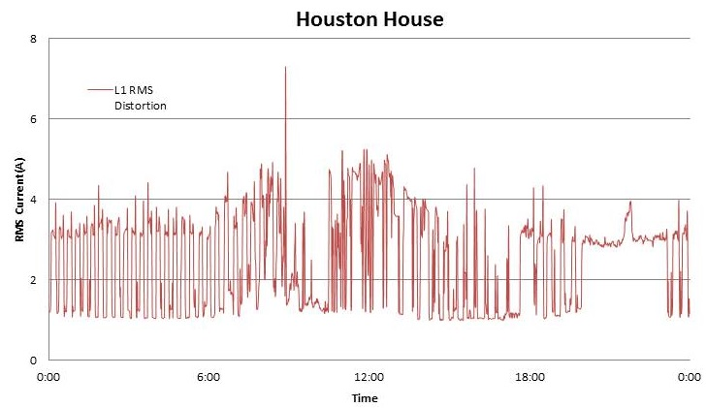
VI. Solar community monitoring (Houston & Austin)
Harmonic Distortion Current Measured at a Houston Harmony Home

Slide 20
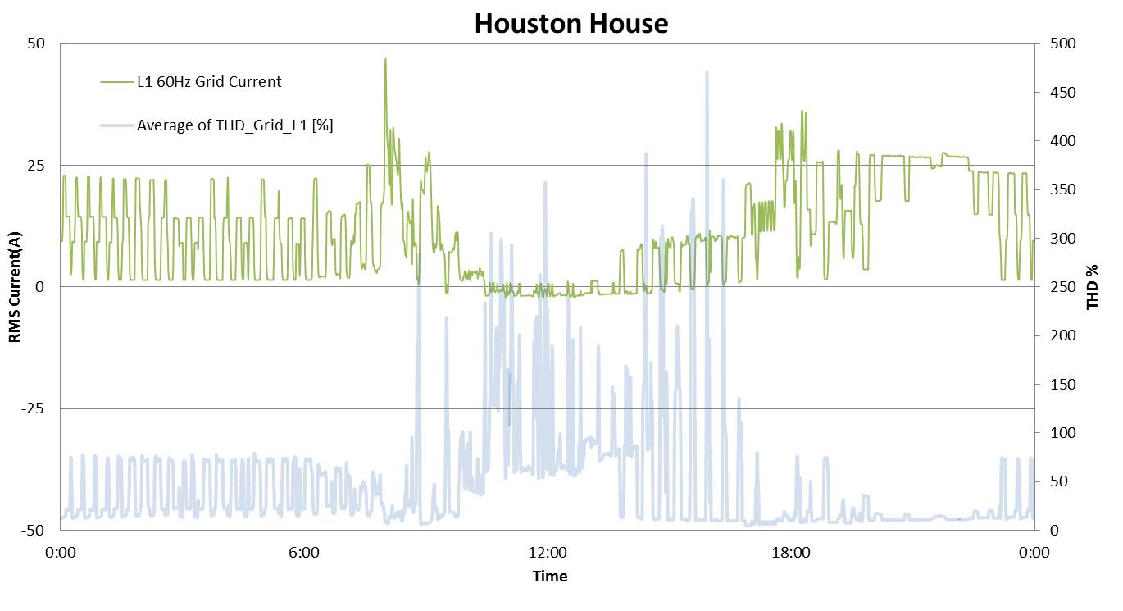
VI. Solar community monitoring (Houston & Austin)
Relationship of THDi to Grid-Supplied Fundamental Current

Slide 21
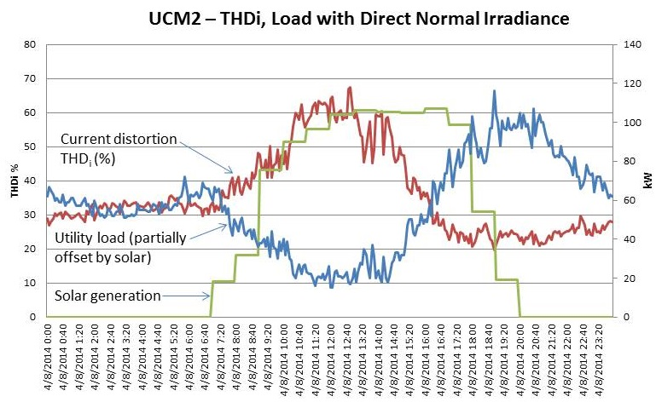
VI. Solar community monitoring (Houston & Austin)

Slide 22
VI. Solar community monitoring (Houston & Austin)
Based on the results shown above, the Team drew the following conclusions
1. THDi at distribution voltage:
Reflects a dynamic composite of all the varying loading conditions for each connected service transformer
Is unique per circuit
Varies throughout the day
Depends primarily on the weather (HVAC load, i.e. seasonal) and the amount of solar PV generation offsetting the utility load
The solar inverter does not add significant distortion to the grid; rather the presence of solar production enables the steady distortion from other devices to appear higher relative to utility loads.
2. In communities with significant solar PV installed, there is an inverse and seasonal relationship between power factor (PF) and solar production at distribution voltage.

Slide 23
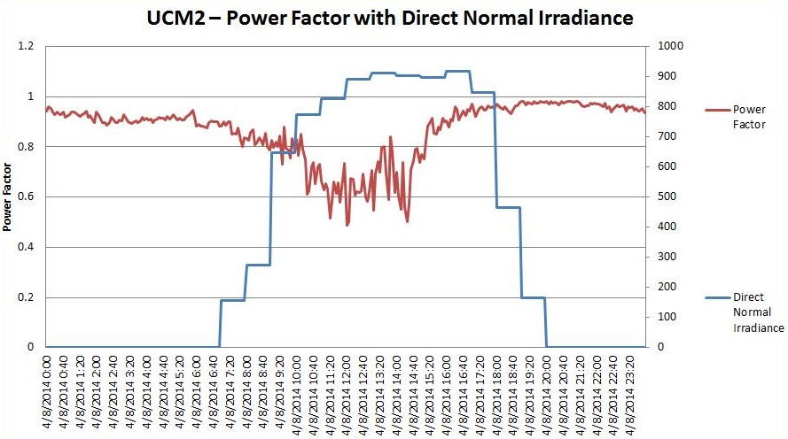
VI. Solar community monitoring (Houston & Austin)
Daily Swings in PF During April 2014

Slide 24
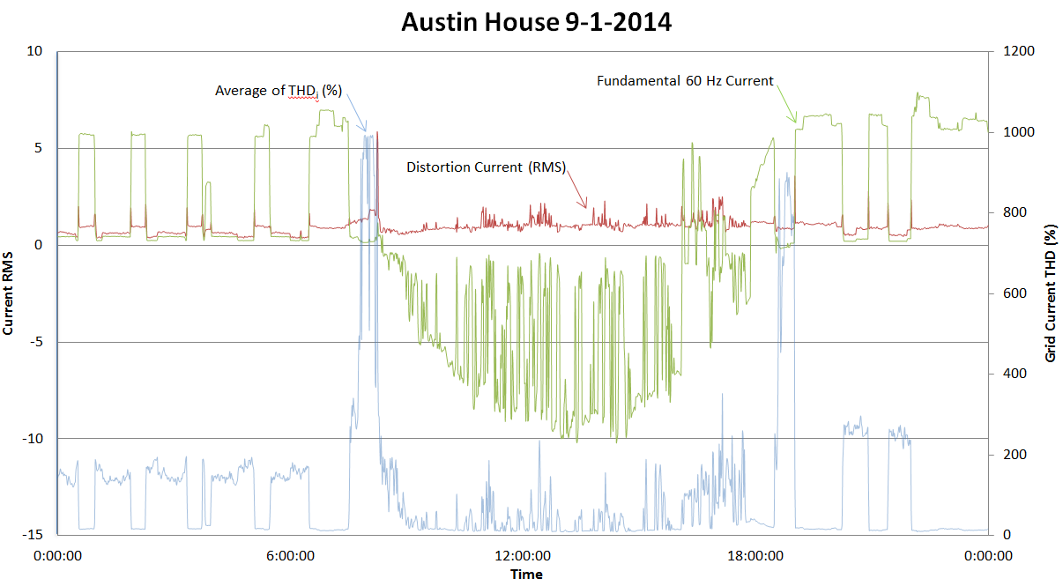
VI. Solar community monitoring (Houston & Austin)
THDi Behavior for Home with Larger Solar PV System

Slide 25
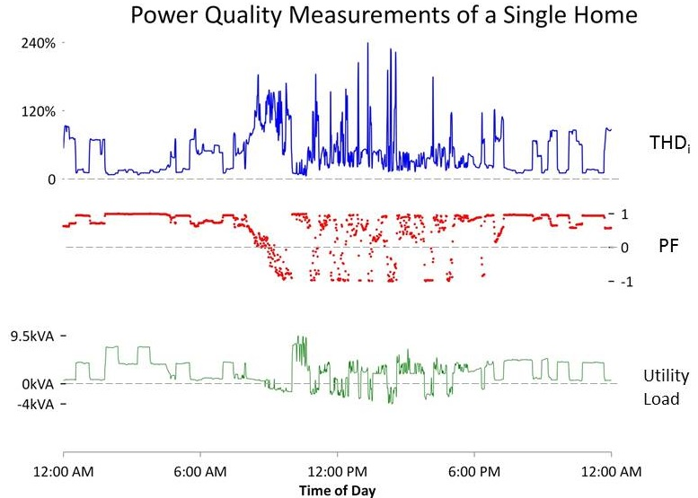
VI. Solar community monitoring (Houston & Austin)
Power Quality Measurements for Single Home in Austin

Slide 26
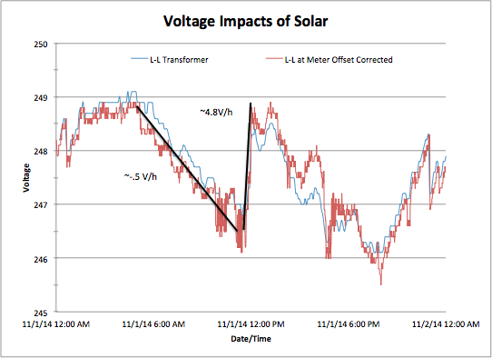
VI. Solar community monitoring (Houston & Austin)
Comparative Voltage at Service Transformer and at House with Solar PV

Slide 27
VI. Solar community monitoring (Houston & Austin)
Graphical analysis was most useful in finding and reporting correlations between fundamental current, distortion current from home appliances, THDi, net utility load (net solar production) and power factor.
The five minute interval data for the 35 kV URD circuit was graphed and then statistically analyzed to quantify the degree of correlation between concurrent values of solar production and several other parameters (power factor, voltage, THDi and THDv).
THDi = distortion current (amps) / fundamental current (+ or -)
In the equation above, two things can increase THDi: 1) increasing distortion current (such as by adding advanced home electronics with switch-mode power supplies, compact florescent lamps, low quality solar PV inverters, high efficiency HVAC equipment with variable speed fans and compressors, etc.), and 2) reduced fundamental current drawn from the utility, such as when solar kW production cancels most (or all) of the demand for utility-supplied fundamental current. When the denominator of the THDi equation approaches zero (for example, when solar production offsets the entire home load, which readily happens in cool weather), the THDi value approaches infinity.

Slide 28
VI. Solar community monitoring (Houston & Austin)
From this investigation, a better understanding has been gained of the behavior of circuit parameters during times when PV production approximately equals the total load of the home. At such times, the utility is only “supplying” distortion current and reactive power, potentially resulting in impacts on stability, voltage control and equipment lifetime.
These impacts include at the local level:
Increased power dissipation in fixed resistance devices due to higher voltage levels,
The potential for inverters to shut down in a safety response to overvoltage situations,
locally poor power factor due to high density solar installations, and
Increased voltage rate of change, both up and down, leading to local voltage instability.
At the grid distribution level, increased switching of tap-changing and power factor correction devices could lead to reduced equipment lifetimes, insufficient voltage and power factor control, the need for more extensive monitoring and potentially faster acting power factor, and voltage control equipment.

Slide 29
VI. Solar community monitoring (Houston & Austin)
Selected Conclusions
Project results will help the utilities make adjustments to their system design, equipment specifications and operations in order to maintain reliable electric service within the parameters of industry standards.
Homes produce their own real power (kW), which at times cancels the real power supplied from the utility. To the extent this condition exists in a given neighborhood, the customer at times would be drawing only distortion current and reactive power from the utility and may be back feeding real power to the utility, leading to high THDi and potentially a sagging power factor on distribution circuits.
When the resistive loading is canceled by solar production, the impact of harmonics on grid stability may become an issue of concern that is not addressed by IEEE-519.
The PF variability on distribution circuits with high solar PV penetration will likely require enhanced monitoring and upsized (and fast acting) PF correction to meet operating standards. One means of mitigation could be VAR injection at the solar PV inverter.
The localized voltage boost associated with residential PV production is additive at the service transformer and will propagate to distribution voltage. Should not be problematic if the magnitude and rate of voltage change can be handled by existing utility voltage control equipment.
PV inverters conforming to industry standards do not add appreciably to voltage or current distortion.

Slide 30
Questions?
Milton Holloway, Ph.D.
(512) 472-3800
mholloway@electrictechnologycenter.com
http://www.electrictechnologycenter.com/

