Slide 1
A Solar Generation Forecasting System for ERCOT Where Would the Data Come From?
January 22, 2015
FRONTIER ASSOCIATES LLC
Jay Zarnikau | President
Steve Wiese | Senior Consultant, Energy Efficiency & Renewables

Slide 2
Background
Modeling distributed PV is challenging because we do not presently have a database with the locations and characteristics of all the systems scattered within the ERCOT region.
There is presently an estimated 39.5 MW of distributed PV capacity at residential sites and 35.1 MW at commercial premises in Texas (US Solar Market Insight Report, Q3 2014).
A clearer understanding of the geographical location and expected performance is important for congestion management and dispatch decisions.
Further, an understanding of where concentrations of PV systems are likely to arise in the future would be valuable to distribution system planners.

Slide 3
Frontier Associates
Within ERCOT, we currently manage PV incentive programs for AEP-TCC, AEP-TNC, and Sharyland Utilities. In the past, we administered PV incentive programs for Oncor and TNMP.
Outside of ERCOT, we currently administer a PV incentive program for El Paso Electric, and have done so for Entergy and SWEPCO in the past as well.

Slide 4
Our Program Databases
Frontier’s databases cover about 18 MW of residential and commercial PV installations.
For each PV system installed through these programs, Frontier has detailed data on:
The location and ESI IDs
Customer class
Tilt and orientation of the solar array
Number and type of panels and inverters installed
Estimated annual production
Type of installation (pole, rooftop, etc.)
Level of shading
We presume that Oncor continues to collect similar information.
Frontier Associates operates Austin Energy’s program databases, so we have similar data for PV projects that received an incentive through Austin’s large program.

Slide 5
Our Program Databases: An Important Caveat
None of the data we collect and maintain can be used without permission from our clients.
But, it may be possible to obtain such permission, if the correct safeguards are put in place.

Slide 6
Additional Sources of Data
ERCOT collects information pertaining to which premises or ESI IDs in areas opened to retail competition have PV systems behind the meter. This information is used to assign customers to a PV profile code. (See Sec. 9.1.5 of the ERCOT Protocols.)
And, then there are the TDU Interconnection Agreements and DG interconnection reports provided to the PUCT.
It is our understanding that CPS Energy in San Antonio collects project data similar to that collected by Frontier Associates.
Also, SECO has a public database which covers approximately 10 MW of public installations completed with ARRA funding in 2010-2011.
The technical data available from utility programs could be combined with GIS data pertaining to tree cover and other site-specific attributes to refine the modeling of systems.

Slide 7
How Might This Data Be Used to Develop Short-Term PV Generation Forecasts?
Someone needs to put all the data from these various sources together – which is a significant task.
The solar generation forecasting model that ERCOT has already acquired to project generation output from large-scale solar systems could also be used to simulate PV generation for sets of distributed PV systems or representative systems.
The electrical generation from a sample of the systems or aggregated sets of systems could be simulated.
If distribution utilities are willing to assist with the assignment of PV systems to transmission nodes or distribution substations, then the geographical distribution could be used to project PV generation by node. Alternatively, the distributed PV systems could be assigned to the TLAPs (Texas load aggregation pockets) defined by ERCOT.

Slide 8
Model Calibration
For a given PV system, actual generation may deviate from model-predicted values, due to tree cover, the actual condition of the panels, and other factors.
The results from the model acquired by ERCOT could be calibrated against actual metered PV output, as collected by many of the TDUs and Austin Energy.
Alternatively, models could be calibrated against the “dip” in grid-purchases apparent in the AMI data collected by ERCOT and stored in Smart Meter Texas (SMT) that was estimated to be attributable to PV generation.

Slide 9
Long-Term Forecasting
Long-term forecasts of PV installations and generation are available from a variety of existing sources.
Future distributed solar investments are affected by the cost of PV relative to grid-power, the availability of tax credits and other incentives, and the impacts of efforts to reduce greenhouse gas emissions.
Dr. Varun Rai at UT-Austin could contribute a long-term forecast of PV technology dissemination.

Slide 10
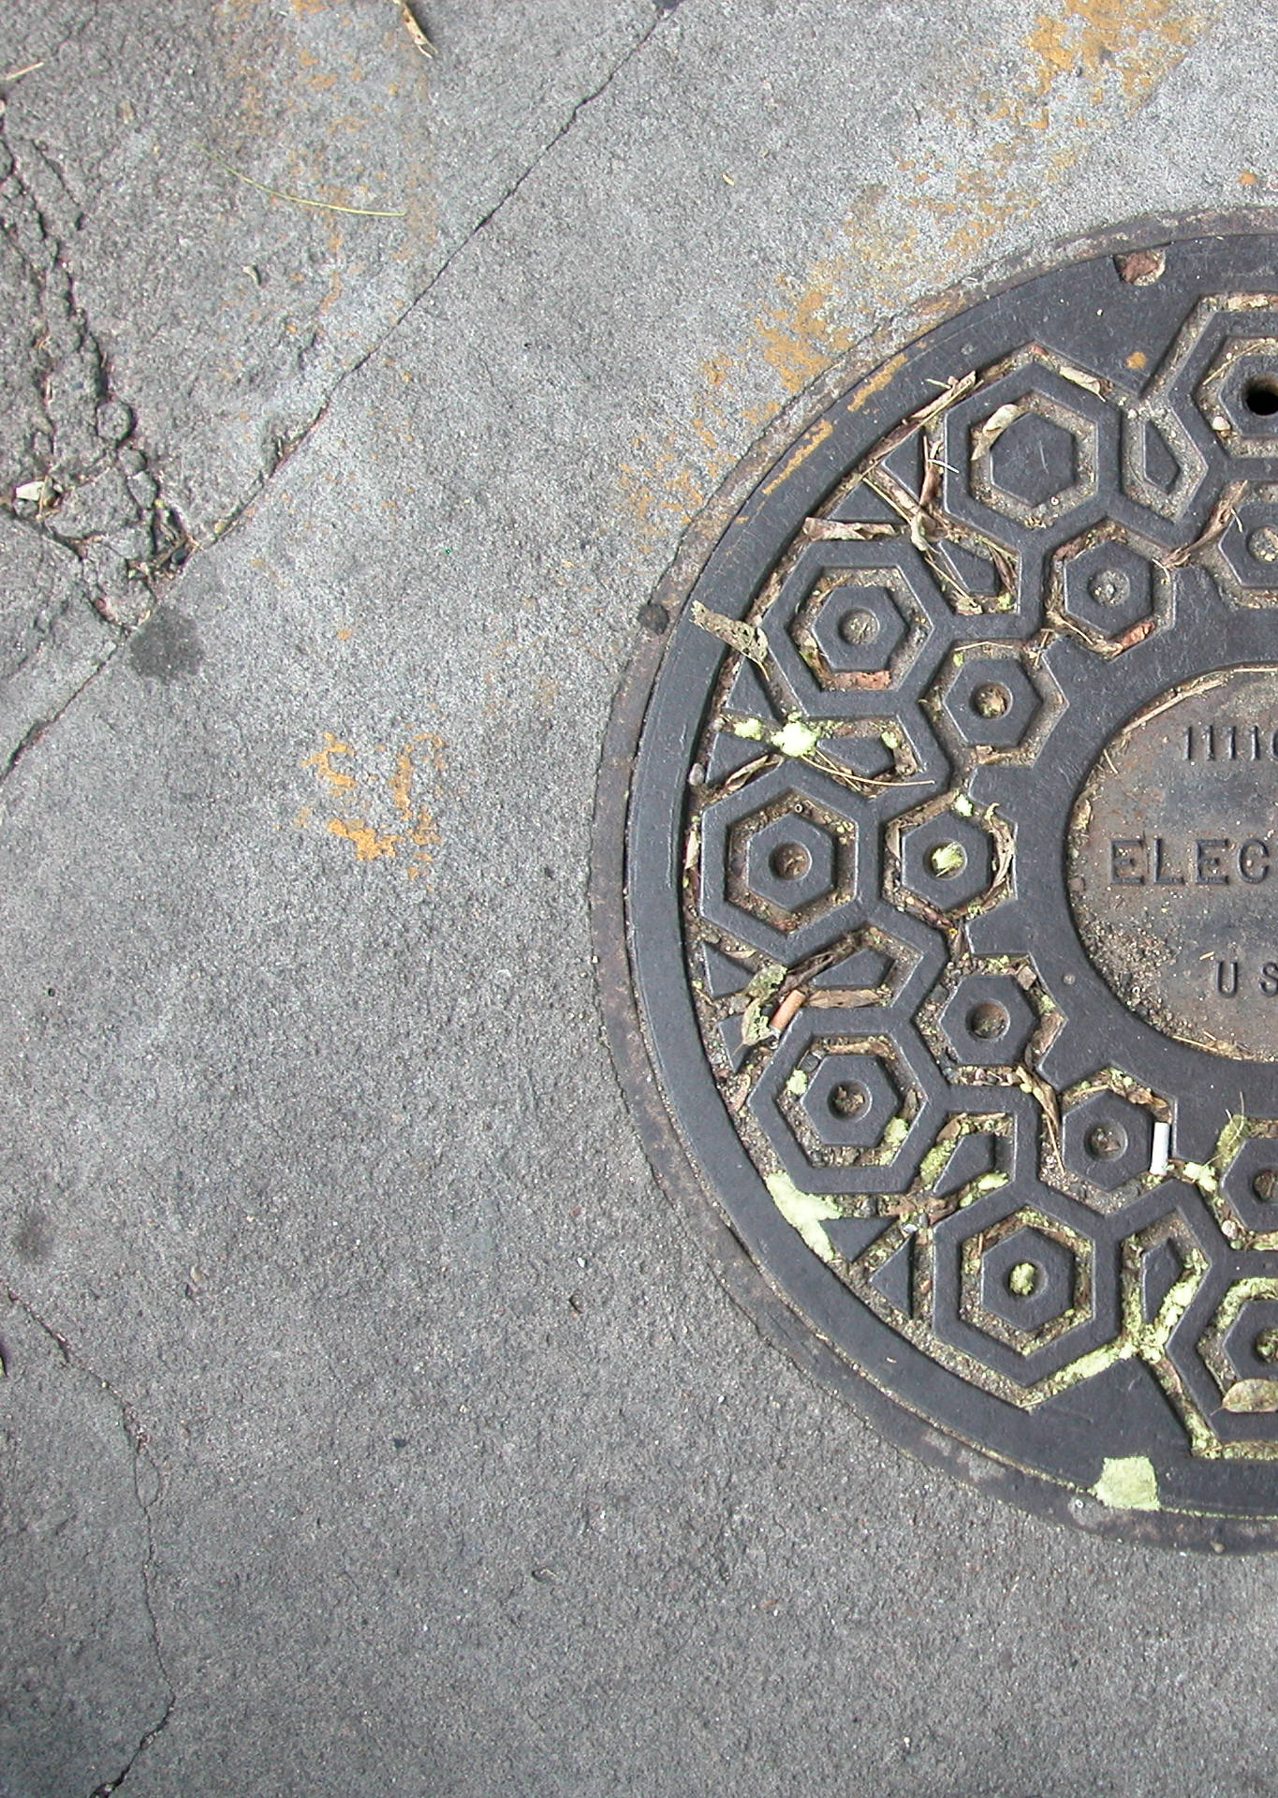
Est. 1999 Austin, Texas
Enhancing value at the utility-customer nexus
Questions?
10

