Slide 1
ERCOT Planning Overview and Summer 2014 Assessments Update
ERCOT Planning

Slide 2
Objectives
Identify the objective of the Capacity, Demand and Reserve Report (CDR)
Identify the CDR 2014 Firm Load Forecast, MW
Identify the objective of the Seasonal Assessment of Resource Adequacy (SARA)
Identify the objective of the Regional Transmission Plan (RTP)
Identify the projected congestion for 2016 and 2018 based on the 2013 RTP model simulation

Slide 3
ERCOT System Planning
ERCOT planning performs coordinated planning studies with input from NERC registered Transmission Planners (TPs), Transmission Owners (TOs) and other stakeholders to address region-wide reliability and economic transmission
Performs transmission studies/assessment (both near-term and long-term planning horizon) to meet ERCOT and NERC standards (TPL-001-004, PRC-023, FAC-013)
Assesses resource availability of existing units and future generators
Load forecasting for the near-term and long-term Planning Horizon

Slide 4
Capacity, Demand, and Reserves Report
CDR report provides an assessment of adequacy of resources for the next 10 years
Includes a load forecast which is based on an analysis of historical load growth and a forecast of future economic growth in the ERCOT region
Resource availability of known existing units
  Seasonal ratings (Summer / Winter)
  Changes in resource availability (e.g. mothball status)
  Effective load-carrying capacity for renewable energy
  Historical contribution during scarcity conditions of resources in Private-use Networks (PUNs)
Includes anticipated future resources with completed interconnection agreements and air permits (if required)

Slide 5
CDR Summer Expectations
Current target reserve margin is 13.75%

Slide 6
Wind Additions Continue
This chart shows historical and expected wind additions in ERCOT as of January 31, 2014.

Slide 7
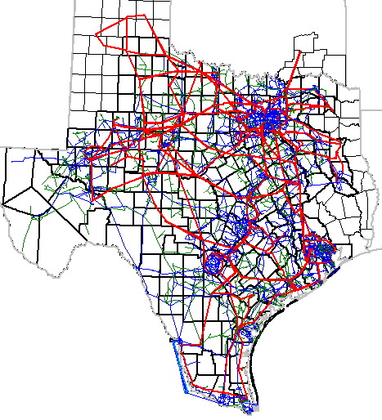
Wind Additions Continue
Much of this new wind is planned for the Panhandle region

Slide 8
Seasonal Assessment of Resource Adequacy (SARA)
  A deterministic view of near-term resource adequacy (for the next two upcoming seasons)
  Incorporates the latest available information regarding weather conditions, unit outages, and other impacts to expected loads and generation
  Illustrates a range of likely resource adequacy outcomes

Slide 9
2014 Summer SARA (Preliminary)
Item | Summer 2014 | Forecasted Season Peak Load | Extreme Load/Typical Generation Outages | Extreme Load/Extreme Generation Outages
1 | Total Resources (MW) | 74,075
2 | Peak Demand (MW) | 68,096
3 | Uses of Reserve Capacity (MW) | 2,930 | 5,243 | 8,035
4 | Capacity Available for Operating Reserves in Early Summer (1-2-3; MW) | 3,049 | 736 | -2,056
5 | Capacity Available for Operating Reserves by August 1 (1-2-3; MW) | 5,161 | 2,848 | 56
Four new units are scheduled to become commercial by August 1: Panda Sherman (720 MW), Panda Temple (717 MW), Ferguson (510 MW), and Deer Park Energy Center (165 MW)
Summer peak forecast based on average (past 12 years) weather conditions and revised load forecast methodology
Prolonged heat waves like those in 2011 are not expected
Drought conditions are not expected to create problems for power plant operations over the summer months

Slide 10
Regional Transmission Plan (RTP) - Objective
Regional Transmission Plan is developed annually by ERCOT in coordination with the RPG and the TSPs
Annual assessment to identify transmission needs of ERCOT system over next six years
Projects identified to meet the ERCOT/NERC reliability requirements (Reliability projects) and to reduce system congestion (Economic projects) that meet the ERCOT economic criteria
The RTP system upgrades identified need to be further reviewed by the appropriate TPs to determine the need for an earlier in-service year

Slide 11
2013 Regional Transmission Plan (RTP) - Process
The SSWG 2013 Data Set B 2014-2018 summer peak base cases and 2016 minimum load base case were used as start cases
    Existing generation plants and new generation (as defined in Planning Guide Section 6.9) were used in the study, with a few exceptions
    The higher of the aggregated weather zone load in the SSWG base cases or the ERCOT 90th percentile weather zone load forecast was used for the summer peak reliability portion of the analysis
    The latest SSWG ERCOT contingency list was used
    Performed Powerworld SCOPF or TARA redispatch to identify reliability issues in the 2014, 2016, and 2018 conditioned cases
    Ran generation outage analysis on 2014, 2016, and 2018 cases to screen for thermal overloads
    Using UPLAN, proposed economic projects that met the ERCOT economic criteria to solve highest congested elements

Slide 12
2013 Regional Transmission Plan (RTP) – Overview of Results
Pronounced impact of resource availability on transmission planning
Significant increase in total number of system improvements identified
Large number of unresolved reliability issues for 2014

Slide 13
New ERCOT Planning Criteria
PGRR025 – Criteria for autotransformer unavailability
PGRR031 – Implements 95% facility rating limit in the planning criteria
PGRR018 – Adds financial commitment and notice to proceed with construction as prerequisites for adding new generation resource to planning models

Slide 14
2013 RTP – Reliability Projects
The 2013 RTP identified 104 reliability improvements in the ERCOT transmission network – 30 projects in the Dallas area, 7 in the Houston area, 8 in the Austin/San Antonio area
Map Index | Reliability Project | In-service Year
1 | A new 345/138-kV autotransformer at Fowlerton | 2014
2 | A new 345/138-kV autotransformer at Lavon | 2016
3 | A new 345/138-kV autotransformer at Jack County Substation | 2016
4 | CPS Northeast Switchyard project - New 345 kV interconnection between CPS and LCRA TSC | 2016
5 | A new second 345/138-kV autotransformer at Lobo | 2016
6 | Katy Area upgrades with Zenith 345/138-kV autotransformer | 2018
7 | Midland Area Upgrades – Two new 345/138 kV switching stations and a new 138 kV line to Midessa | 2018

Slide 15
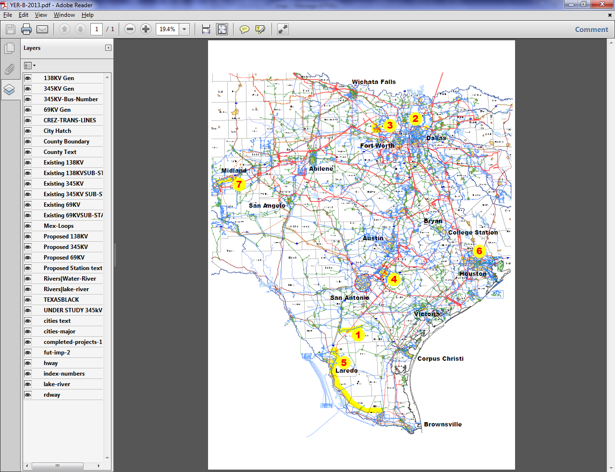
2013 RTP – Reliability Projects

Slide 16
2013 RTP – Remaining congestion
The table below shows the constraints projected to be the most congested for 2016 and 2018 based on model simulation.
Map Index | Projected Constraining Element | 2016 Congestion | 2018 Congestion
1 | Cico – Comfort 138 kV line
2 | Dupont Switch - Dupont PP-1 (Ingleside) 138 kV line
3 | Hamilton Road – Maverick 138 kV line
4 | Jack Creek - Twin Oak 345 kV line
5 | Kendall - Highway 46 West 345 kV line
6 | Kiamichi Energy - Kiowa Switch 345 kV line
7 | Morris Dido - Eagle Mountain 138 kV line
8 | Randolph Field – Weiderstein 138 kV line
9 | Rincon – Bonnieview 69 kV line
10 | River Oaks - Highway 46 West 138 kV line
11 | Singleton – Zenith 345 kV line
12 | Wolfgang – Rotan 69 kV line
Congestion Color Key
 | None
 | Low
 | Medium
 | High

Slide 17
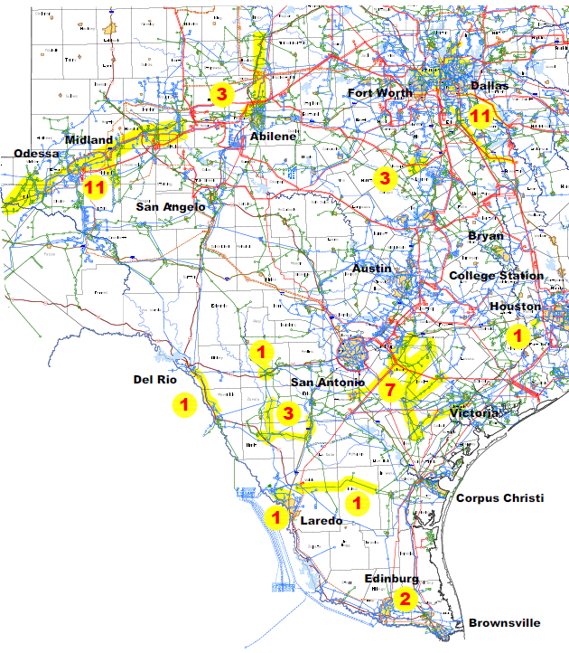
2013 RTP – 2014 Reliability Issues that Need Mitigation Plans

Slide 18
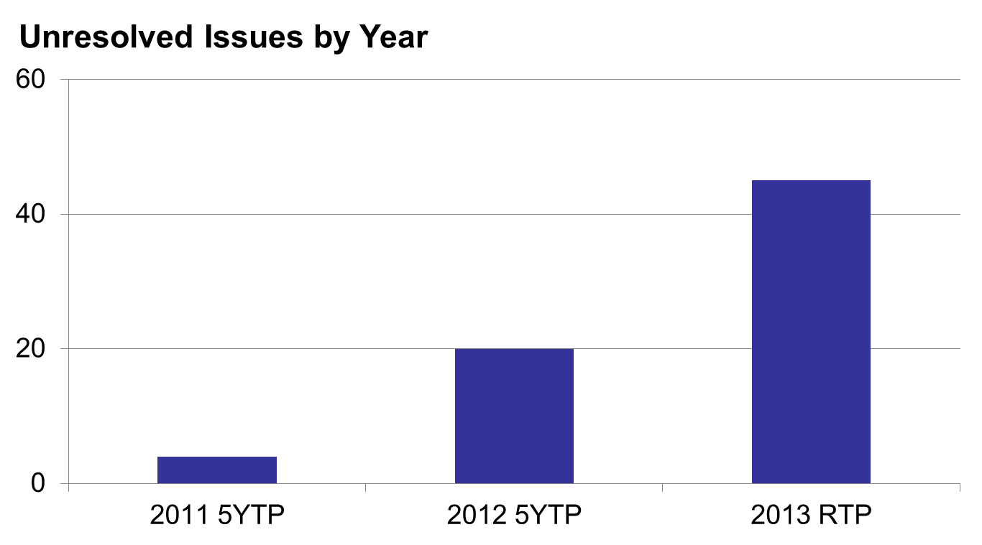
Comparison of Number of Unresolved Issues

Slide 19
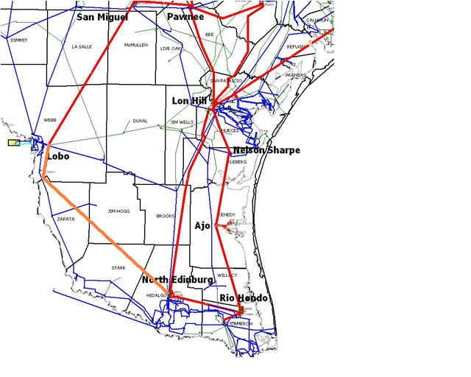
Lower Rio Grande Valley Project
Driver – Reliability need in 2016
Project Components
  Lobo-Rio Bravo-N. Edinburg 163 mile single circuit 345 kV line on double circuit structures with 50% series compensation
  Energized reconductor of Lon Hill-N. Edinburg and Lon Hill-Rio Hondo 345 kV lines
  Reconfigure N. Edinburg and Rio Hondo series capacitors
Cost Estimate - $527 million
Expected in-service - 2016

Slide 20
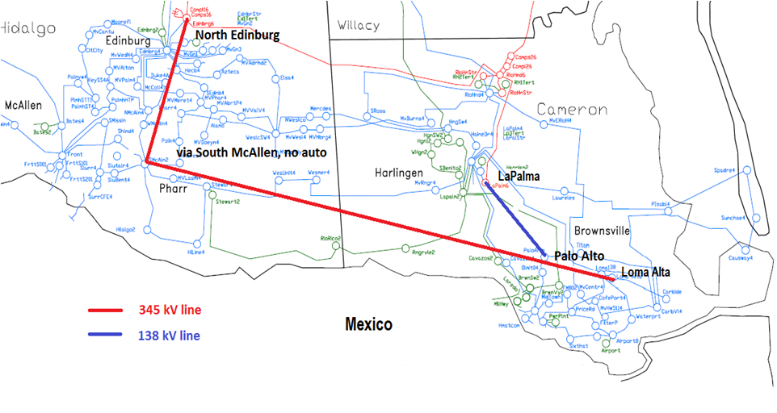
Cross Valley 345 kV Project
Driver – Reliability need in 2016
Project Components
  La Palma-Palo Alto 138 kV line (~12 miles)
  North Edinburg-Loma Alta 345 kV line (double circuit capable with one circuit in place) routed in proximity to the existing South McAllen Substation (~106 miles )
  345kV bus at the Loma Alta station with one 345/138kV autotransformer
Cost Estimate - $274 million
Expected in-service - 2016

Slide 21
Houston Import Project
Driver – Reliability need in 2018
Project Components
  Construction of a new Limestone-Gibbons Creek-Zenith 345 kV double circuit (~130 miles)
  Upgrade of the stations at Limestone, Gibbons Creek and Zenith
  Upgrade of the existing T.H. Wharton – Addicks 345 kV line
Cost Estimate - $590 million
Expected in-service - 2018

Slide 22
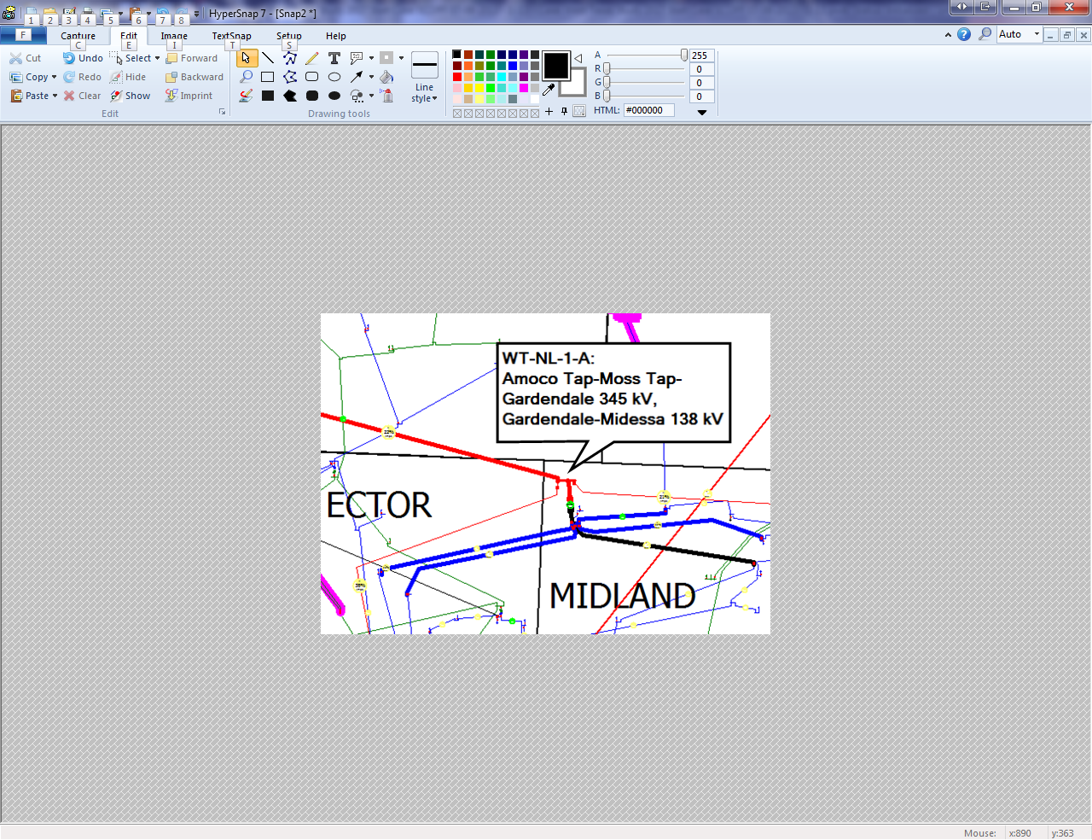
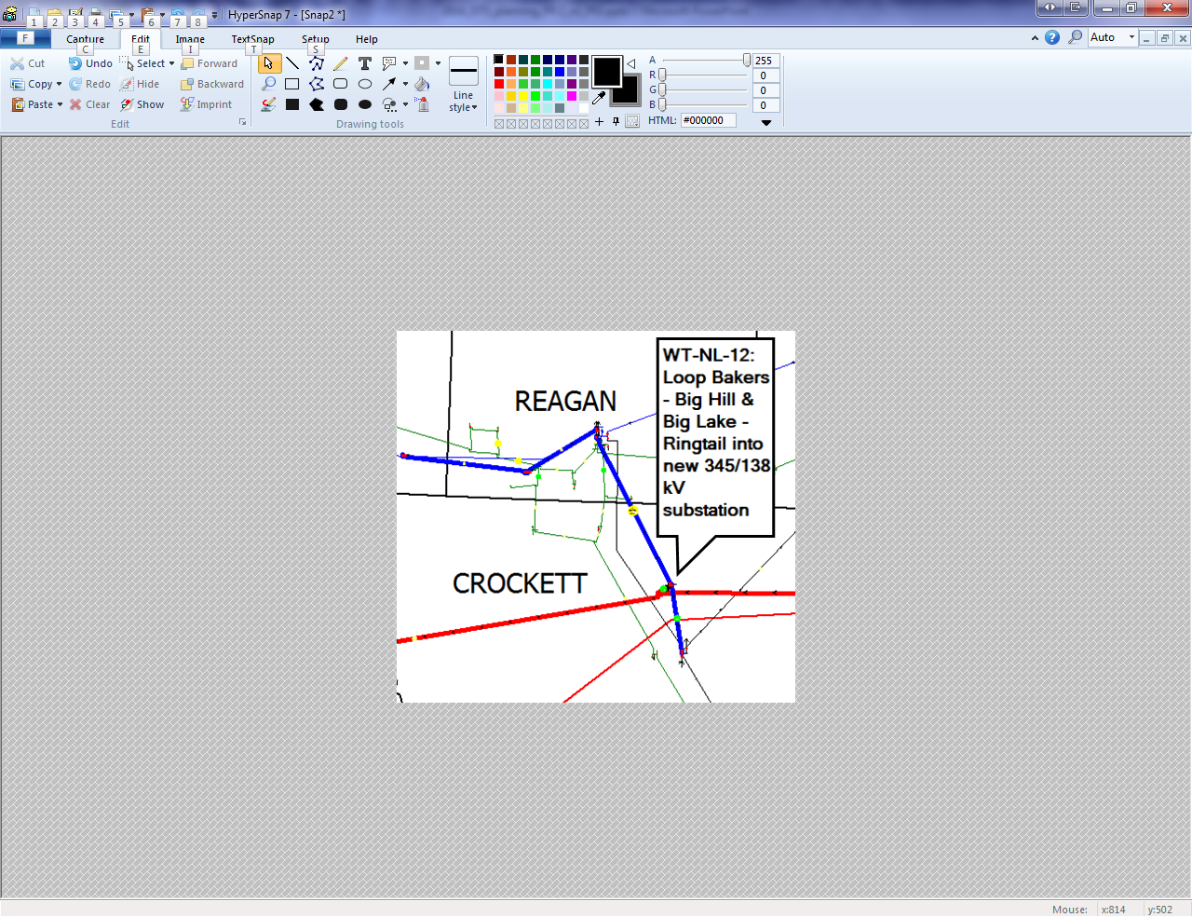
West Texas Study
ERCOT identified more than 60 reliability projects needed over the next four years to meet the projected oil and natural gas load growth in west Texas

Slide 23
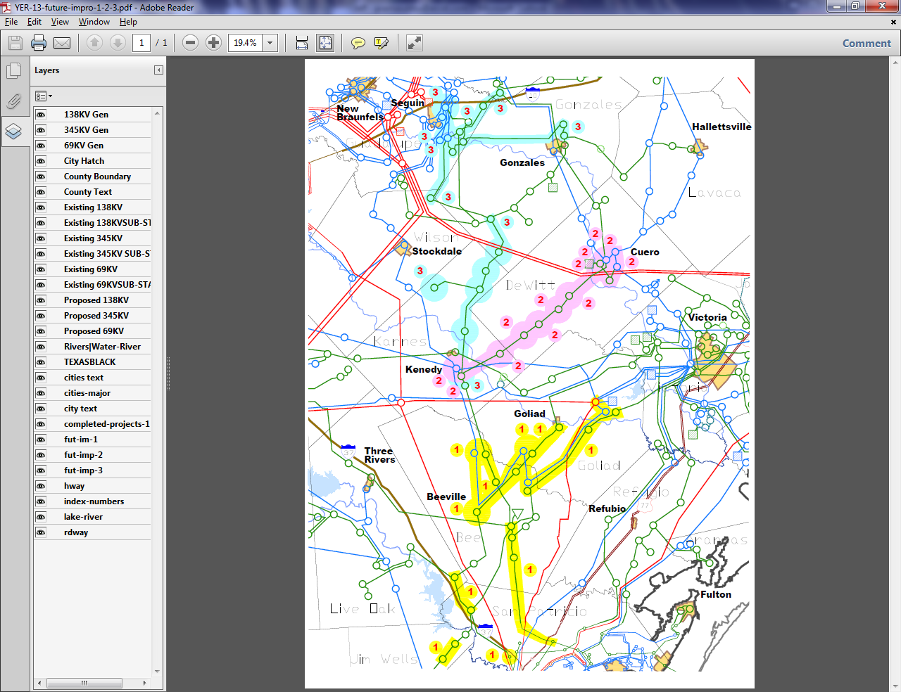
Eagle Ford Shale Oil and Natural Gas Related Projects
Driver – Reliability need between 2013 and 2016
Project Components
  Sinton – Beeville – Kenedy Area Improvements Project (2013-2016)
  Kenedy Switch – Guadalupe Project (2015)
  Kenedy Switch – Nixon – Seguin upgrade and conversion from 69 kV to 138 kV service (2016)
Cost Estimate for 3 additional projects - $178.4 million
Expected in-service – 2013-2016

Slide 24
Overview
Resource adequacy heavily impacts outcome of planning studies
Remaining unresolved reliability issues in 2014
System improvements triggered by oil and gas related load growth
New ERCOT planning criteria provide larger safety margin for system reliability

Slide 25
Questions
?
?

Slide 26
The CDR report provides an __________ of __________ of resources for the next ten years.
assessment
adequacy
reliability
both a and b
both b and c

Slide 27
The CDR 2014 Firm Load Forecast, MW is _______________.
67592
69020
66179
66900

Slide 28
SARA provides a deterministic view of near-term resource adequacy (for the next ______ upcoming seasons)
two
three
four
six

Slide 29
One of the purposes of the Regional Transmission Plan is an annual assessment to identify transmission needs of ERCOT system over next _______ years.
four
six
seven
ten

Slide 30
One of the RTP constraints projected to be high congested for 2016 is _______________.
Cico – Comfort 138kV line
Hamilton Road – Maverick 138kV line
Kendall – Highway 46 West 345kV line
Morris Dido – Eagle Mountain 138kV line

