Slide 1
State Operations Center
Dede Powell
State Coordinator for Operations
Texas Division of Emergency Management

Slide 2
Terminal Objectives
Identify daily operations activities of the State Emergency Operations Center.
Identify the State Management Team (SMT) daily activities.
Identify the weather response of the Emergency Management Council (EMC).
Identify the State Operations Center (SOC) responses to an ERCOT declared EEA 2.
Identify the State Operations Center (SOC) responses to an ERCOT black start.

Slide 3
TDEM ORGANIZATION
Assistant Director
Chief Nim Kidd
Deputy Assistant Director
Response
Tom Polonis
Deputy Assistant Director
Finance
Shari Ramirez-MacKay
Deputy Assistant Director
Support Services
Sandra Fulenwider
Deputy Assistant Director
Recovery, Mitigation & Standards
Paula Logan
Operations
Grants
Contracts
Recovery
State Management Team
State Disaster Reimbursement
Procurement
Mitigation
Standards
Preparedness
Critical Information Systems
Field Response
Mike Miller
Chief of Staff
Lauren Allen

Slide 4
RESPONSE
Deputy Assistant Director
Tom Polonis
State Coordinator for Operations
Dede Powell
State Coordinator for Preparedness
Chuck Phinney
Operations Section
Preparedness Section
Operations Section Coordinator
Major Patrick Mulligan
State Coordinator for Critical Information Systems
Jeff Newbold
State Management Team
CIS Section

Slide 5
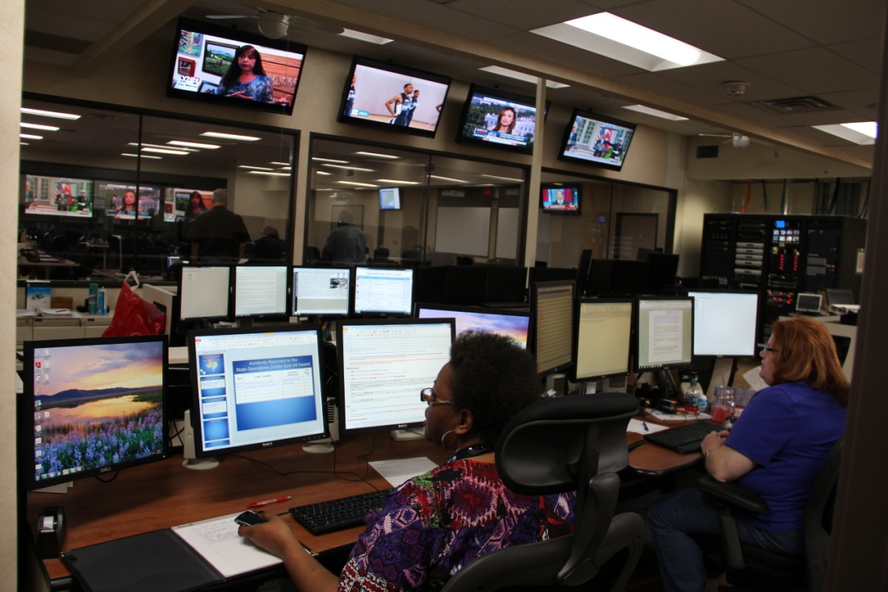
DAILY OPERATIONS CENTER
State Coordinator for Operations
Dede Powell
Operations Section Administrator
Gisela Ryan-Bunger
Day Watch Supervisor
Linda Moorer
Evening Watch Supervisor
Karl Schumacher
Midnight Watch Supervisor
Bob Harrell
Technical Operations Officers
Technical Operations Officers
Technical Operations Officers

Slide 6
DAILY OPERATIONS ACTIVITIES
Operates 24/7
State Warning Point
Coordinates assistance to local governments
Missing Alerts (Amber, Silver, Endangered Missing, Blue)
Maintain situational awareness
Situation Reports

Slide 7
STATE MANAGEMENT TEAM
Operations Section Coordinator
Major Patrick Mulligan
Deputy Operations Coordinator
Captain Rhonda Lawson
Mass Care Coordinator
Larry Shine
Volunteer Agency Liaison
Anna Tangredi
Emergency Plans Section Coordinator
Marty Penney
Logistics Section Coordinator
Wade Parks
Finance Section Coordinator
Eric Shuey
PWRT Coordinator
Darrick Hesson
Deputy Logistics Section Coordinator
Ken Bodisch
Resource Staging Area Manager
Frank Gaitan

Slide 8
SMT DAILY ACTIVITIES
Develops policies and standard operating guidelines
Maintains contingency contracts
Coordinates preparedness activities
Emergency Management Council
Mass care and volunteer organizations
DPS Disaster Districts
Activities to prepare for response

Slide 9
EMERGENCY READINESS AND RESPONSE LEVELS
Level 4 – Normal Conditions (ERCOT EEA 1, 2, 3)
Level 3 – Increased Readiness Conditions (ERCOT EEA 1, 2, 3)
Higher than normal readiness warranted due to increased vulnerability to a specific hazard.
Level 2 - Escalated Response Conditions (ERCOT EEA 3)
Scope of emergency situation has expanded beyond that which can be managed by local responders.
Emergency Management Council may partially activate.
Level 1 – Emergency Conditions (ERCOT EEA 3, 4)
Scope of incident has expanded beyond the response capability of local agencies.
EMC and affected Disaster District Committees are fully activated.

Slide 10
REQUESTING ASSISTANCE

Slide 11
Emergency Management council (emc)
SOC Activation
DPS Asst. Dir
SOC Manager
Deputy SOC Manager
Operations
Section
Plans
Section
Logistics Section
Finance Section
Emergency Svc. Branch (TFS)
Infrastructure
Branch (TxDOT)
Human Svc.
Branch (DSHS)
Military
Branch
Mass Care

Slide 12
Emergency Management council (emc)
SOC Activation
FEMA
LIAISON
SOC MANAGER
CRITICAL
Information
Systems
INTEL
LIAISON
SAFETY
DEPUTY SOC
MANAGER
SOC MANAGER
ASSISTANT
SOC DAILY
OPERATIONS
WEBEOC
DISPLAY
OPERATIONS
SECTION
COORDINATOR
(OSC)
DEPUTY OPS
SECTION
COORDINATOR
PLANS SECTION
COORDINATOR
(PSC)
LOGISTICS
SECTION
COORDINATOR
(LSC)
DEPUTY
LOGISTICS
COORDINATOR
FINANCE
SECTION
COORDINATOR
DEPUTY PLANS
COORDINATOR
EMERGENCY
SERVICES
BRANCH
INFRASTRUCTURE
BRANCH
HUMAN
SERVICES
BRANCH
MILITARY
BRANCH
RESOURCE UNIT
LEADER
CHECK IN
INTAKE
VETTERS
TIME UNIT
TFS
PUC
MEDICAL
SERVICES
SUPPORT
SERVICES
SITUATION UNIT
LEADER
RECOVERY
UNIT
WAREHOUSE
PROCUREMENT
MASS CARE
TX TF1
TXDOT
DOCUMENTATION
PRIVATE
SECTOR
BUSES
DPS
PROCUREMENT
TDI
HHSC
DSHS
TDHCA
EMERGENCY
FUEL
TPWD
DEMOBILIZATION
UNIT LEADER
TPASS
DIR
ETN
DADS
(SMOC)
DFPS
RESOURCE
TRACKER
TXDPS
CCG
COST UNIT
LEADER
211
DARS
(SMOC)
TWC
NATIONAL WEATHER
SERVICE (NWS)
FOOD UNIT
CAP
TCEQ
TAHC
STATE
AUDITOR’S
OFFICE
PWRT
TDA
HURRICANE
PLANNER
SUPPLY UNIT
OAG
RRC
ARC
TEA
COMPLIANCE
AND
REVIEW
TDCJ LE
UT/CSR
&
GIS
FEMA
LOGISTICS
GLO
TSA
OCA
CIKR
TDCJ
FUEL
GROUP
USACE

Slide 13
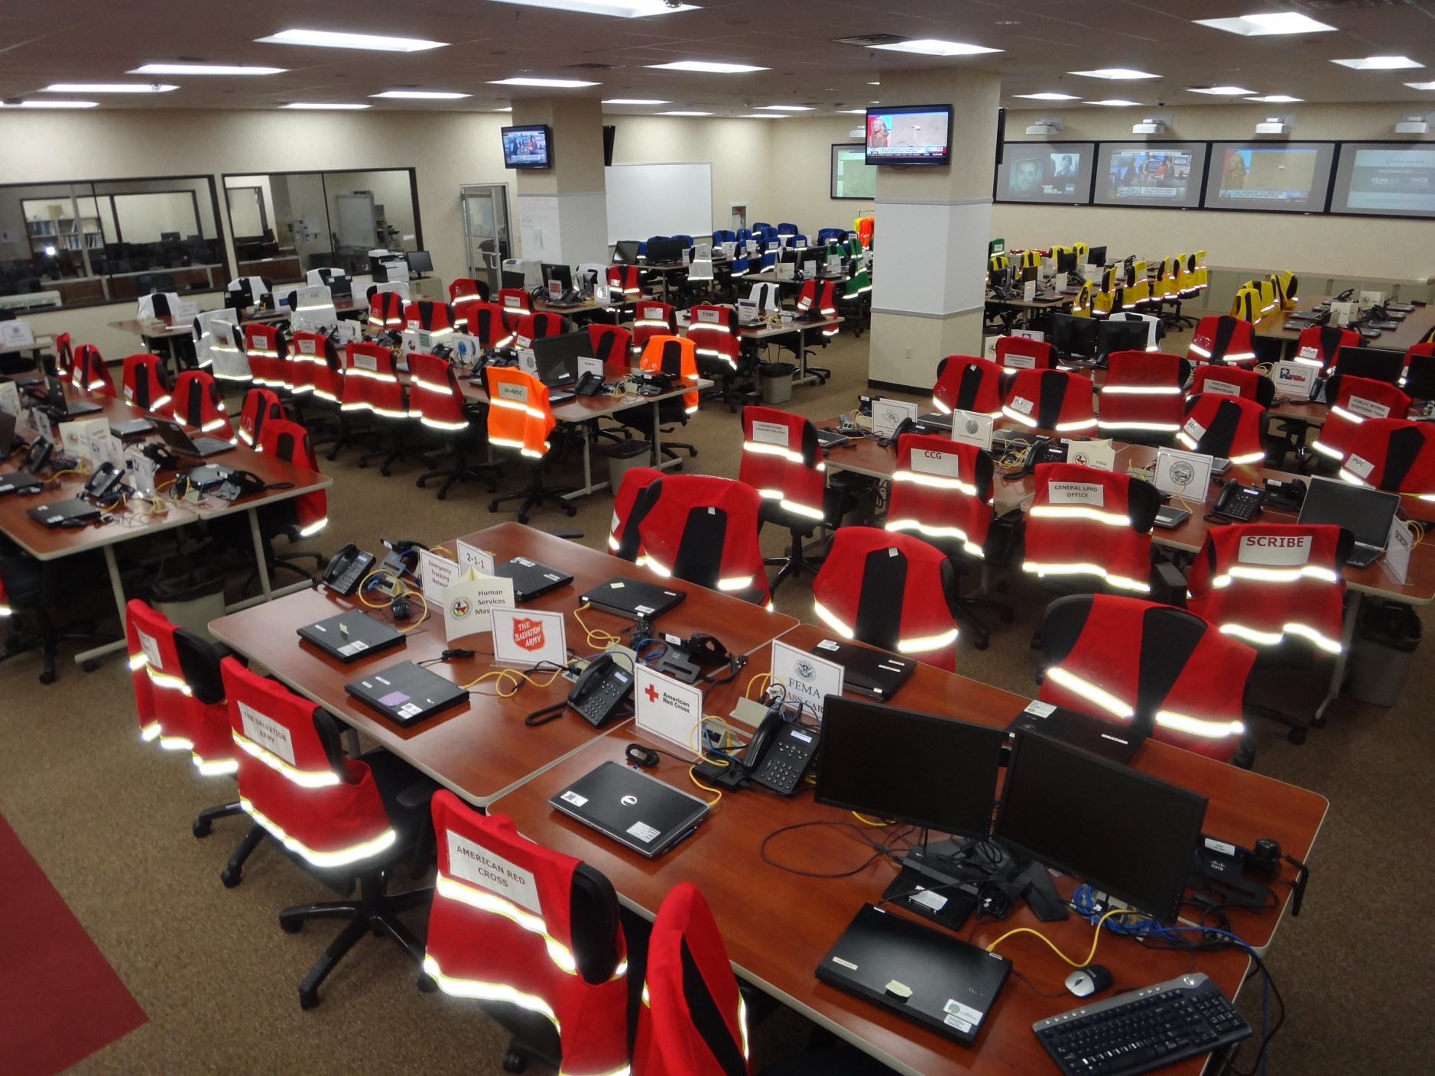

Slide 14
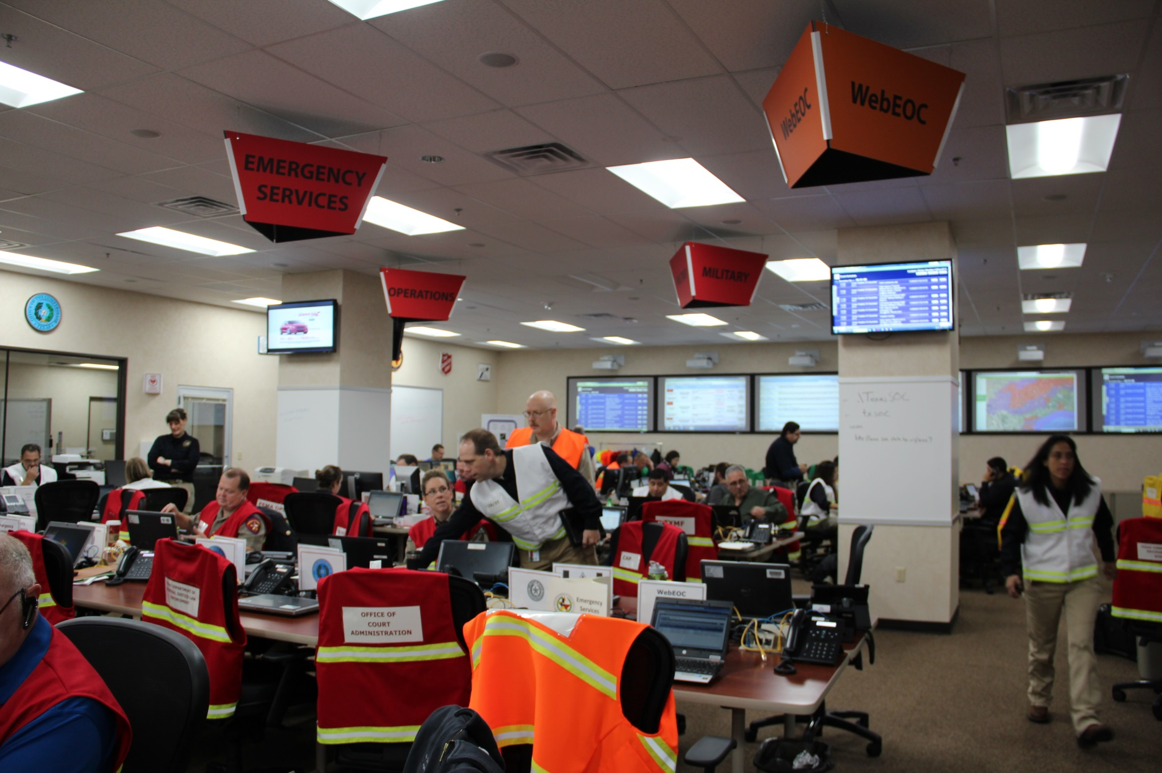
STATE OPERATIONS CENTER RESPONSE

Slide 15
EMERGENCY MANAGEMENT COUNCIL
EMC Organization
32 State Agencies, 2 Volunteer Organizations
TDEM Staff supplements and supports
Uses the National Incident Command Structure
Activated for a response to emergency incident or disaster response event
May be partially activated or in its entirety for a major event

Slide 16
EMC ACTIVITIES
Provides assistance as requested to local governments to respond to emergency incidents that are beyond their capabilities including:
Equipment
Personnel
Teams (Search and Rescue (SAR), Incident Management Teams (IMT))
Subject Matter Expertise
FEMA assistance (if Federal Disaster Declaration)

Slide 17
SOC RESPONSE TO ENERGY EMERGENCY ALERTS
EEA 1 – Power Watch
Situational Awareness
Forward press releases
EEA 2 – Power Watch
Situational Awareness
Forward press releases
Coordination with District Coordinators/local governments as necessary

Slide 18
SOC RESPONSE TO ENERGY EMERGENCY ALERTS
EEA – 3 – Energy Emergency
Situational Awareness
May conduct conference calls
Forward press releases
Coordination with District Coordinators/local governments as necessary
Coordinate with energy providers on local government priorities as requested
Provided assistance on critical needs as necessary

Slide 19
SOC RESPONSE TO BLACK START
Dependent upon situation
Activation of EMC
Coordination with local governments on critical needs
Generators
Evacuations
Shelters
Equipment/personnel
Other assets as requested

Slide 20
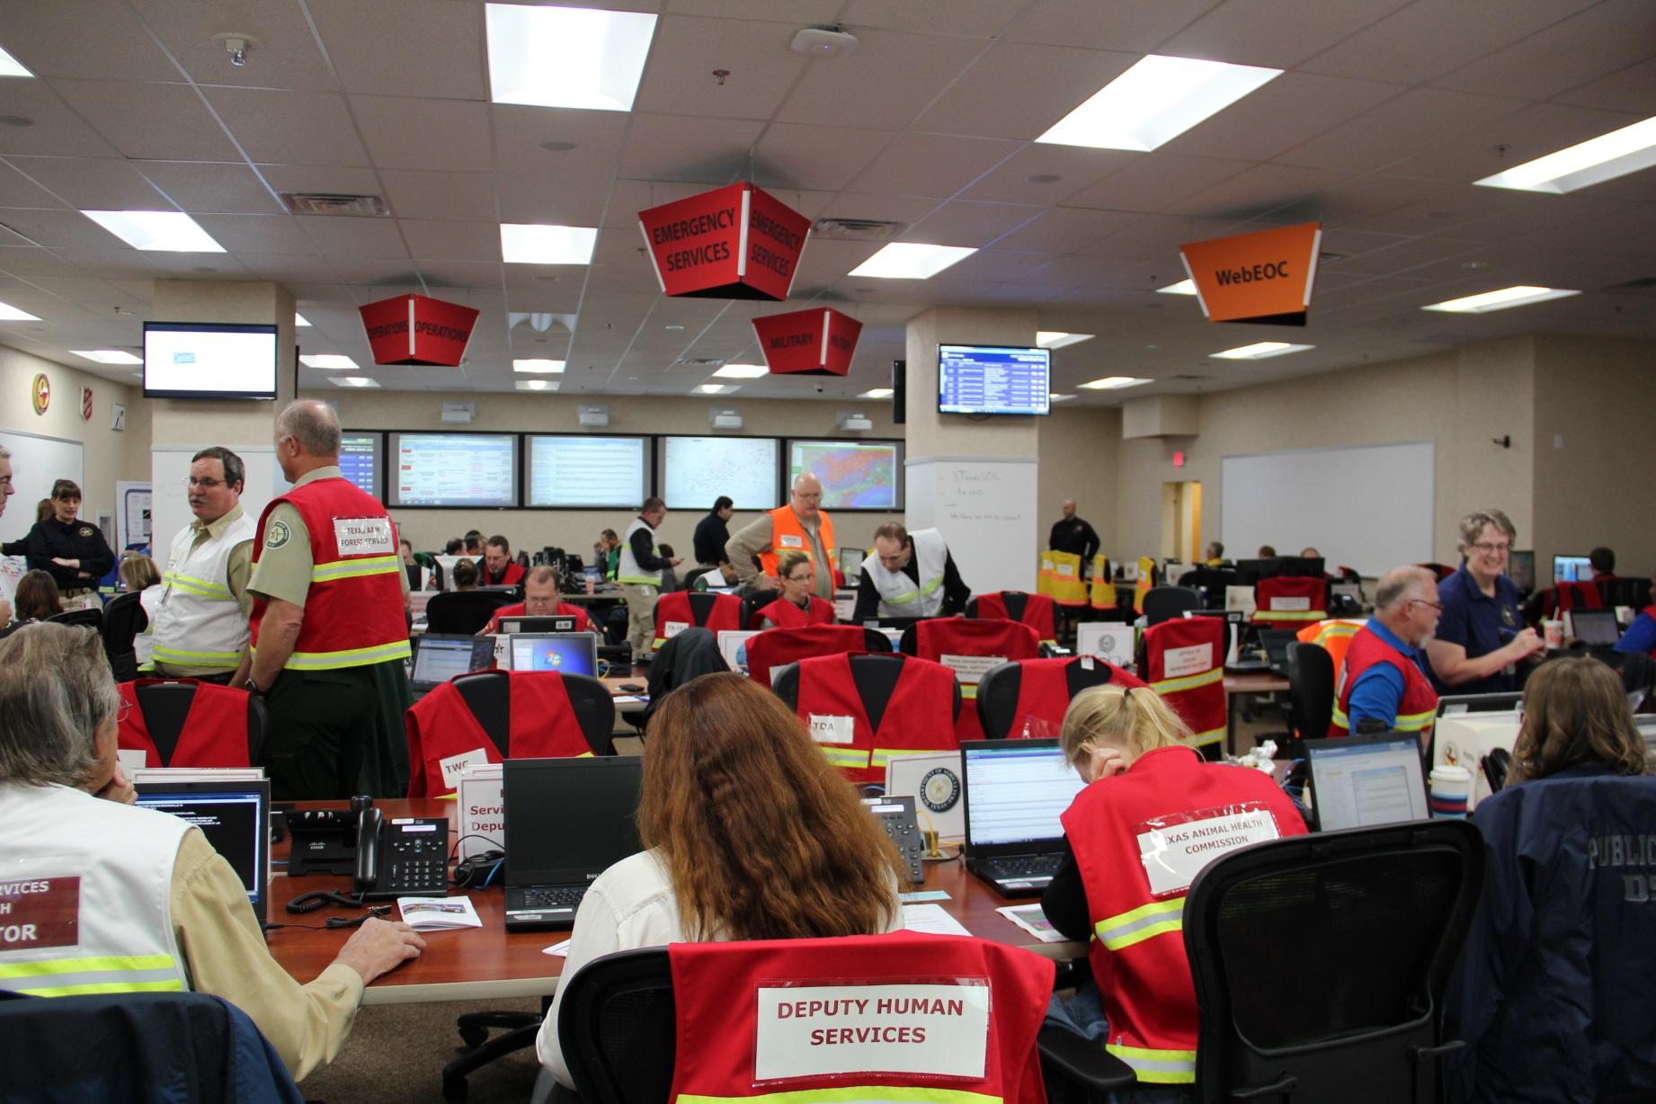
Questions?

Slide 21
Daily operations activities of the State Operations Center includes:
State warning point
Coordinates assistance to local governments
Hope for the best
Both a and b

Slide 22
The State Management Team (SMT) daily activities include:
Maintains contingency contracts
Coordinates preparedness activities
Both a and b
None of the above

Slide 23
The Emergency Management Council (EMC) provides assistance to local governments (as requested) for ?
Equipment
Personnel
Subject matter experts
All of the above

Slide 24
One of the State Operation Center’s (SOC) responses to an ERCOT declared EEA 2 is:
Call the ERCOT control room
Forward press releases
Turn off SOC lights
Shed their load

Slide 25
One of the State Operation Center’s (SOC) responses to an ERCOT black start is ?
Activation of the EMC
Assessment of the ERCOT grid
Call ERCOT control room as to the cause
Keeping the lights on at the Capital

