Slide 1
IMPACT TO FREQUENCY CONTROL DURING STARTUP AND SHUT DOWN OF UNITS
Sandip Sharma
ERCOT Operations Analysis

Slide 2
Introduction
This presentation is intended to explain ERCOT’s expectation of the Resource Entities and QSEs during start-up and shut-down of the units based on the ERCOT Protocol, Operating Guides and Business Practice manual.
Due to improper start-up and shut-down at the individual Resource level, there have been performance issues and Base Point Deviation Charges.
At the system level, ERCOT has experienced frequency deviations and exhaustion of regulating reserves.

Slide 3
Objectives
At the completion of this course of instruction you will:
Identify the QSE’s responsibilities during Startup and Shutdown.
Identify the correct sequence of generation resource Startup.
Identify the correct sequence of generation resource Shutdown.
Identify the impact on ERCOT Grid Operations of improper start-up or shut-down of units.
Identify the impact on ERCOT Market Operations of improper start-up or shut-down of units.

Slide 4
Agenda
Definitions
Resource Status
QSEs responsibility during Start-up
Start-up Sequence
Start-up issues
QSEs responsibility during Shut-Down
Shutdown issues
Other observed issues
Questions

Slide 5
Definitions
STARTUP – The Resource is On-Line and in a start-up sequence and has no Ancillary Service Obligations. This Resource Status is only to be used for Real-Time telemetry purposes;
SHUTDOWN – The Resource is On-Line and in a shut-down sequence, and has no Ancillary Service Obligations. This Resource Status is only to be used for Real-Time telemetry purposes;
GREDP – Generation Resource Energy Deployment Performance
SCED – Security Constrained Economic Dispatch
RLC – Resource Limit Calculator
LSL – Low Sustained Limit
HSL – High Sustained Limit
NURR – Normal Up-Ramp Rate
NDRR – Normal Down-Ramp Rate
BP – Base Point

Slide 6
Resource Status
Startup and Shutdown Status
  STARTUP – 16
  SHUTDOWN - 15
Online Status
  ONRUC – 1 (hour is RUC-committed interval)
  ONREG – 2 (with energy offer curve and providing regulation)
  ON – 3 (online with energy offer curve)
  ONDSR – 4 (dynamically scheduled resources)
  ONOS – 5 (with output schedule)
  ONOSREG – 6 (with output schedule providing regulation)
  ONDSRREG – 7 (dynamically scheduled resource providing regulation)
  ONOPTOUT – 18 (online and the hour is a RUC buy back hour)
Offline Status
  OUT – 11 (offline and unavailable)
  OFFNS – 12 (reserved for offline non-spinning)
  OFF – 13 (offline but available)

Slide 7
QSE’s Responsibility During Start-up
Once the generator breaker is closed, QSE must change telemetered Resource Status to STARTUP from OFF. This should be done about a minute prior to SCED run.
The QSE should telemeter a Normal Up Ramp Rate value to ERCOT that reflects the MW per minute rate at which the QSE anticipates bringing the Resource On-Line.
  Low Sustained Limit (LSL) and High Sustained Limit (HSL) should reflect the true capabilities of the Resource (In other words, don’t mess with them)
ERCOT does not expect the telemetered Ramp Rate value will be exactly correct, but the QSE should update the ramp rate as often as needed during the start-up process to provide a reasonable estimation

Slide 8
Start-up Sequence
The QSE should align bringing the Resource On-Line after a SCED execution, which takes into consideration the STARTUP status.
RLC will calculate Low Dispatch Limit (LDL) as the telemetered real power output plus the five-minute ramping capability of the Resources.
RLC will set the High Dispatch Limit (HDL) equal to the Low Dispatch Limit (LDL)

Slide 9
Start-up Sequence
When SCED observes Resource Status of STARTUP, SCED will issue a Base Point equal to LDL which is equal the current telemetered net real power plus five times normal ramp rate of the Resource
During periods in which the Resource has a telemetered Resource Status of STARTUP, the QSE is exempt from GREDP scoring and Base Point deviation charges.
Once the Resource has reached a stable operating condition and is ready to be dispatched normally by SCED, the QSE should change the Resource Status to an appropriate online status and begin responding directly to ERCOT dispatch instructions.

Slide 10
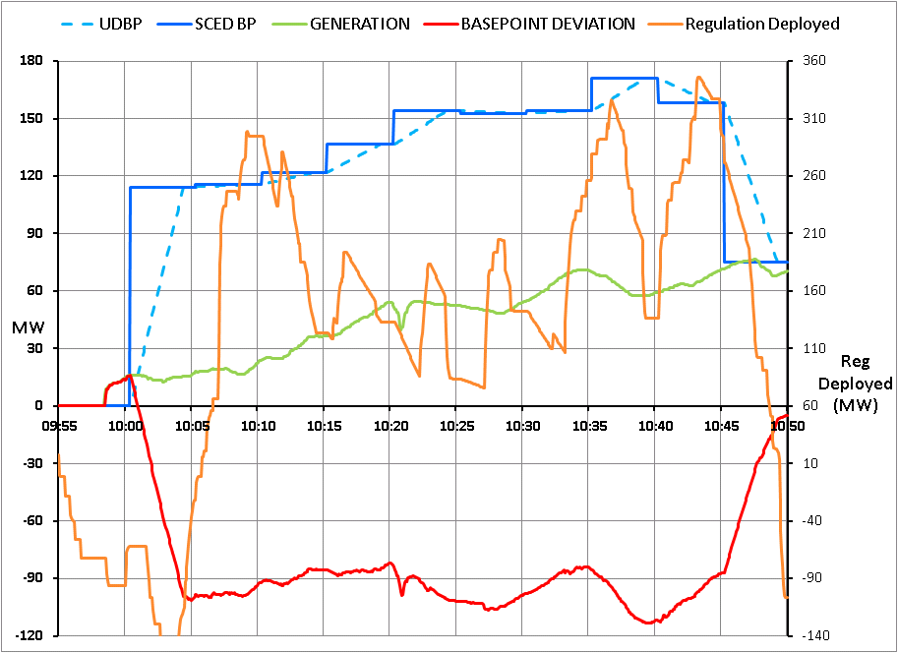
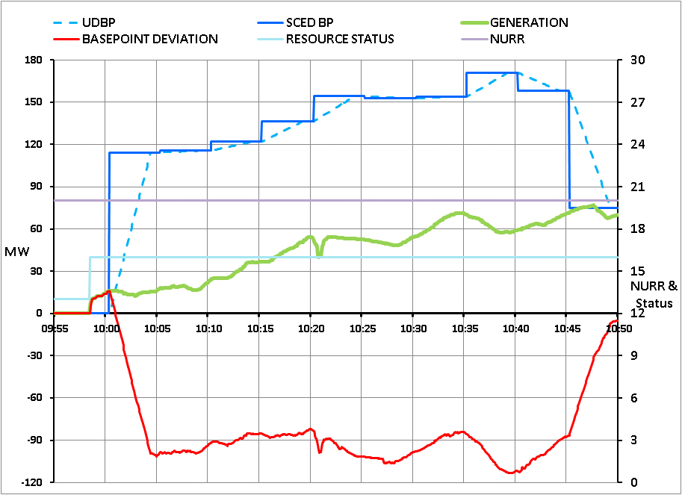
Observed Issues
#1. Too high NURR during start-up

Slide 11
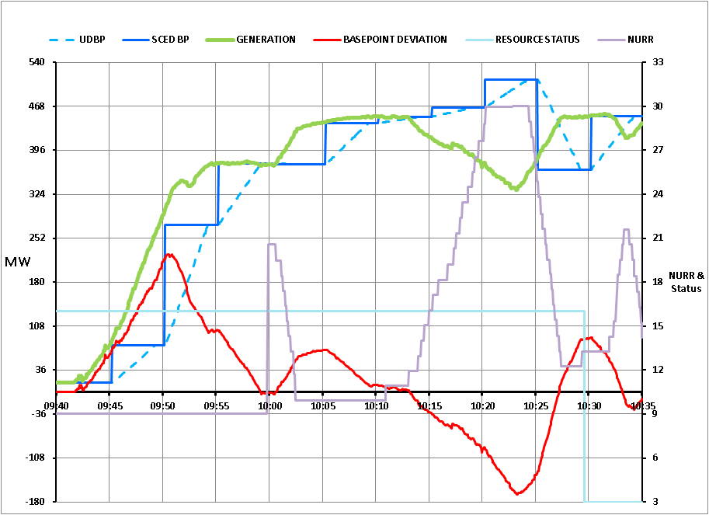
Observed Issues
#2. Too Low NURR during start-up

Slide 12
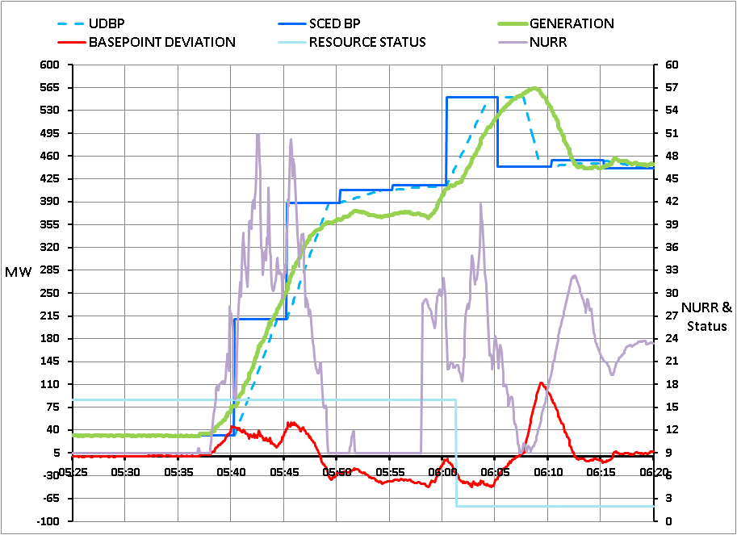
CORRECT STARTUP SEQUENCE

Slide 13
QSEs Responsibility During Shut-Down
The QSE will initiate the shut-down sequence by changing the Resource status to SHUTDOWN
The QSE should telemeter a Normal Down Ramp Rate value to ERCOT that reflects the MW per minute rate at which the QSE anticipates bringing the Resource Off-Line
  The QSE should not begin taking the Resource Off-Line until a SCED execution has completed taking into consideration the SHUTDOWN status.

Slide 14
Shut-Down Sequence
RLC will calculate HDL as the telemetered real power output minus the five-minute ramping capability
RLC will set the Low Dispatch Limit (LDL) equal to the High Dispatch Limit (HDL)
SCED will issue Base Points equal to the HDL and ramp the resource smoothly down to a Base Point of zero

Slide 15
Shut-Down Sequence
During the shut-down process when the Base Points issued by SCED is above the Resource’s telemetered LSL, the QSE must follow the Base Point instructions issued by SCED
For periods in which the SCED Base Point is below the telemetered LSL, the QSE is exempt from Generation GREDP scoring and Base Point deviation charges
Once the Resource has reached a real power output level of zero and the generator breaker has been opened, the QSE will change the telemetered Resource Status to an appropriate offline status

Slide 16
Observed Issues
#1. NDRR not updated accurately during shut-down

Slide 17
Observed Issues
#2 Improper sequence of shut-down

Slide 18
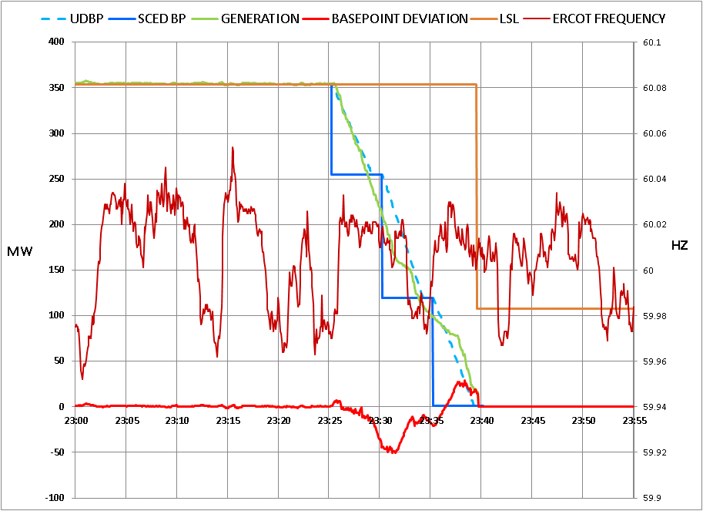
CORRECT SHUTDOWN SEQUENCE

Slide 19
Other Observed Issues
NURR/NDRR telemetry is correct but it is outside the RARF reasonability limit
For temporary limitations like configuration change, activation of power augmentation, start second boiler feed-pump, etc.
  Resource HSLs are not updated to reflect temporary limitations
  SCED continuously dispatches these Resources economically
  While SCED dispatches these Resources with temporary limits higher, SCED is also dispatching other more expensive generator lower. This has market impact as well as affects grid frequency and leads to exhaustion of regulation-up service.
  The impact of these large deviations are similar to what were discussed with Startup and Shutdown
¹For additional details on expected actions from a QSE, please see “ERCOT and QSE Operations Practices During the Operating Hour” Section 3.2 Generation Resource Power Operation. (http://www.ercot.com/content/mktrules/bpm/BP%20ERCOT%20And%20QSE%20Operations%20Practices_v5%205.doc )

Slide 20
Temporary Limitations without AS
Into duct firing mode

Slide 21
Temporary Limitations with AS
Into duct firing mode

Slide 22
Summary
Improper start-up and shut-down impacts Grid Frequency, leads to exhaustion of regulation service and has market impacts
What RLC and SCED expects during Start-Up and Shut-Down of units were explained
Proper sequence of start-up and shut-down were explained

Slide 23
Questions
?
?

Slide 24
1. The QSE’s responsibilities during Startup include:
about a minute before a SCED run, change Resource Status from OFF to STARTUP
calculate Low Dispatch Limit (LDL)
set the High Dispatch Limit (HDL) equal to the Low Dispatch Limit (LDL)
issue a Base Point equal to LDL which is equal the current telemetered net real power

Slide 25
When SCED observes a Resource Status of STARTUP on a unit:
It will issue a Base Point equal to LDL which is equal to current output plus 5 times NURR.
It will issue a Base Point equal to Normal Down Ramp Rate value.
It will change the Resource Status to ONLINE.
It will begin economically dispatching the unit.

Slide 26
The QSE correct sequence of generation resource Shut-Down is:
The QSE will initiate the shut-down sequence by changing the Resource status to SHUTDOWN
The QSE will telemeter a Normal Down Ramp Rate value to ERCOT
The QSE should not begin taking the resource off-line until a SCED execution
All of the above

Slide 27
One impact on ERCOT Grid Operations of improper shut-down of units is:
Improper shut-down impacts grid frequency
Off line non-spin is impacted
Start of HRUC delayed during those hours
Load resources are incorrectly calculated

Slide 28
One impact on ERCOT Market Operations of improper start-up of units is:
Prolonged regulation deployment and impacts system lambda calculation
DRUC is delayed for those hours
HRUC is delayed for those hours
Mid-term load forecast is incorrectly calculated

