Slide 1
Demand Response
in ERCOT
2014 Operators Training Seminar

Slide 2
Introduction
This presentation on Demand Response in ERCOT is intended to introduce the various Demand Response Products that are both administered by ERCOT or provided by market participants in the ERCOT region.

Slide 3
Objectives
At the completion of this course of instruction you will:
Identify the various types of Demand Response participating in the ERCOT region
Identify when each of these types may be used to help maintain the reliability of the ERCOT grid.

Slide 4

Demand Response in ERCOT
Load Resources
  Non-Controllable (NCLR)
  Controllable (CLR)
  Loads In SCED
Emergency Response Service
  10-Minute ERS
  30-Minute ERS
  Weather-Sensitive ERS
4CP (Transmission Costs)
TDSP Load Management Programs
Voluntary Load Response

Slide 5
Load Resources
Load Type | Service | Requirements | Description/Notes
Non-Controllable Load Resources (NCLR) | Responsive Reserve Service (RRS) | Interval metering Telemetry Under-Frequency Relay (instantaneous trip) plus 10-minute ramp capability ERCOT Qualification | Industrial Loads 217 LRs with 2900 MW of total registered capacity LRs limited to 50% of total RRS Dispatched during Energy Emergency Alert (EEA) or automatically due to frequency drop
Controllable Load Resources (CLR) | Regulation Service Responsive Reserve Service | Interval metering Telemetry Ability to move load in both directions in response to AGC-type signals Governor-type frequency response ERCOT Qualification | Industrial Loads and storage devices with sophisticated control systems and ramping capability Must move automatically in both directions Very limited participation
Beginning June 1, 2014
Controllable Load Resources | Energy Only or Non-Spinning Reserve Service | Interval metering Telemetry Ability to follow SCED Base Points ERCOT Qualification | Existing CLRs or Aggregated Commercial and Residential Loads (ALRs) Energy Bids considered by SCED May set SCED clearing price

Slide 6
Non-Controllable Load Resources
Non-Controllable Load Resources Providing RRS can be deployed:
  Automatic trip based on UFR settings
  Verbal dispatch by ERCOT during EEA event (by group or as a block*)
  Verbal dispatch by ERCOT during an Emergency Condition (by group or as a block*)
  Verbal dispatch by ERCOT to solve a local Emergency Condition (location-specific)

Slide 7
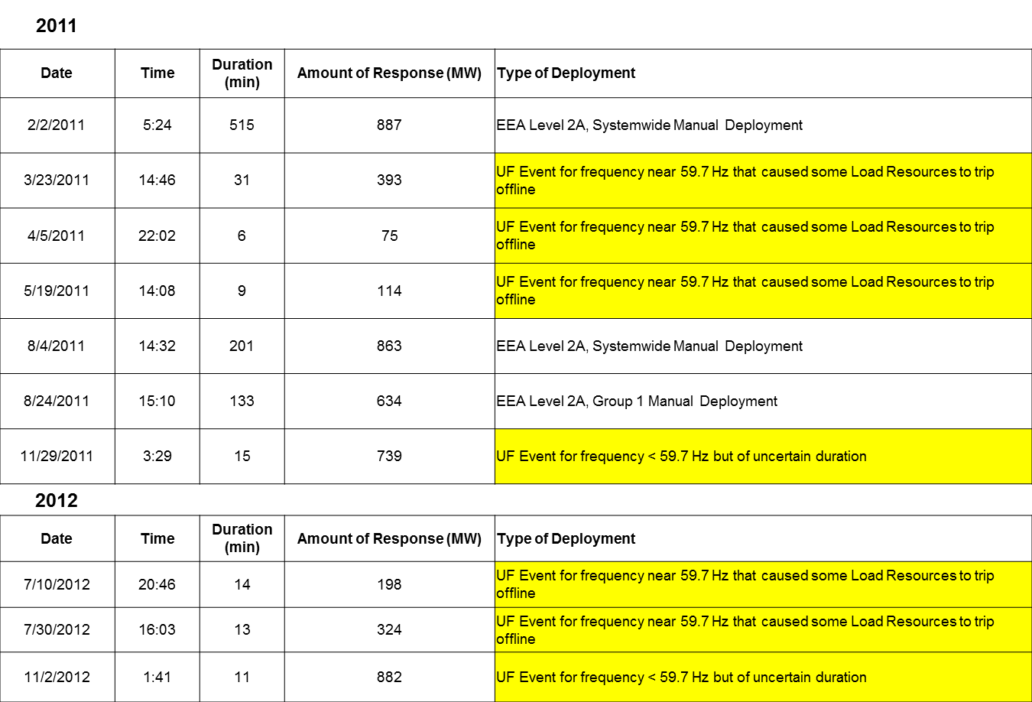
Load Resource RRS Deployments 2011 to Current

Slide 8
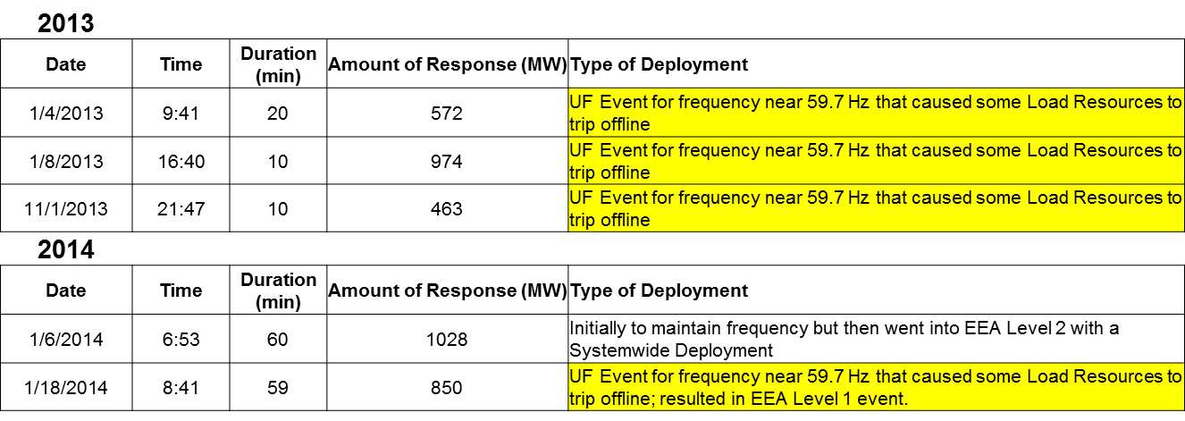
Load Resource RRS Deployments 2011 to Current

Slide 9

Controllable Load Resources
Energy storage technologies when charging off the ERCOT grid can participate as a Controllable Load Resource
Some energy storage technologies can provide fast response to deployment signals
A Fast Response Regulation Service (FRRS) Pilot Project was approved by the ERCOT board in November 2012.
The FRRS Pilot was initiated in February 2013.
When the pilot began, there were 32 MW FRRS UP and 30 MW FRRS DOWN qualified to participate.

Slide 10
Loads In SCED
NPRR555, Load Resource Participation in Security-Constrained Economic Dispatch represents ERCOT’s effort to find a way for demand response to contribute to price formation
Eligibility to participate: LSE QSEs representing Load Resources capable of following 5-minute SCED base point instructions
  Existing or new single-site Controllable Load Resources (CLRs)
  Aggregate Load Resources (ALRs) composed of multiple sites within single ERCOT Load Zone (subset of CLR)
  QSEs with LRs in SCED will submit Bids to buy (not Offers to sell)

Slide 11

Loads IN SCED (Cont’)
Bids will reflect LR’s willingness to consume “up to” a specified five-minute Load Zone LMP
Bid will modify the SCED demand curve and have ability to set price
  SCED Generation to be Dispatched (GTBD) will be adjusted to accommodate LR participation
  This will ensure proper price formation and reduce the likelihood of oscillating dispatch instructions
LR benefits and opportunity:
  Avoided cost of consumption above specified price
  Price certainty due to ERCOT dispatch
  Eligibility to provide Non-spin
For ALRs, participation in SCED and Non-spin are both contingent on validation by ERCOT of the QSE’s telemetry at time of LR qualification, and spot-validation thereafter

Slide 12
Loads IN SCED (Cont’)
RRS and Non-Spin from CLR will be deployed via economic dispatch of DR capacity via SCED
  CLR will have RTM Energy Bid that covers the RRS and/or Non-Spin capacity released to SCED
  Also can optionally bid additional DR capacity for SCED dispatch
No change to existing participation in RRS by UFR-type Load Resources
  UFR-LR-RRS may still be deployed manually in EEA 2
No change to existing ERS

Slide 13
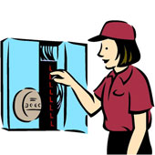
Emergency Response Service
Emergency Response Service (ERS) is:
An additional emergency tool for ERCOT operators to reduce the likelihood of involuntary firm load shedding (a.k.a. rolling blackouts)
Service provided by loads (customers) willing to
interrupt during an electric grid emergency in
exchange for a payment
Deployed ONLY in the late stages of a
grid emergency as a last resort prior to
firm load shedding (rotating outages)
“Controlled interruption of
prepared customers
vs.
uncontrolled interruption of
unprepared customers”

Slide 14
Emergency Response Service
When will ERS be needed?
Emergencies can occur at any time:
  Cold weather months -- due to natural gas
  curtailment & higher than expected forced outages
  Shoulder months -- due to unforeseen weather events & large amounts of scheduled maintenance
  Traditional summer peaks
  Anytime, as may be caused by:
    generation outages (scheduled, forced or both)
    transmission outages beyond likely contingencies
    extreme weather events
    multiple simultaneous contingencies
ERS may be more likely to be needed in off-peak or shoulder months than during traditional summer peaks

Slide 15

Emergency Response Service
ERS may be provided by:
  Loads or Back-up-Generation capable of being deployed within specified ramp rates
  Distributed Generation capable of injecting energy within specified ramp rates
  ERS Service Types
    10-Minute Ramp ERS
    30-Minute Ramp ERS
    Weather Sensitive ERS (starting 6/1/2014)
Interval Metering Required
No Real-Time telemetry Required
Dispatch Sequence
  30-Minute ERS Dispatched in EEA Level 1 ( PRC<2300 MWs)
  10-Minute ERS Dispatched in EEA Level 2 ( PRC<1750 MWs)

Slide 16

Weather Sensitive ERS
ERCOT Board approved WS ERS Pilot Project in March 2013 to test an ERS product with demand reduction capability that varies based on weather.
Procured for June 2013 through September 2013 Contract Period (Pilot Only)
Pilot Project included 1 Residential Aggregation (2.5 MWs) and 1 non-residential aggregation (0.1 MW)
NPRR 571, ERS Weather Sensitive Loads Requirements Approved by ERCOT Board in December 2013
Shall be available for the June through September 2014 Standard Contract Term
ERS Weather Sensitive Pilot

Slide 17
Participation in ERS by Service Type
ERS-10
 | Oct11Jan12 | FebMay12 | JunSep12 | Oct12Jan13 | FebMay13 | JunSep13 | Oct13Jan14 | FebMay14
BH1 | 466.800 | 469.800 | 513.075 | 450.060 | 457.700 | 472.125 | 589.095 | 622.920
BH2 | 403.500 | 473.100 | 364.900 | 447.560 | 456.460 | 351.550 | 582.995 | 607.035
BH3 | 445.300 | 456.000 | 357.000 | 434.310 | 440.830 | 345.500 | 568.470 | 598.360
NBH | 388.700 | 390.400 | 451.890 | 402.385 | 383.610 | 384.875 | 510.320 | 518.140
ERS-30
 | Oct11Jan12 | FebMay12 | JunSep12 | Oct12Jan13 | FebMay13 | JunSep13 | Oct13Jan14 | FebMay14
BH1 | N/A | N/A | 19.400 | 80.280 | 73.000 | 126.970 | 134.252 | 149.310
BH2 | N/A | N/A | 16.250 | 82.330 | 72.900 | 87.650 | 136.348 | 125.935
BH3 | N/A | N/A | 15.800 | 82.010 | 59.000 | 76.190 | 122.565 | 118.270
NBH | N/A | N/A | 9.500 | 71.150 | 40.500 | 100.940 | 111.671 | 97.295
Weather-Sensitive ERS
 | Oct11Jan12 | FebMay12 | JunSep12 | Oct12Jan13 | FebMay13 | JunSep13 | Oct13Jan14 | FebMay14
BH2 | N/A | N/A | N/A | N/A | N/A | 2.6 | N/A | N/A
BH3 | N/A | N/A | N/A | N/A | N/A | 2.6 | N/A | N/A
WEH | N/A | N/A | N/A | N/A | N/A | 2.6 | N/A | N/A
BH1 - Business Hours 1 HE 0900 through 1300, Monday thru Friday except ERCOT Holidays
BH2 - Business Hours 2 HE 1400 through 1600, Monday thru Friday except ERCOT Holidays
BH3 - Business Hours 3 HE 1700 through 2000, Monday thru Friday except ERCOT Holidays
NBH - Non-Business Hours All other hours

Slide 18
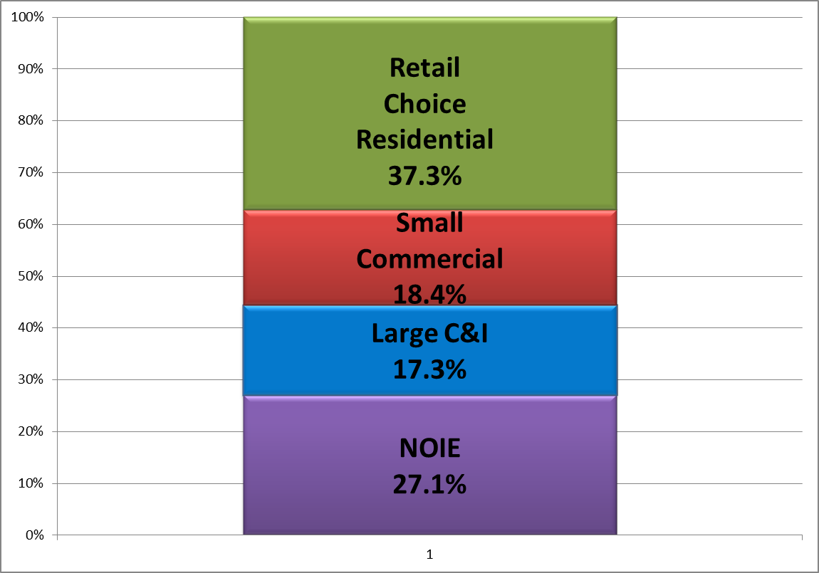
What is 4CP?
The Four Coincident Peaks in ERCOT are the highest-Load 15-minute settlement intervals in each of the four summer months (June, July, August, September)
These intervals are the basis of various Transmission & Distribution (T&D) charges for much of the ERCOT Load
  Non-Opt In Entities (Muni’s and Co-ops), at the
  boundary meter level
  Retail Choice customers with peak
  demand ≥700 kW (Interval Data
  Recorder meter required)
Retail choice load
Combined, over 44% of total ERCOT Load is subject to 4CP charges
Chart represents percentages of Load at IE 1700 on Aug. 3, 2011, ERCOT’s all-time system peak
“Large C&I” = IDR Required

Slide 19
At wholesale, 4CP is the basis of TCOS funding
Each Transmission Service Provider (TSP) calculates its expenses which are added to region-wide Transmission Cost of Service (TCOS)
  Includes capital costs (typically amortized over 30 years) and current year O&M
Investor-owned TSP charges are subject to PUC approval and may be adjusted up to twice a year
NOIE charges are approved by the respective governing body
  TSPs recover these costs by billing DSPs based on the DSP’s prior year 4CP Load Ratio Share
  This is known as ‘postage stamp’ cost allocation
DSPs recover these costs by billing customers (NOIEs) or billing customers’ REPs (investor-owned DSPs)

Slide 20
4CP charges as a DR incentive
4CP was not intentionally designed as an incentive for demand response, but…
Reducing Load during these intervals yields considerable savings
  NOIEs can reduce their 4CP Load Ratio Share, lowering their share of TCOS obligation
  Retail Choice Loads can directly reduce charges on their bills for the following year
Many Loads and NOIEs have acquired 4CP predictors
  Some are developed in-house
  Some are offered as a service by the LSE
  Some are acquired through subscription from an LSE or third party
Entities then plan demand response around probable 4CP intervals

Slide 21

4CP Tariffs: Hypothetical case study
Let’s assume an industrial customer:
  Has 10 MWs of Load and is capable of interrupting all of it
  Is connected at transmission voltage
  Is in Oncor service territory, where current tariff is $2.840117 per 4CP kW
  Correctly anticipates and reduces Load to zero for all four 4CP intervals in 2013
Our customer’s transmission charge line item would be $0.00 per month for each month of 2014
If he had been consuming his usual 10 MWs during those 4 intervals, his charge would be:
  $2.84 x 1000 (kW to MW) x 10 (MW) = $28,400 per month
  x 12 (months) = $340,800 in savings for the year

Slide 22
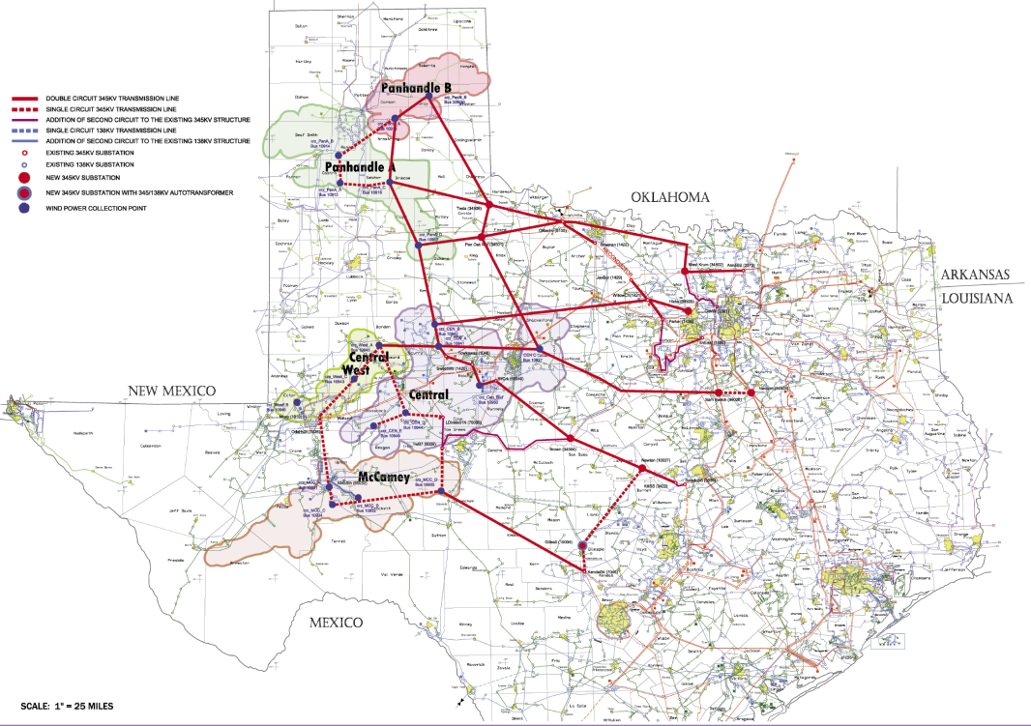
TCOS trends = greater 4CP exposure
ERCOT Region is very active in building new transmission projects
  Load growth necessitates new projects
  Streamlined planning process and single-state regulation expedite approval
In addition, transmission
build-out in Competitive
Renewable Energy Zones
(CREZ), authorized by
legislation and Rule, is in the
process of adding nearly
$7 billion to TCOS

Slide 23
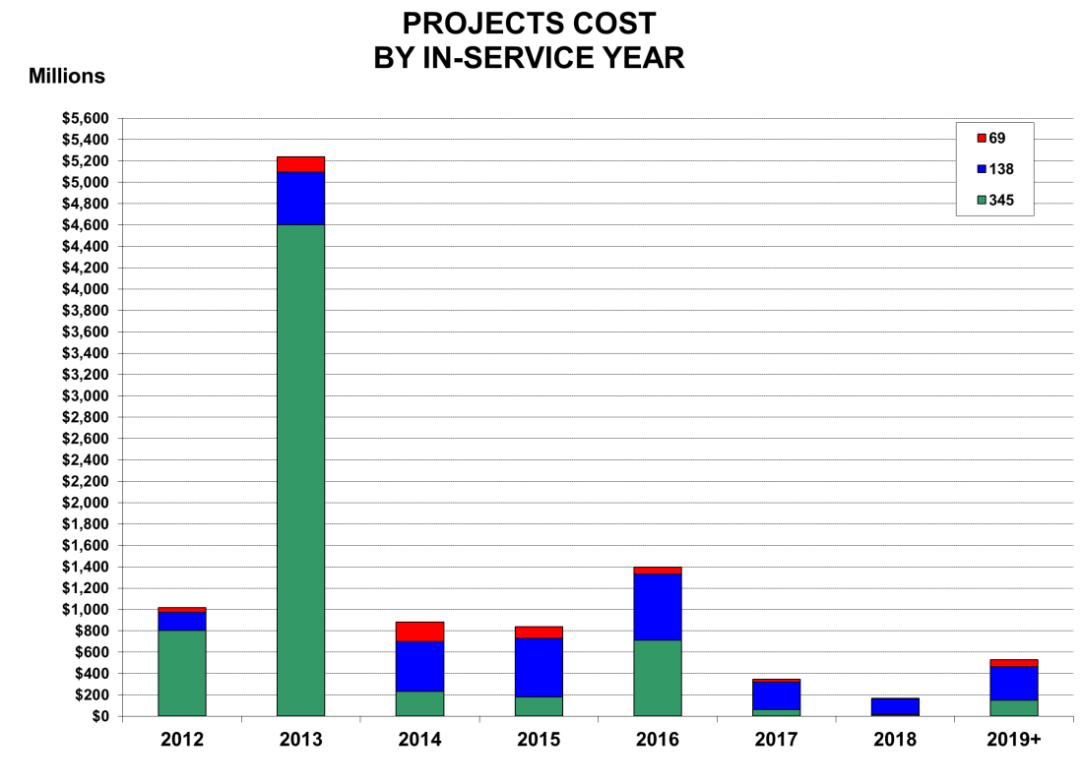
CREZ Impacts to TCOS
CREZ projects are now almost entirely on line
Over $5.2 billion
in new facilities
were energized
in 2013 – over 5
times the average
These dollars will
be recovered thru
TCOS rates over
the next 30 years
Source: ERCOT Transmission Projects Information Tracking (TPIT) Report, Nov. 2013

Slide 24
TCOS Trends
Date | TCOS Snapshot | ‘Postage Stamp’ TCOS Rate (per 4CP kW)
4/16/2010 | $1.543 billion | $26.05
4/8/2011 | $1.670 billion | $28.10
4/12/2012 | $1.772 billion | $29.36
3/23/2013 | $2.002 billion | $30.95
11/30/2013 | $2.724 billion | $40.86
Includes approximately 80% of CREZ charges

Slide 25

TDSP Load Management Programs
Programs designed to help TDSPs meet their Annual Energy Efficiency Goals set by the PUCT.
Available
  From 1-7 pm weekdays (except holidays)
  June – Sept months only
Dispatched by ERCOT instruction as early as EEA Level 1
Programs vary slightly across TDSPs
Approx. 240 MWs

Slide 26

Voluntary Load Response
Price Responsive Customers
  Customers respond voluntarily when real time energy prices go high
  Special Demand Response incentives from REPS—as simple as a communicating programmable t-stat to more sophisticated dispatchable products
ERCOT currently conducting study to determine:
  How much (MWs)
  Trigger mechanisms

Slide 27


Slide 28
Demand Response in ERCOT for load resources is classified as _____________.
a) Non-Controllable Load (NCLR)
b) Controllable Load (CLR)
c) Loads in SCED
d) All of the above

Slide 29
Which of the following are Emergency Response Service (ERS) types?
10-Minute ERS
30-Minute ERS
Weather-Sensitive ERS
All of the above

Slide 30
Non–Controllable Load Resources are used for ___________________.
Responsive Reserve Service
Off line non-spin
On line non-spin
Regulation Service

Slide 31
The Four Coincident Peaks in ERCOT are the ___________________settlement intervals in each of the four summer months (June, July, August, September)
Lowest-Load 15 minute
Highest-Load 15 minute
Forecasted-Load 15 minute
None of the above

Slide 32
TDSP Load management Programs are designed to help TDSP’s meet their annual energy efficient goals set by the PUCT and are available___________________.
January – March months
October – December months
June – September months only
From 1am - 6am (weekends only)

