Slide 1

CEO Perspectives
Trip Doggett
President & CEO
ERCOT
2014 ERCOT Operations Training Seminar
April 21, 2014

Slide 2
Opening Remarks

Slide 3
Objectives:
Identify which tools ERCOT provided in 2013 to support preparedness.
Identify the ERCOT Peak Demand Record.
Identify the new Wind Record.
Identify the percentage of total wind capacity that is measured for capacity, demand and reserves analysis.
Identify the reason for six of the top ten constraints for 2013.

Slide 4

2013 in Review – Highlights and Accomplishments
ERCOT’s key accomplishments in 2013 reflect a shared commitment with stakeholders and policymakers to support electric reliability, market competitiveness and innovation for the future.
In general, we…
Applied and developed numerous tools, processes and programs to support grid reliability and market efficiency; enhanced employee recruitment, development and retention; and improved overall service to market participants and other stakeholders.
Completed more than 150 revision requests to support market and grid operations, incorporate new technologies and address ongoing resource adequacy concerns.
Supported our community in a variety of ways.
Maintained reliable operations in 2013.

Slide 5


2013 Highlights and Accomplishments (continued)
Working together to strengthen the grid, adapt to changing needs
Coordinated successful, on-time completion of CREZ projects
Completed pilots for new Emergency Response Service and Fast-Responding Regulation Service options
Collaborated with generating companies to enact best known weatherization practices to prepare for peak summer and winter conditions
Achieved settlement of more than 97 percent of retail load in competitive areas with 15-minute interval data (6.6+ million advanced meters)
Developing market-based tools to support reliability, competition
Established and began implementing Operating Reserve Demand Curve
Introduced concepts and began discussions about future Ancillary Services
Improved Congestion Revenue Rights (CRR) program with implementation of rolling CRR auction and improvements to assignment of appropriate credit risks to specific paths
Established plan and rules to shorten settlement timeline from seven days to five

Slide 6


2013 Highlights and Accomplishments (continued)
Providing innovative tools to support preparedness
Tested and improved preparedness plans for range of grid situations, from a winter storm to black start restoration
Redesigned and enhanced mobile app with more real-time information, to improve public awareness
Released Macomber Map® as open source software with training support and improved interface
Ensuring accountability while preparing for the future
Supported development of five-year comprehensive strategic plan by
Board of Directors
Achieved favorable audit results for 2012 financials, SSAE16, NERC CIP and an independent review of internal audit practices
Realized at least $4.4 million in cost savings through vendor negotiations and other actions while continuing to identify opportunities to streamline projects and processes

Slide 7


2013 Highlights and Accomplishments (continued)
Supporting our neighbors and preparing for a brighter future
Received recognition from the State Board of Education and Texas Education Agency with 2013 Employers for Education Excellence Award for effective mentoring and other educational partnership programs with Taylor ISD
Donated $16,500 to United Way of Williamson County through employees’ first annual giving campaign
Sent four World War II veterans to Washington, D.C., through Honor Flight Austin
Provided meals, financial donations, holiday gifts, blood donations and other support to organizations serving children, the elderly and others in need

Slide 8
Current Records – April 18, 2014
Peak Demand Record: 68,305 megawatts (MW)
68,305 MW, August 3, 2011
Weekend Record
65,159 MW, Sunday, August 28, 2011
Winter Peak Record: 57,265 MW
57,265 MW, February 10, 2011
Wind Generation Records (instantaneous)
10,296 MW, March 26, 2014, 8:48 p.m.
  Non-Coastal Wind Output = 8,863 MW
  Coastal Wind Output = 1,433 MW
  Supplying 28.78% of the 35,768 MW Load
  Installed Commercial Capacity = 11,055 MW
39.40% Wind Penetration, March 31, 2013, 2:12 a.m.
  Total Wind Output = 9,699 MW
  Total Load = 24,618 MW
Summer 2013 Demand
  64,418 MW, June 27
  64,814 MW, July 31
  67,245 MW, August 7
  63,388 MW, September 3
  No new records

Slide 9

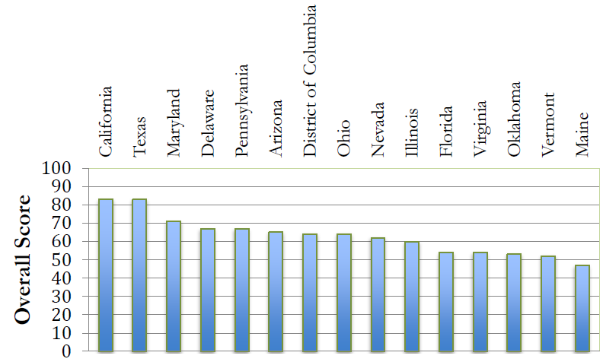
Grid Modernization Index (GMI)
Texas and California tied for #1 ranking (83 of 100 points) based on grid modernization policies and activities
GridWise Alliance and Smart Grid Policy Center studied 41 states and District of Columbia
Highest-ranking states typically:
  Belong to Regional Transmission Organization (RTO) or Independent System Operator (ISO, such as ERCOT)
  Have Renewable Portfolio Standards
  Have higher scores for cyber-security and data privacy
  Have residential/commercial smart meters, top 10 = 60% or more

Slide 10
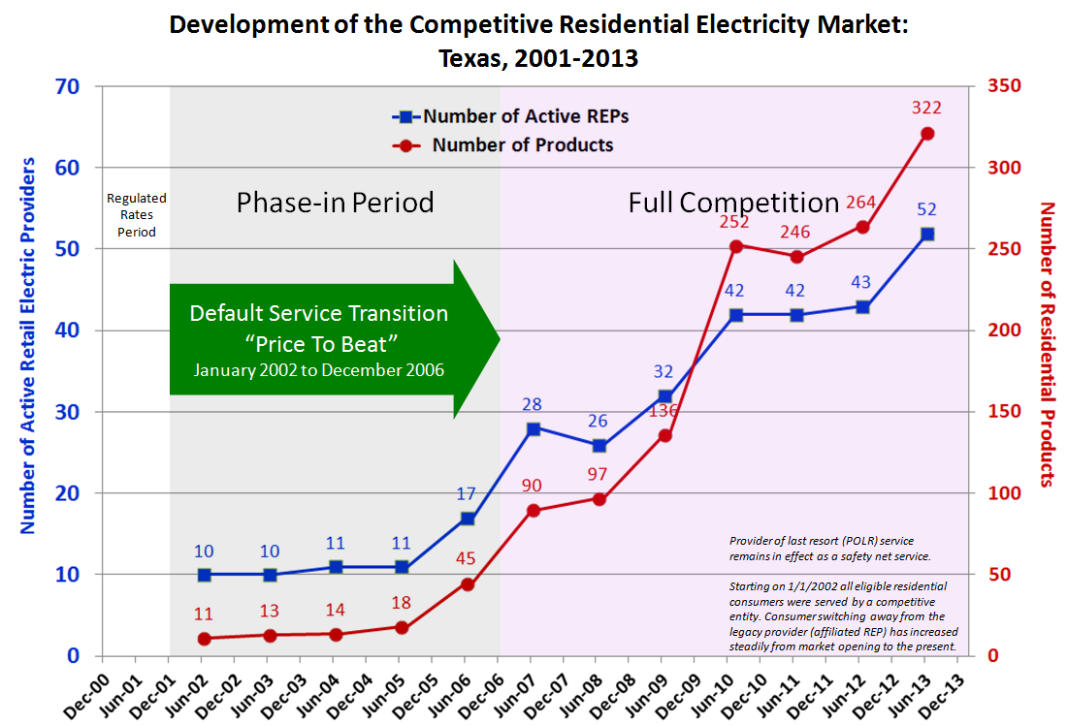
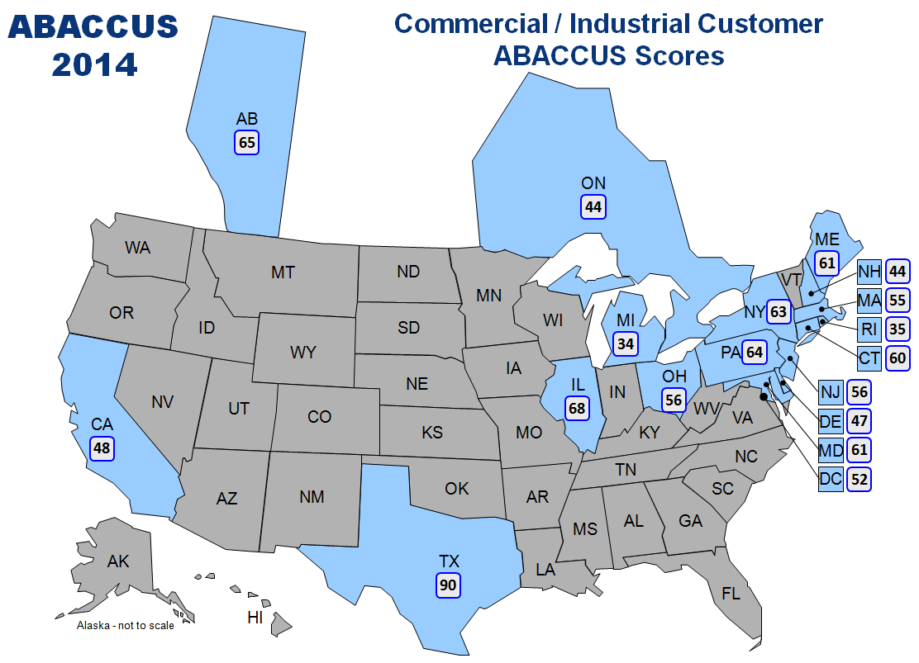
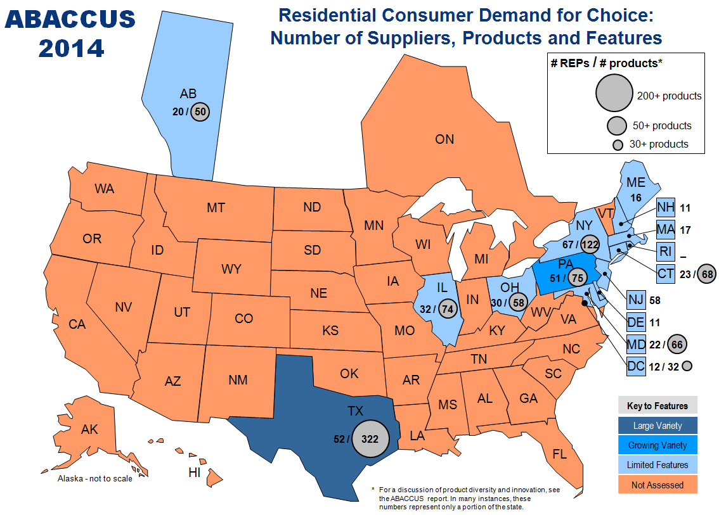
Top Retail Market in the United States and Canada
ERCOT competitive retail market #1
in the United States and Canada seventh year in a row
Top rankings for both residential and commercial/industrial retail markets in Texas (Annual Baseline Assessment of Choice in Canada
and the United States*)
Most product offerings (300+) among states assessed
5.9 million residential customers taking competitive electric service
*Published annually by Distributed Energy Financial Group, LLC

Slide 11
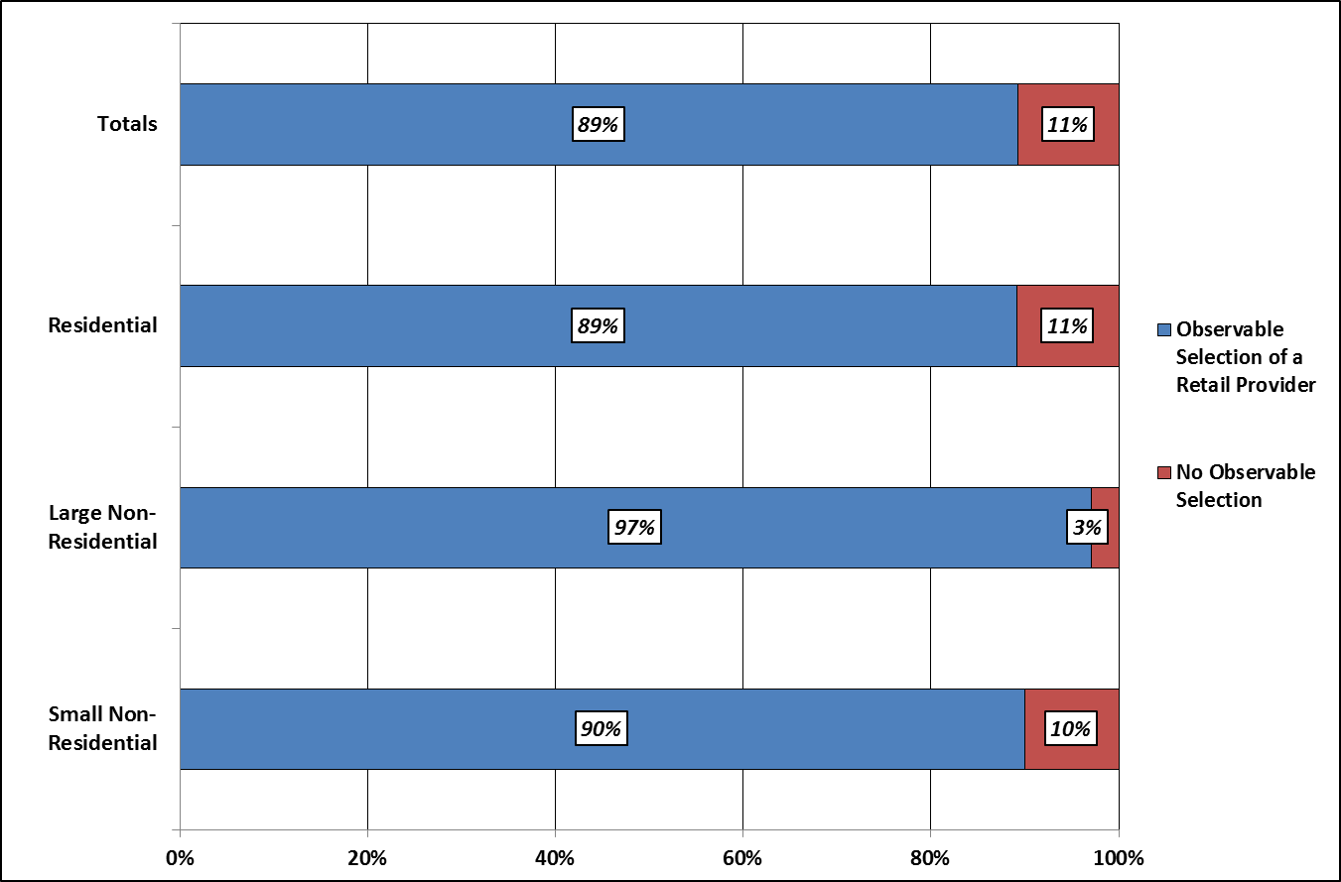
Retail Market Success through 2013

Slide 12
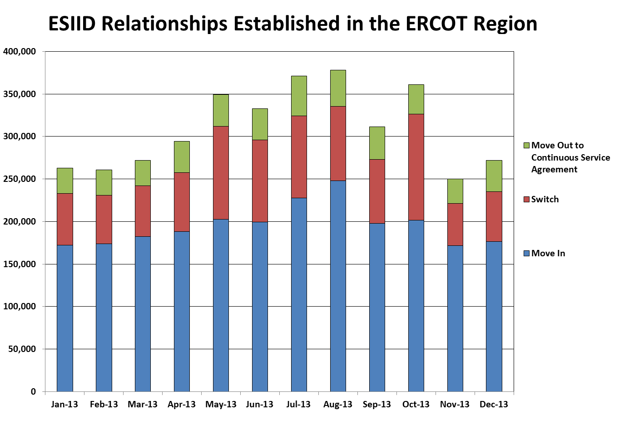
Retail Market Activity
Notes:
Move Out to CSA represents the initiation of a service period with a retailer having an existing Continuous Service Agreement at a premise. This is often used in landlord/tenant scenarios.
*Average per Month = 309,599
*Total for 2013 = 3,715,182
* Number of ESI IDs in competitive areas: ~ 6.8M

Slide 13
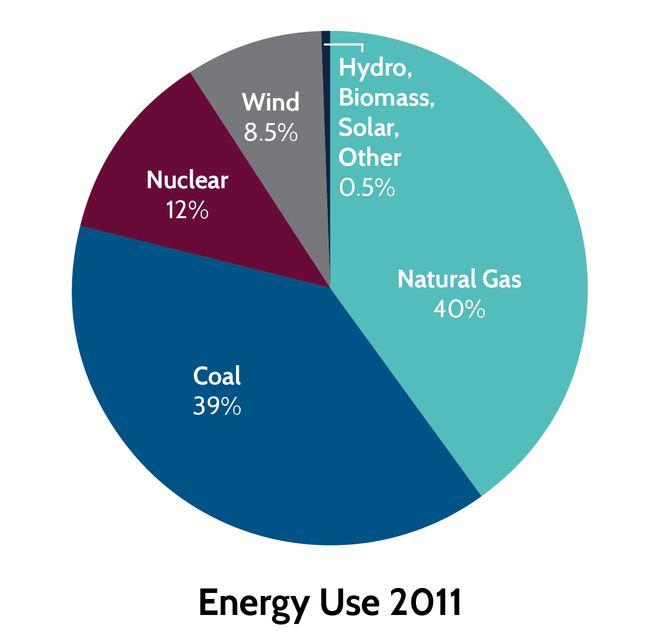
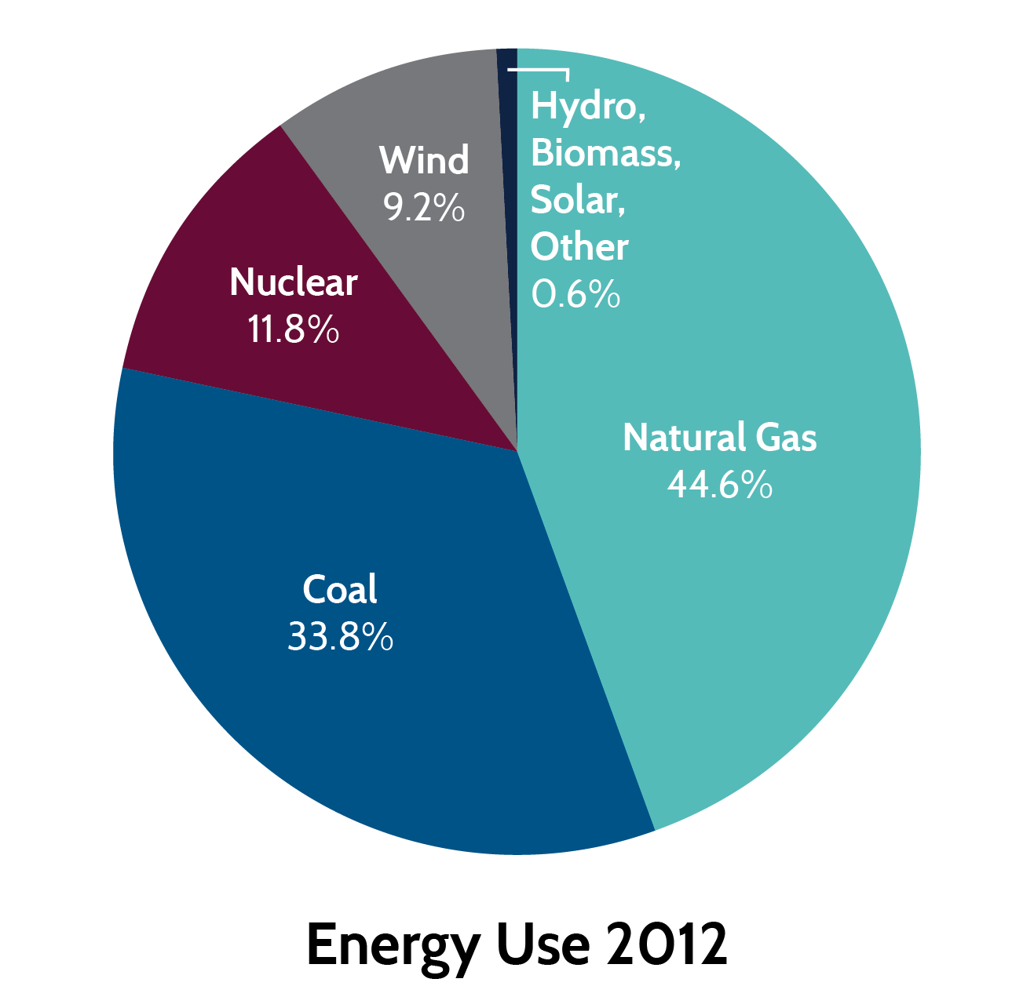
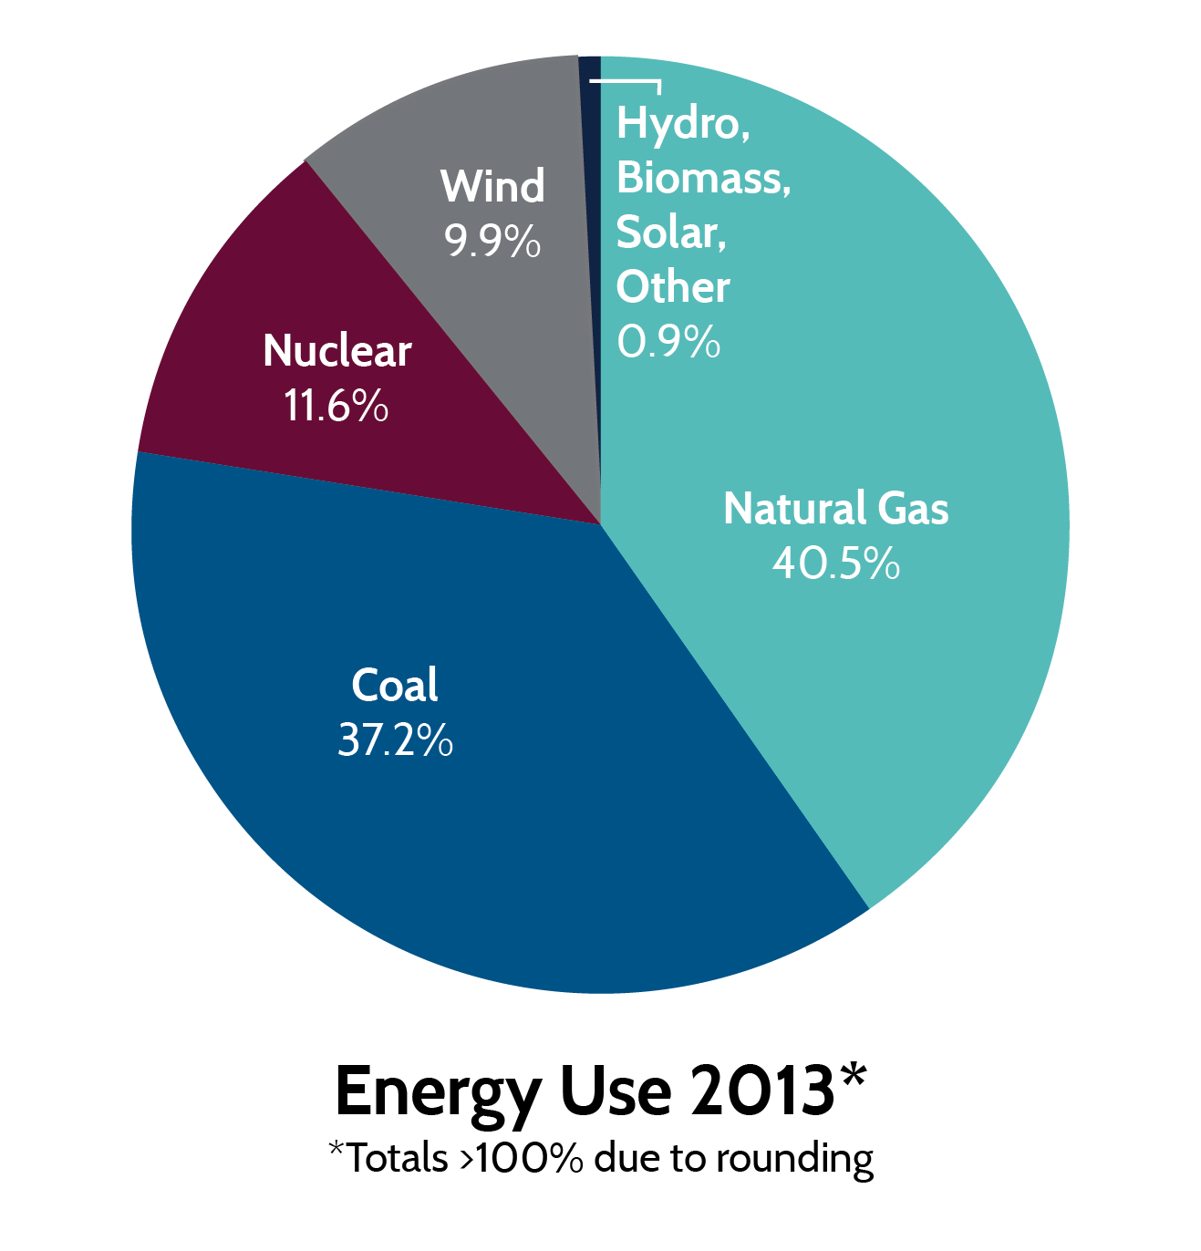
Energy Use Comparison
Total energy consumed:
333,885,158 MWh
Total energy consumed:
324,859,701 MWh
Total energy consumed:
331,624,102 MWh

Slide 14
Wind Generation Capacity – March 2014
Texas is #1 in the U.S. in wind capacity.
Our capacity is more than twice the amount of #2 (California)
If Texas were a separate country, we’d be #6 in the world in wind generation capacity.

Slide 15
Load Forecast

Slide 16
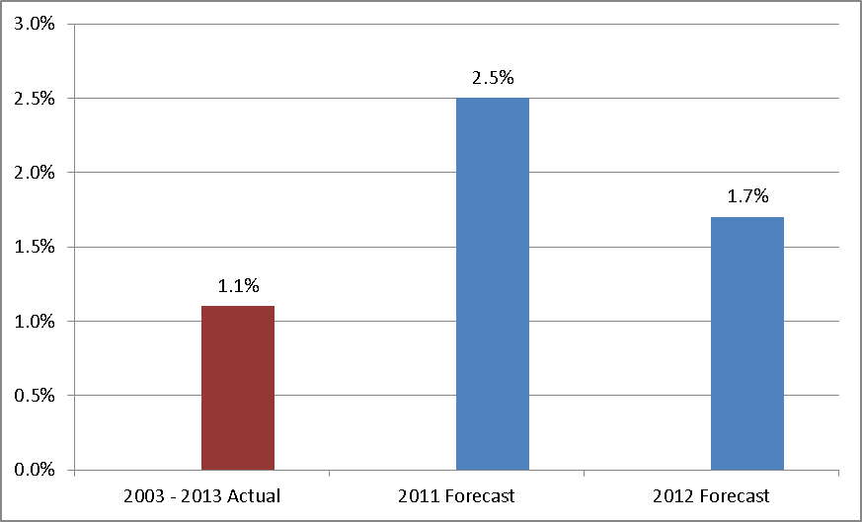
Economic Growth based Peak Demand Forecast
Will Peak Demand grow nearly twice as fast over the next 10 years compared to the prior 10 years?
10-year average annual compound growth rate in Peak Demand
2011 forecast based on Moody’s base scenario (2012 – 2021)
2012 forecast based on Moody’s low scenario (2013 – 2022)

Slide 17
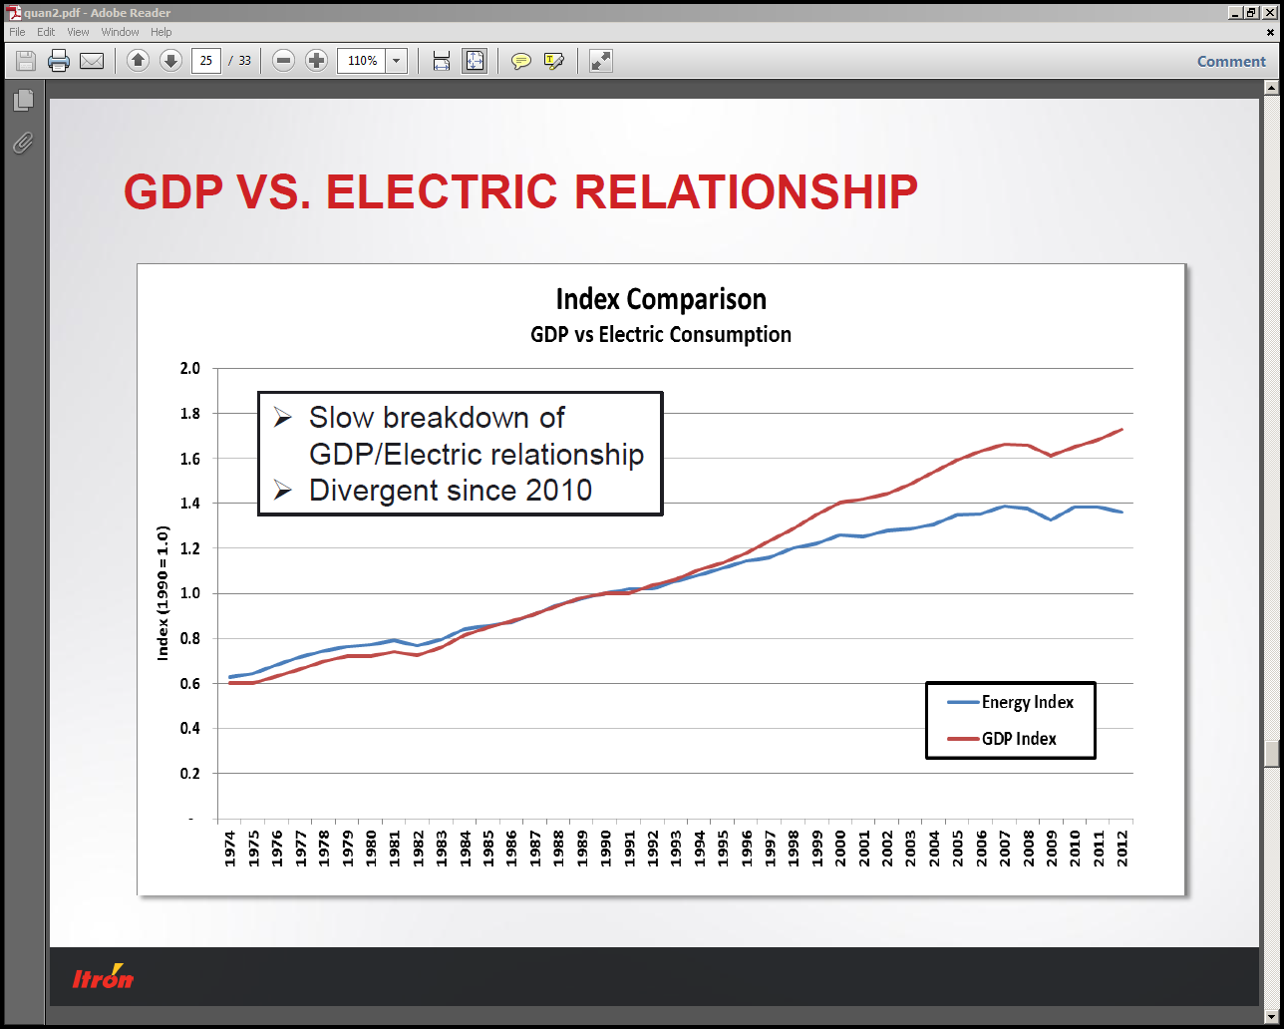
National trends
Source: Energy Trends Benchmarking Survey 2013, Mark Quan, November, 2013

Slide 18
Changing Relation Between Load and Nonfarm Employment
Price responsive load
  Combination of 2011 scarcity pricing and PUC’s decision to increase System-Wide Offer Caps is changing behavior:
    Commercial & industrial loads with prices indexed to the ERCOT wholesale market are increasing their price response flexibility
    Load-serving entities (LSE) are investing in demand response as insurance against wholesale market exposure
  ERCOT Staff, working with LSEs, are attempting to quantify this behavior; starting with summer 2013 data
  4 CP impact
Energy efficiency upgrades
  Energy Star appliances
  Conversions to CFL and LED lighting

Slide 19
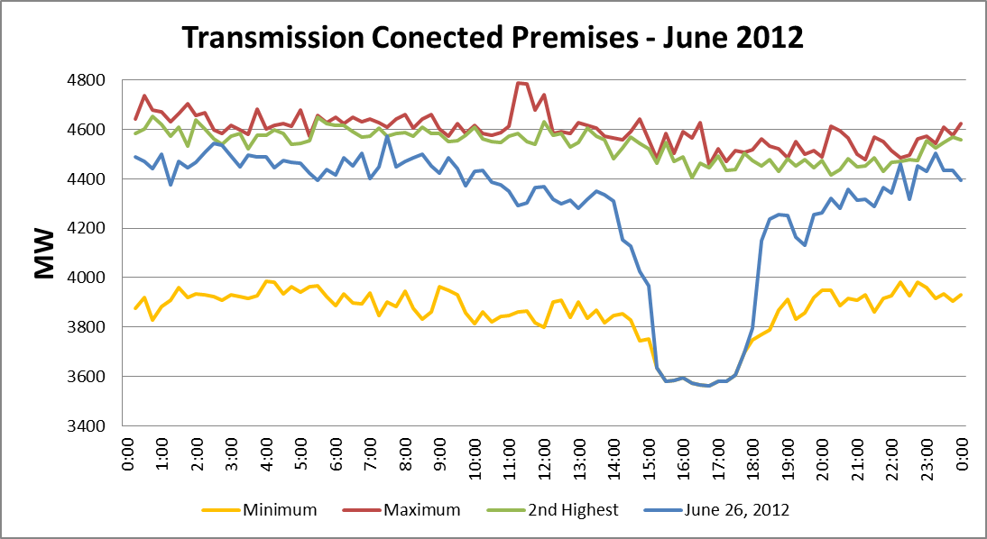
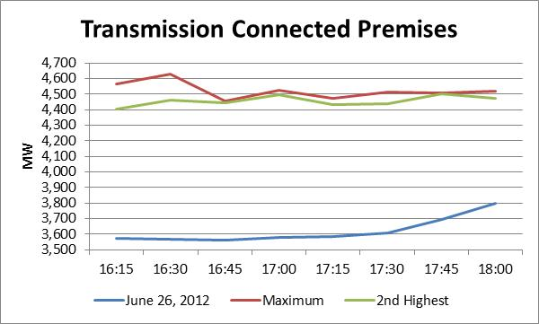
2012 Summer Peak - 4 CP & Price Response Impacts (June 26)
Impacts shown are based on aggregated transmission load values for ~430 premises
Not estimated based on an analysis of individual premises
Difference represents the 4 CP & Price Response impacts of ~ 900 MW on an aggregated basis
Transmission charges based on 4CP usage apply to Munis, Co-ops, and Loads with >700 kW of peak demand in retail choice areas.
This data is an example of observed 4CP and price response impacts.
4 CP & Price Response Impacts

Slide 20
Load Forecasting Review Process
ERCOT staff developed a methodology for the load forecast that is different from what has been used in recent years
The new methodology is different from what any other ISO is using today
The new methodology represented a significant change and was thoroughly reviewed by the Board and stakeholders before it was incorporated into our Capacity, Demand and Reserves (CDR) Report.
Joint review by the Reliability & Operations Subcommittee (ROS) and Wholesale Market Subcommittee (WMS) of the Technical Advisory Committee (TAC).
ERCOT retained an independent consultant to review the methodology and incorporated all of the consultant’s recommendations.

Slide 21
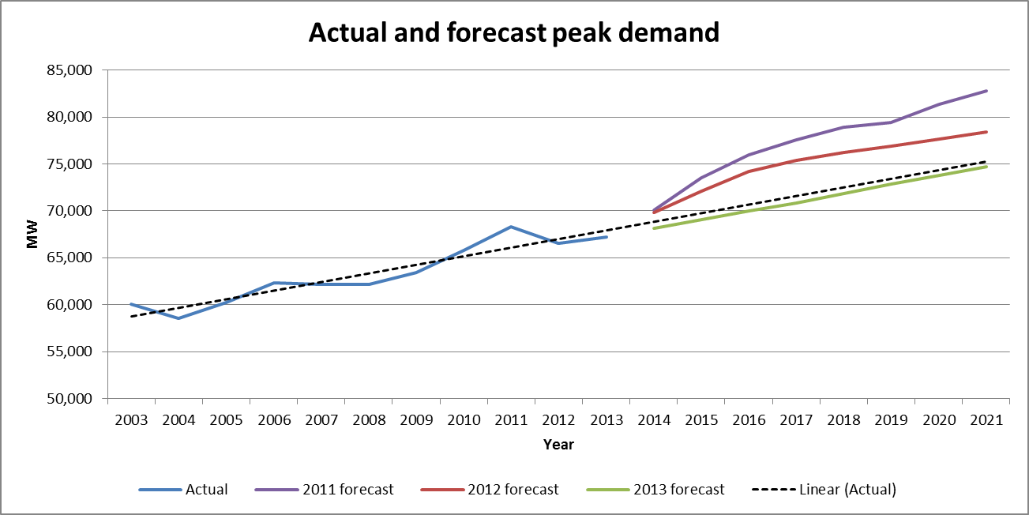
Comparison of historical peak demand forecasts
15% increase over the previous ten years
Oil and Gas Boom begins 2010
2011 forecast based on Moody’s base scenario
2012 forecast based on Moody’s low scenario
Notes:
Linear trend forecasts a 1.3% AAGR while the actual historical value from 2003 – 2013 is 1.1%. The base forecast also has a 1.3% AAGR. Calculation (15% increase) based on 1.14% to 1.30%.

Slide 22
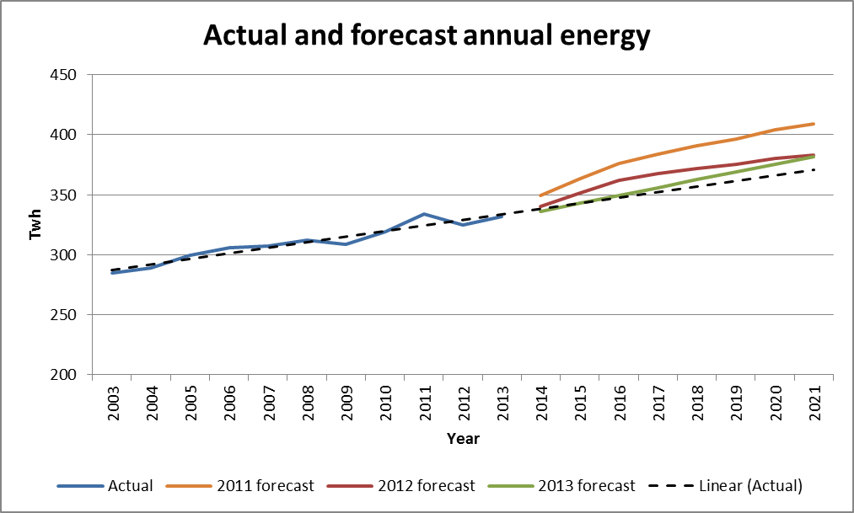
Comparison of historical energy forecasts
18% increase over the previous ten years
Oil and Gas Boom begins 2010
2011 forecast based on Moody’s base scenario
2012 forecast based on Moody’s low scenario

Slide 23
Resource Adequacy &
Demand Response

Slide 24
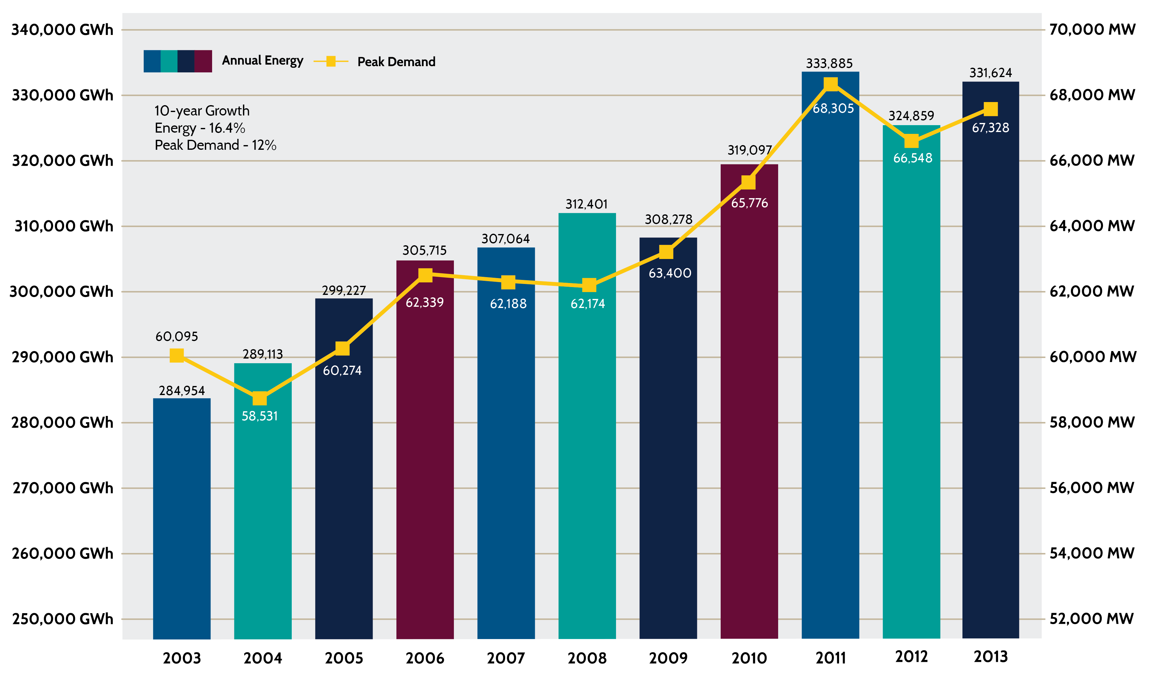
Annual Energy and Peak Demand (2003-2013)

Slide 25
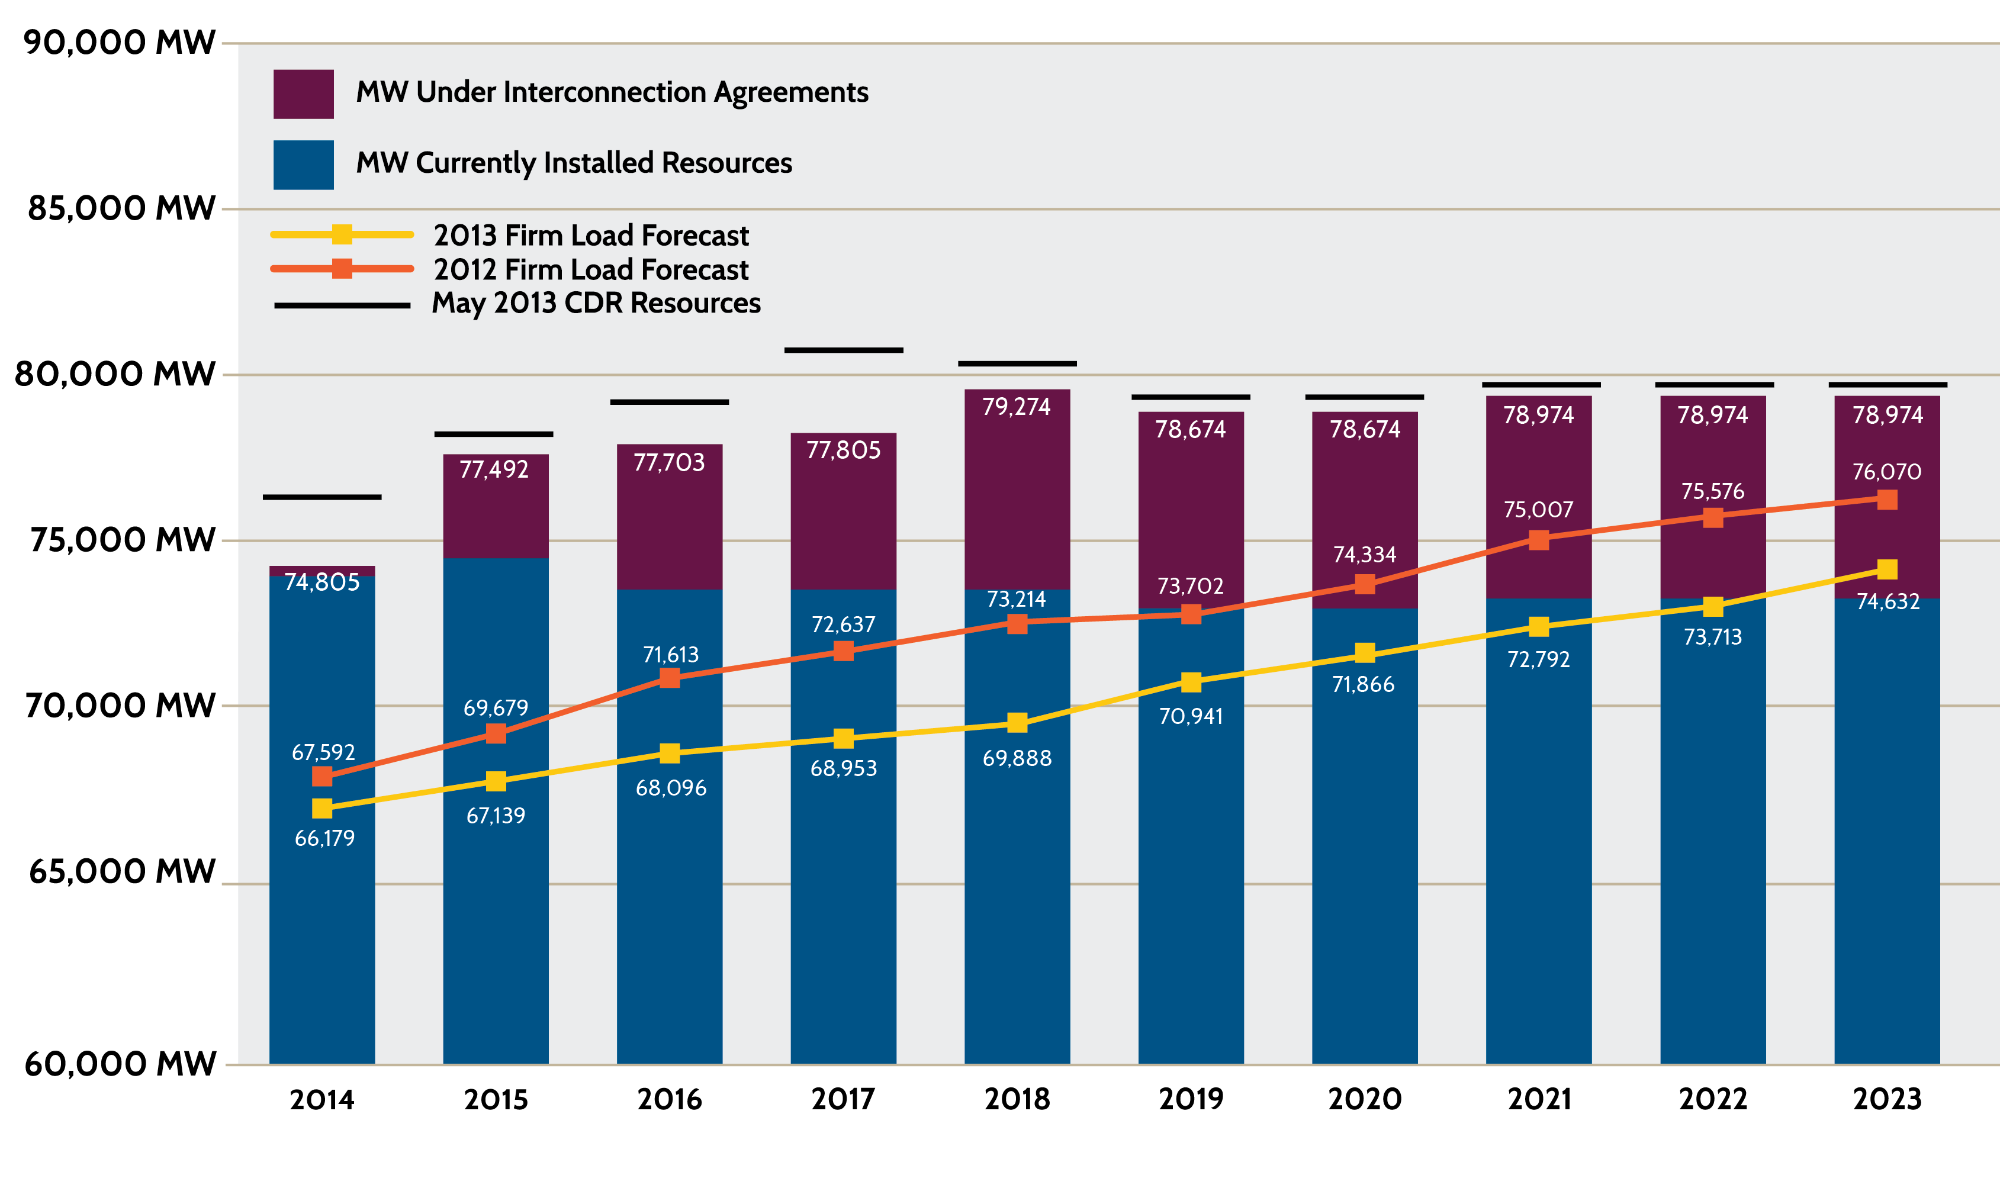
Capacity, Demand and Reserves (CDR) – February 2014
Wind generation is included at 8.7 percent.*
ERCOT has been analyzing the operational characteristics of wind generation to determine whether it can depend on a higher percentage of installed capacity during periods of peak demand.

Slide 26
Generation Interconnection Activity by Fuel

Slide 27
2013 Completed Actions
NPRR 520 – (Real-Time Mitigation Rules and Creation of a Real-Time Constraint Competitiveness) implemented in the summer of 2013 to address over-mitigation
30-minute Emergency Response Service (ERS) pilot and Weather Sensitive ERS pilot were completed and corresponding NPRRs were approved by the BOD
TSPs with guidance from the Voltage Reduction Task Force completed voltage reduction testing in the summer of 2013
Value of Lost Load (VOLL) Literature Review and Macro Economic Analysis
NPRR 568 – (RT Reserve Price Adder Based on ORDC) and NPRR 555 – (Loads in SCED) were approved by the BOD
Scoping and Impact Analysis for Real-Time Co-optimization

Slide 28
What’s Around the Corner?
NPRR 568 – (RT Reserve Price Adder Based on ORDC) to be implemented by June 2014
NPRR 555 – (Loads in SCED) targeted to be implemented by June 2014
30 minute ERS and Weather Sensitive ERS effective in Protocols in 2014
The Voltage Reduction Task Force final report on the Summer 2013 voltage reduction testing
Calculation of retail price/demand response using data collected from Load Serving Entities

Slide 29
Transmission Projects

Slide 30
CREZ Transmission Update – January 30, 2014
Transmission Plan designed to serve approximately 18.5 GW:
  ~3600 right-of-way miles of 345 kV
  $6.8 billion project cost
Lines are open-access; use not limited to wind

Slide 31
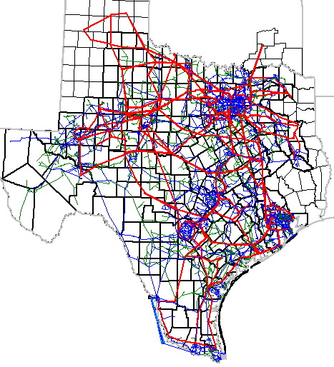
ERCOT Panhandle Grid Characteristics
Minimal to no nearby synchronous generation
No local load
These conditions lead to voltage stability and grid strength challenges
Current wind generation development:
  ~5.3 GW of wind capacity in the Panhandle with signed interconnection agreements
  ~6.0 GW of additional wind generation in the interconnection study process
Long Term Studies show a continued expansion of wind resources in the Panhandle under a range of future outcomes.
CREZ Reactive Study Recommendations were designed to accommodate 2,400 MW of wind generation in the Panhandle CREZ regions

Slide 32
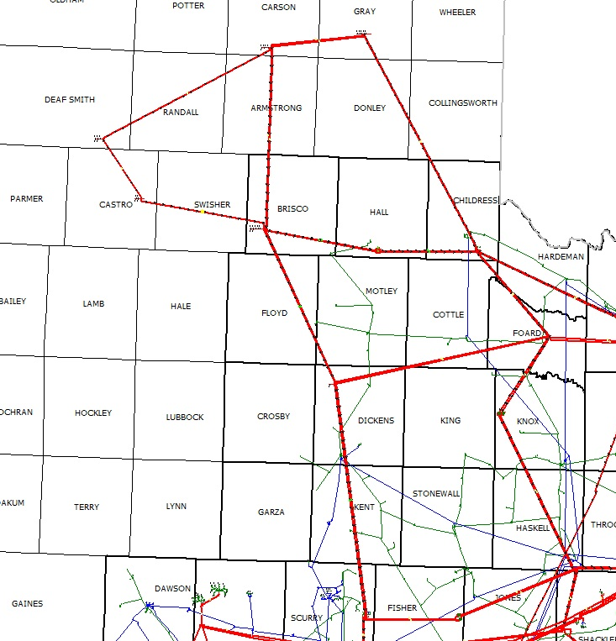


Panhandle Renewable Energy Zones (PREZ) Study
Gray
An initial set of transmission upgrades includes:
New 345-kV circuits on existing towers from Alibates to Windmill, Windmill to Ogallala, and Ogallala to Tule Canyon (towers were designed to accommodate these additional circuits).
Synchronous condenser at the Windmill substation
A potential future set of upgrades includes:
New 345-kV circuit from Ogallala to Long Draw
Additional synchronous condensers at Windmill, Alibates, and Gray substations
Alibates
Windmill
Ogallala
Tule Canyon
Tesla
Cotton Wood
Dermott
Long Draw

Slide 33
Eagle Ford and Cline Shale
Oil and natural gas related demand has caused a significant amount of load growth in west Texas and south Texas
Six of the top ten transmission constraints on the ERCOT System in 2013 were related to serving the increased demand in west Texas
A significant number of transmission projects have been implemented in west Texas within the past two years, and more than 60 are planned over the next four years to meet the oil and natural gas related needs
More than $330 million in transmission projects have been approved by the ERCOT Regional Planning Group since 2012 in order to meet Eagle Ford Shale load growth in south Texas (Expected in-service – 2013 through 2016)

Slide 34
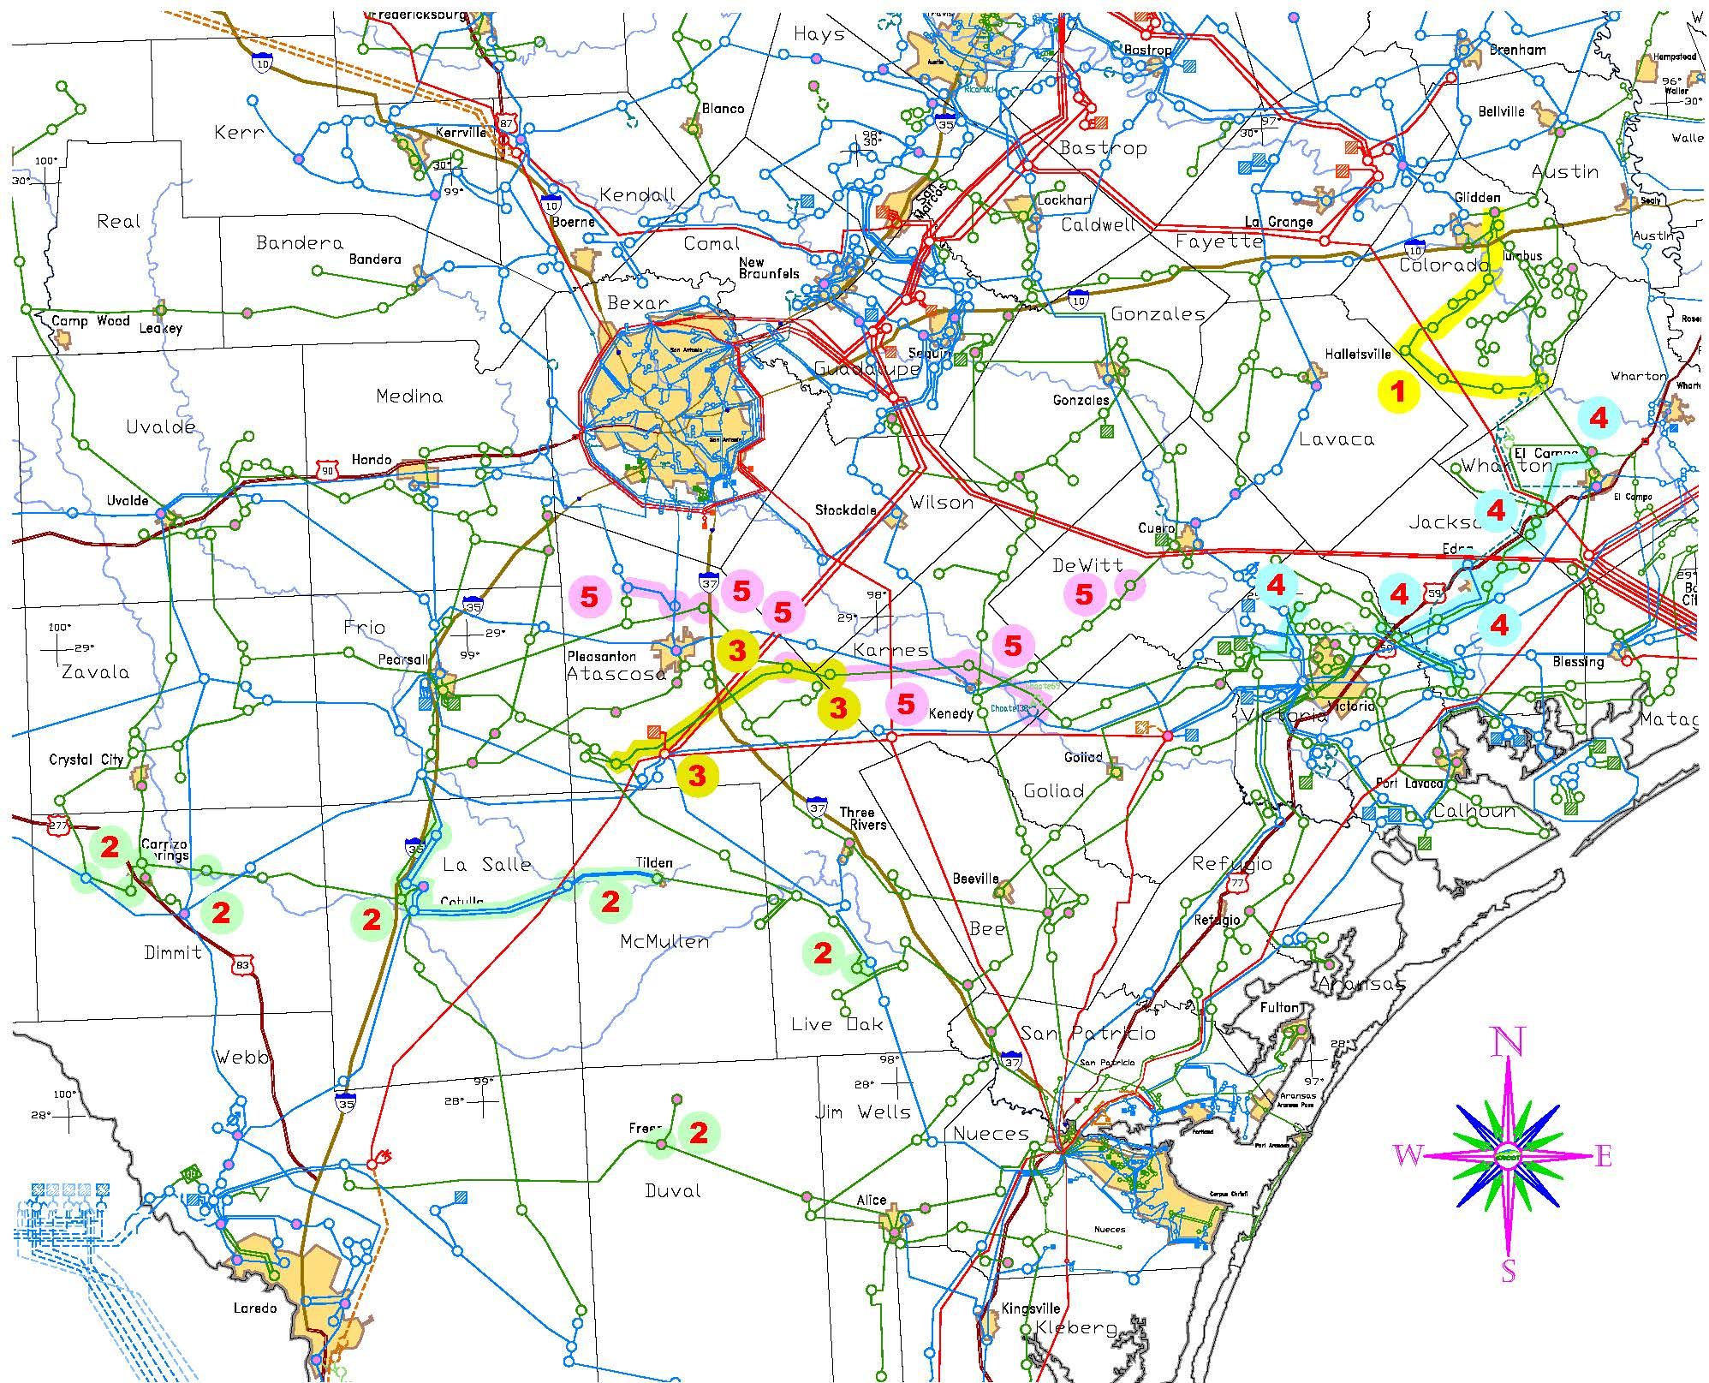
Eagle Ford Shale Projects I
Driver – Reliability Need to support new oil and gas load
Project Components:
      Glidden-Colorado-Nada 69 kV upgrade project – April 14
      Karnes Electric Cooperative-Medina Electric Cooperative load addition project – Dec 15
      Coy City load addition project – June 14
      El Campo-Vanderbilt load addition project – April 14
      Karnes Electric Cooperative load addition project – June 15

Slide 35
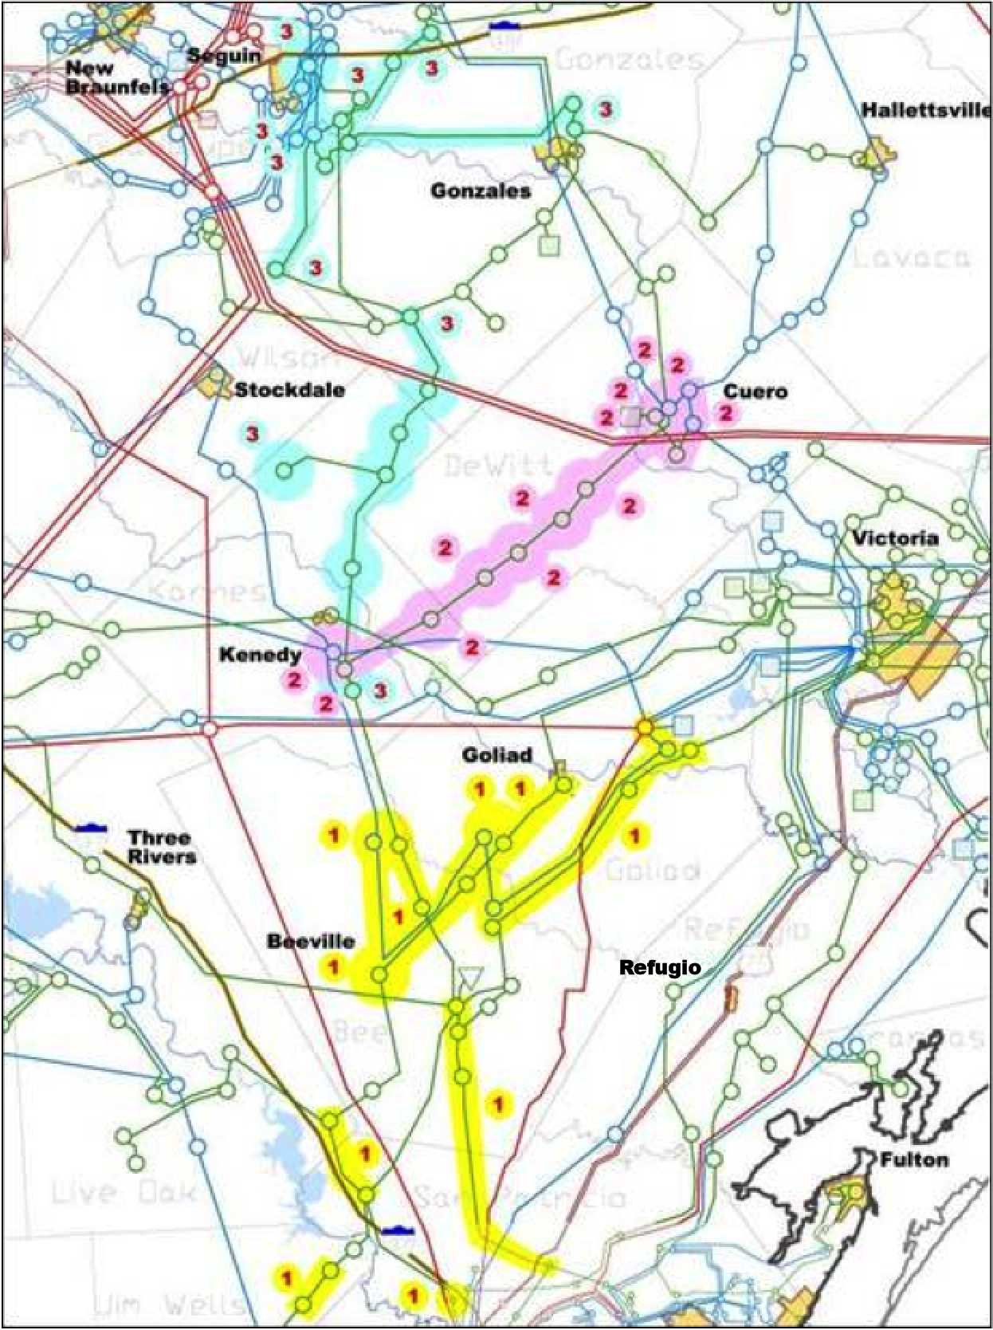
Eagle Ford Shale Projects II
Driver – Reliability Need to support new oil and gas load
Project Components
    Sinton - Beeville - Kenedy Area Improvements Project – May 15
    Kenedy Switch – Guadalupe Project – June 15
    Kenedy Switch to Nixon to Seguin upgrade and conversion from 69 kV to 138 kV – June 16

Slide 36
Houston Import Project
ERCOT conducted an independent review of the proposed set of projects to increase the import capability into the Houston area
ERCOT determined that there will be a reliability need for additional import capacity into Houston by 2018, based on planning studies that indicate:
  Thermal overloads of the import paths from North to Houston
  Low voltages around Bobville, Rothwood, Tomball, and Kuykendahl
  Additional reliability criteria violations (G-1+N-1)
ERCOT reviewed 21 transmission alternatives
  ERCOT conducted reliability analyses (steady-state N-1 contingency analysis; G-1 + N-1 analysis; voltage stability; NERC Category C and D analysis; and generator retirement analysis)
  ERCOT assessed the long-term benefits from projects that met the reliability criteria and used a cost/benefit analysis to rank the alternatives

Slide 37
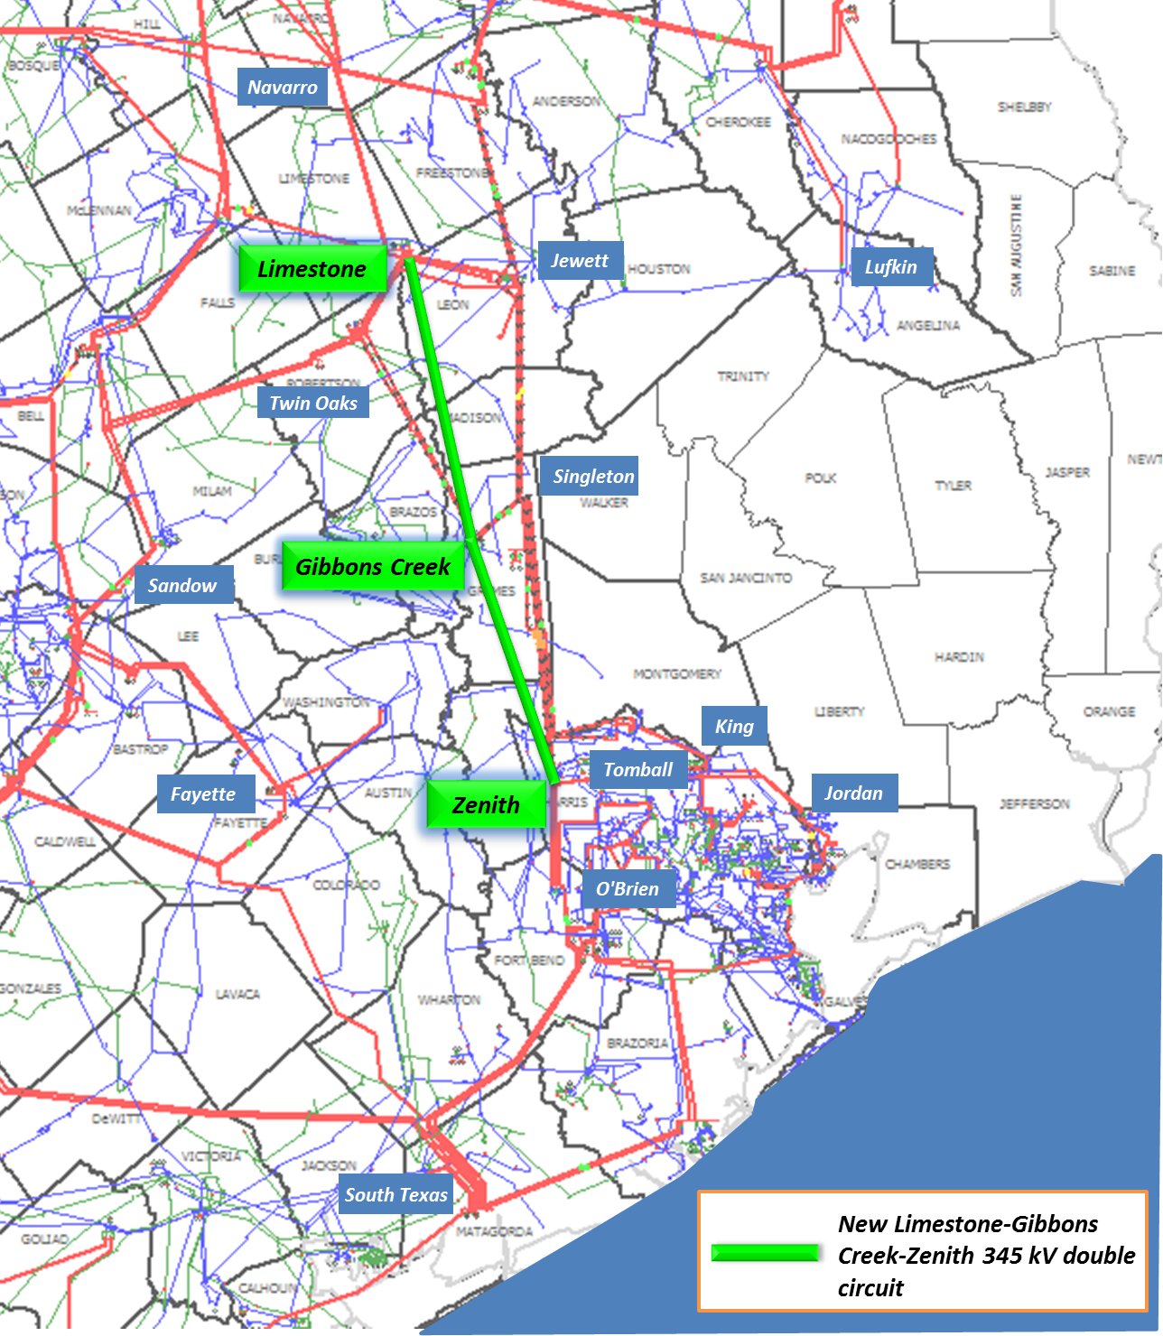
Houston Import Project – Board Endorsement
On April 8, 2014, the ERCOT Board of Directors endorsed the Houston Import Project:
New Limestone-Gibbons Creek-Zenith 345 kV double-circuit line deemed critical
Includes improvements to substations and other existing facilities
Scheduled for completion by summer 2018

Slide 38
Drought

Slide 39
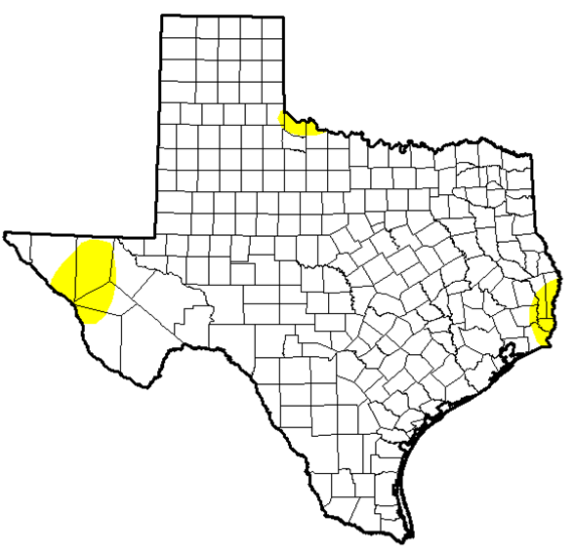
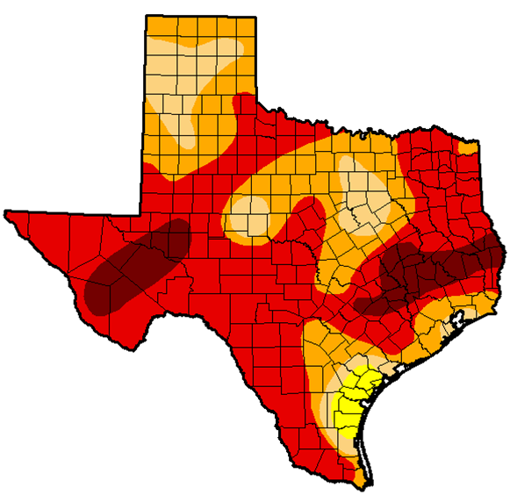
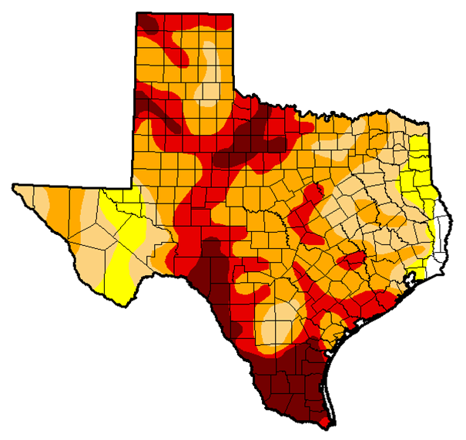
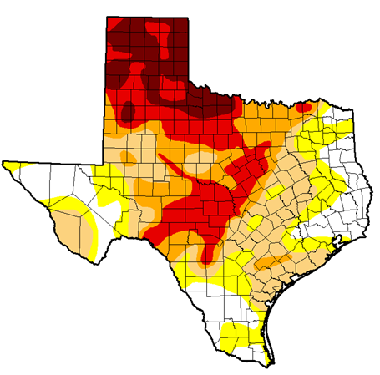
Comparing Mid-April Drought Conditions
2010
2011
0% of the state
in moderate or worse drought
98% of the state
in moderate or worse drought
2013
2014
91% of the state
in moderate or worse drought
66% of the state
in moderate or worse drought
Current drought began in October 2010.
A dry winter/early-spring has resulted in deteriorating conditions over the past four months, especially West.
PDO has gone positive and some hints of El Nino developing mid-to-late summer. Some cautious potential for wetter conditions later this year.

Slide 40
Lake Levels Risk Analysis
Risk
MW and Cooling Technology
Source Redundancy (additional Supply)
MWh Produced
Reservoir and Basin Level
Rainfall
Reservoir Demand
Reservoir Temperature
Reservoir Storage
Intake or Critical Level

Slide 41
Report on Key Initiatives

Slide 42
30-Minute ERS
Pilot Project – Objectives
Assess the operational benefits and challenges of deploying an ERS product with a thirty-minute ramp period
Study the optimal means of deploying 30-Minute ERS in an Energy Emergency Alert (EEA)
Gather data to
  Analyze the execution and benefits of a clearing price mechanism
  Assist ERCOT in determining the appropriate price to pay for 30-Minute ERS
  Compare costs and benefits relative to 10-Minute ERS
ERS – 30 is currently included in Protocols
Participation started with Feb – May 2014 Contract Terms

Slide 43
Weather Sensitive (WS) ERS
Pilot Project – Objectives
Evaluate the ability of weather-sensitive loads to provide dispatchable demand response during summer system conditions
Evaluate the accuracy of Qualified Scheduling Entity (QSE) projections of demand response capabilities and load growth
Evaluate deployment impacts on end-use customers
Identify any unforeseen challenges in procuring, deploying and evaluating the performance of weather-sensitive loads
WS-ERS is currently included in Protocols
Participation will begin with Jun – Sep 2014 Contract Terms
Resources can opt for either 10- or 30-minute deployment ramps

Slide 44
Fast Responding Regulation Service (FRRS) Pilot
12 month pilot – February 2013 to February 2014
Technology neutral, likely resources providing FRRS include
  Batteries
  Fly-wheels
  Load Resources
  Electric Vehicle Charging Centers
Gather and analyze data to assist in determining potential for
  Improving ERCOT’s ability to arrest frequency decay during unit trips due to FRRS
  Reducing current regulation requirements due to FRRS
NPRR 581 “Add FRRS as a Subset of Regulation Service” was implemented on March 1, 2014
Ancillary Services (AS) “Rethink” effort addresses the need to adjust the ERCOT Ancillary Services for the long term

Slide 45
Current Ancillary Services (AS) Framework
Today’s Ancillary Services
  Regulation Reserve Up (REGUP)
  Regulation Reserve Down (REGDN)
  Non-Spinning Reserve (NSPIN)
  Responsive Reserve (RRS)
Offers are Resource specific
A single Resource may be offered into
  Multiple AS markets
  Energy and AS
AS are procured in the Day Ahead Market (DAM)
Notes:
Slide #5

Slide 46
Drivers for new AS Framework
Current AS Framework has performed well but has issues
  Resources could provide some services more efficiently if the requirements were decoupled (Primary Frequency Response / Fast Frequency Response / Contingency Reserve)
  New service needed to ensure technical requirements are met that used to be provided, inherently, by generators (e.g. inertia)
  Awkward to fit capabilities of new technologies (e.g. CCGTs with duct firing, wind turbines) that could provide services efficiently
  Changes in market design and control systems (e.g. 5 minute dispatch, HRUC) have reduced the need for other services
  New regulatory requirements (BAL-003)
Need for changes has been highlighted in discussion of FRRS, NPRR 524 (Resource Limits in Providing Ancillary Service), etc.
Notes:
Slide #5

Slide 47
Goal for AS Framework
Current AS Framework
Based on capabilities of conventional steam generating units
Unique services bundled together due to inherent capabilities of conventional units
Mix of compensated and uncompensated services
New technologies are cobbled on, with difficulty
Future AS Framework
Technology neutral
Market-based
Based on fundamental needs of the system, not resource characteristics
Unbundled services
Flexible for new technologies
Pay for performance, where practical
Co-optimized procurement
Will evolve over time
Transition Plan TBD
Now
5+ Years
Notes:
This is key slide

Slide 48
ERCOT Proposal for Future AS Framework
  ERCOT proposes the transition to the following AS products
  Synchronous Inertial Response (SIR)
  Fast Frequency Response (FFR)
  Primary Frequency Response (PFR)
  Regulating Reserve Up (RRU)
  Regulating Reserve Down (RRD)
  Contingency Reserve (CR)

Slide 49
Social Media Update

Slide 50
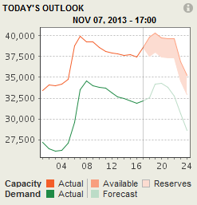
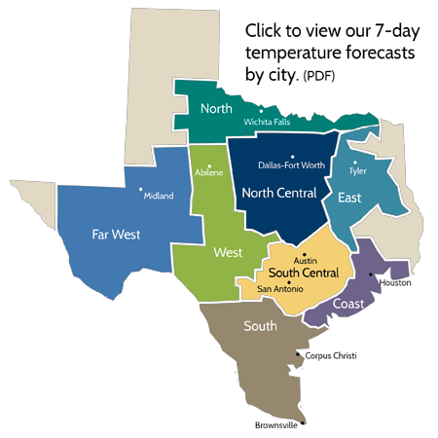



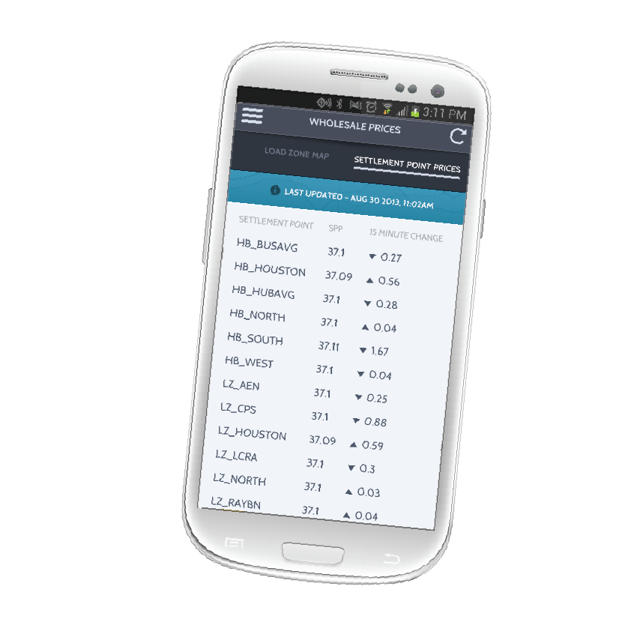

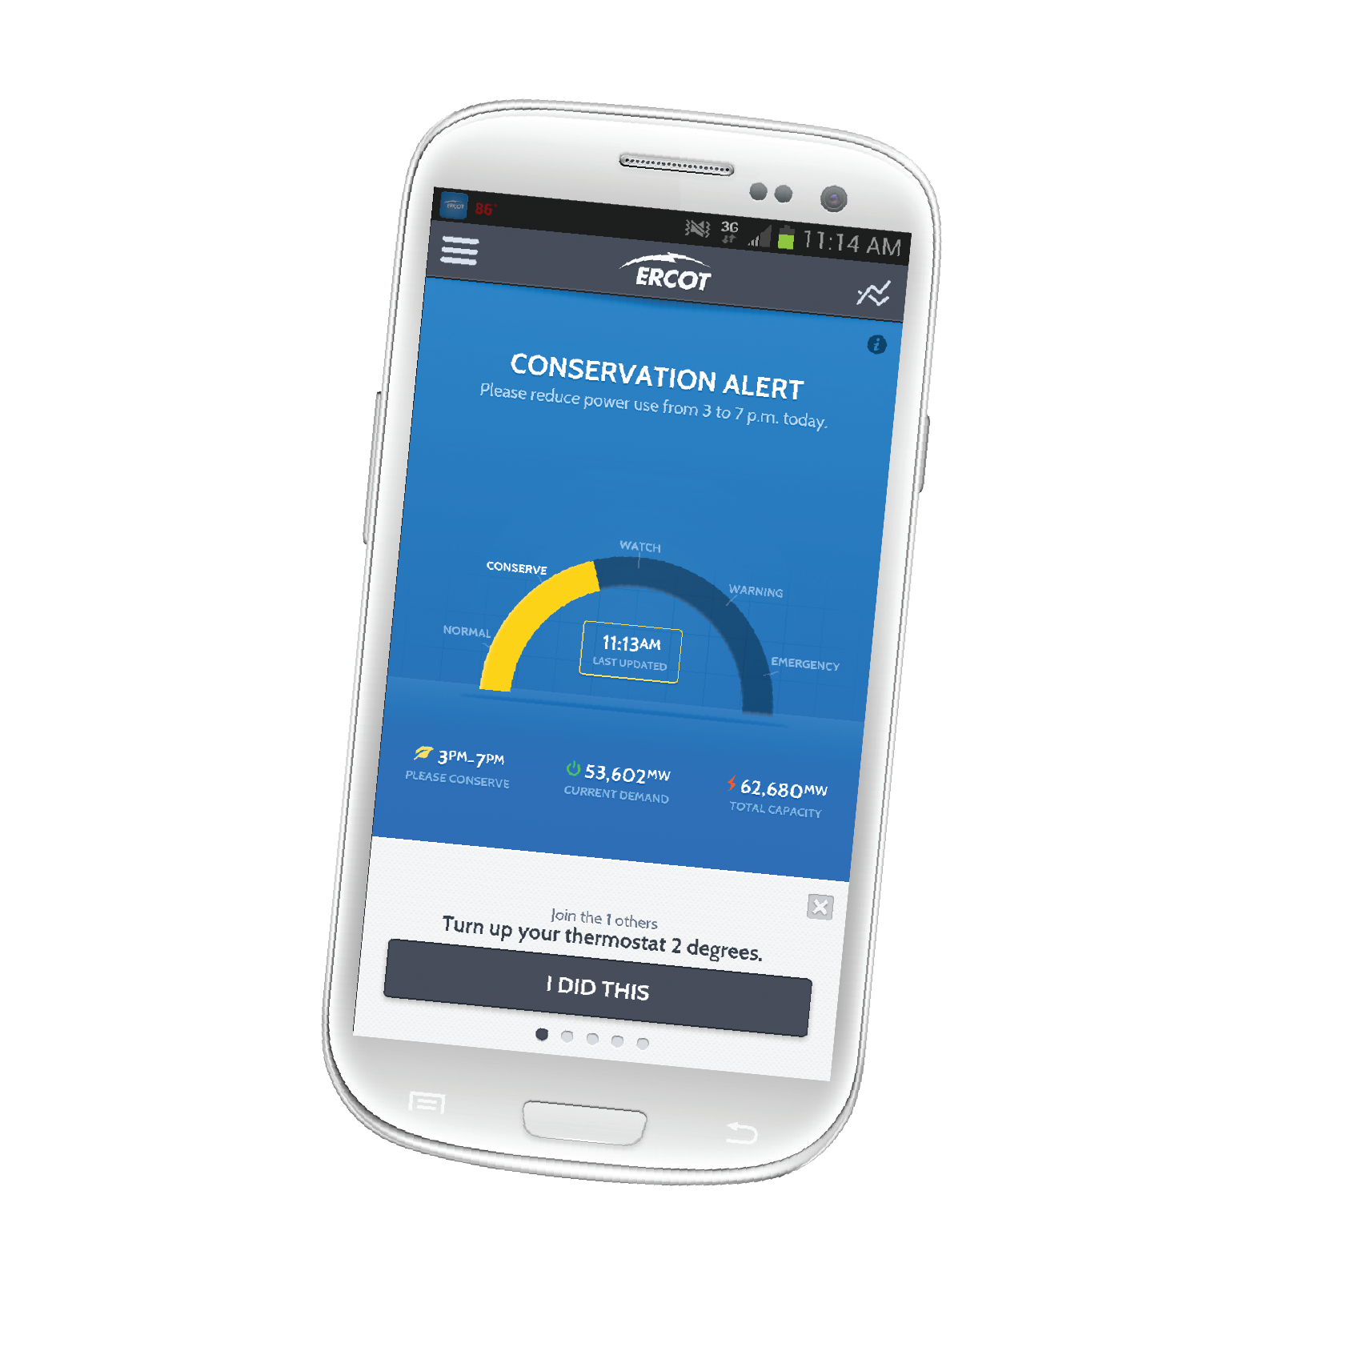
Improving communications with consumers
ERCOT website – added features
Today’s Outlook: Hourly generation and load information
Weather page: Daily, seasonal
Social media – join us!
Twitter: 5,500+ followers
Facebook: 1,400+ friends
LinkedIn: 2,507 followers
ERCOT Energy Saver mobile app – upgraded
System conditions – hourly and real-time updates
Wholesale pricing information – Hubs and Load Zones
Other improved features and information sharing
Notes:
Communication will remain important to help consumers understand when conservation needed most and how best to get there.
Also working to improve awareness of operating reserves – new Today’s Outlook on home page shows generation capacity
Added weather page for Chris’ forecasts, adding a page this week for longer-term outlooks, working on new conservation page
Organizational change this spring moved ercot.com to Corporate Communications.
Overall website overhaul still in progress – team moved to Corporate Communications. Goal is rollout by summer 2014
Amy Apodaca working to keep content on existing site fresh
Aubrey Hale working on strategy for site redesign

Slide 51
Looking back on 2013
ERCOT relies on all of you — transmission and distribution operators, QSE and plant operators, and our own internal team — to accomplish the critical mission we share, every hour of every day. During 2013, we continued to use our shared knowledge and experience to operate even more efficiently while maintaining the reliable state of the grid. Together, we managed final stages of the CREZ projects, drought conditions in some regions, continued growth in wind generation and ongoing resource adequacy discussions. It takes all of us to keep the lights on, and our success in that mission is a testament to your commitment and excellent teamwork. I sincerely thank you all for your continued hard work and dedication. It truly matters and makes a difference.

Slide 52
During 2013 which innovative tools did ERCOT provide to support preparedness?
Tested and improved preparedness plans for range of grid situations, from a winter storm to black start restoration
Released Macomber Map as open source software with training support and improved interface
Supported our community in a variety of ways
Both a and b

Slide 53
The peak demand record of ____________ occurred on August 3, 2011.
68,305 MW
59,911 MW
60,002 MW
64,325 MW

Slide 54
A new wind record of _____________ occurred on March 26, 2014 at 8:48 p.m.
11,025 MW
10,296 MW
7,252 MW
12,159 MW

Slide 55
During capacity, demand and reserves analysis wind is measured at what percentage of total capacity?
21.5%
59.91%
60.02%
8.7%

Slide 56
Six of the top ten constraints on the ERCOT System in 2013 were related to what?
Increased demand in West Texas
Lack of demand in West Texas
Consumers running air conditioners during off peak
None of the above

